Slide 1
Compromise of 1850
Competency 4: Legislative Action

Slide 2
Objectives
Students will understand the components of the Compromise of 1850.
Students will understand the growing sectionalism that led to this compromise.
Students will understand how the U.S. previously dealt with the issue of slavery in the United States and new territories.
Students will understand how the Compromise of 1850 failed to resolve underlying tensions and contributed to the Civil War.

Slide 3
Vocabulary and Key Figures
Vocabulary
  Sovereignty – the authority of a state to govern itself or another state
  Acquisition - an asset or object bought or obtained
  Nullification – the act of making something void or invalid
  Compromise - an agreement or a settlement of a dispute that is reached by each side making concessions.
  Territories - an area of land under the jurisdiction of a ruler or state
Key Figures
  U.S. Senator Henry Clay (Kentucky) – The “Great Compromiser”
  U.S. Senator Stephen A. Douglas (Illinois) – The “Champion of Popular Sovereignty”
  U.S. Senator Daniel Webster (Massachusetts) – Key orator who successfully argued for compromise

Slide 4






WHAT LED UP TO THE
COMPROMISE OF 1850?
1786
1787
1803
1820
Northwest Ordinance
Outlawed Slavery in
Northwest Territory
US Constitution and the 3/5 Compromise
Louisiana Purchase
Missouri Compromise
of 1820
1844
1845
1846-48
Manifest Destiny
Election
US Annexes Texas
Mexican American War
1848
1850
Treaty of Guadalupe Hidalgo
Compromise of 1850

Slide 5
Compromise of 1850 Video
The Compromise of 1850

Slide 6
The Compromise of 1850 Overview
The Compromise of 1850 was a series of bills passed mainly to address issues related to slavery in newly acquired territories following the Mexican American War. The bills provided for slavery to be decided by popular sovereignty in the admission of new states, prohibited the slave trade in Washington DC, settled a Texas boundary dispute, and established a stricter fugitive slave law.

Slide 7
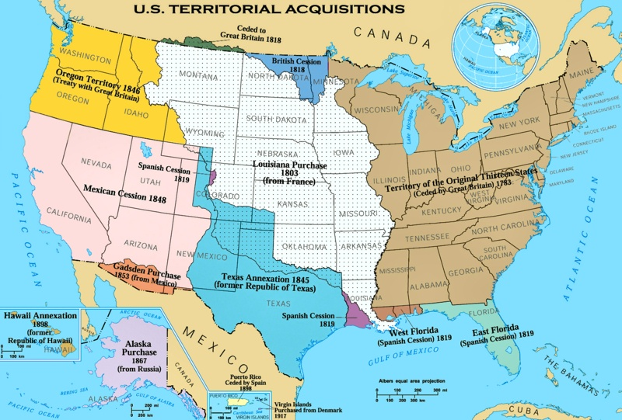

Slide 8
Components of the Compromise of 1850
California admitted as a free state
Territory disputed by Texas and New Mexico go to New Mexico
Abolition of slave trade (not slavery) in Washington, DC
New Mexico and Utah secure popular sovereignty
Texas to receive $10 million from the federal government
New, very strict, Fugitive Slave Act

Slide 9
Fugitive Slave Act
Single major success for slave holding states
Angry anti-slavery advocates were angry and tried to find loopholes
Personal liberty laws were established as early as the 1830’s in some northern states that did not require citizens to turn in runaway slaves. These laws prohibited federal officers from using jails, etc.
The U.S. Supreme Court affirmed the rights of slaveholders to capture runaways.
The law further increased sectional tensions
This law created and funded federal agents to capture runaways
Connecticut appointed commissioners decide if people were free or runaways and got paid a double fee for runaways.
$1000 fee and up to a year in jail for helping runaways

Slide 10
Fugitive Slave Clause in the US Constitution
Article IV, Section 2, Clause 3:
No Person held to Service or Labour in one State, under the Laws thereof, escaping into another, shall, in Consequence of any Law or Regulation therein, be discharged from such Service or Labour, but shall be delivered up on Claim of the Party to whom such Service or Labour may be due.
Why do you think this clause was included in the Constitution?
Do you believe that the Fugitive Slave Clause aligns with our founding principles? Why or why not?

Slide 11
Fugitive Slave Law 1850
Fugitive Slave Law of 1850 Section 5
That it shall be the duty of all marshals and deputy marshals to obey and execute all warrants and precepts issued under the provisions of this act, when to them directed; and should any marshal or deputy marshal refuse to receive such warrant, or other process, when tendered, or to use all proper means diligently to execute the same, he shall, on conviction thereof, be fined in the sum of one thousand dollars . . .
How is this clause similar to or different from the one in the U.S. Constitution?
How might anti-slavery proponents react to this law, especially excerpts like the Fugitive Slave Law of 1850, Section 5?
Does the Compromise of 1850 solve the underlying slavery issues facing the nation at the time?

Slide 12
Sample Item #1
Popular sovereignty was an important element of the Compromise of 1850 because it
  A. stopped the spread of slavery in the United States
  B. reflected the democratic tradition of self-determination.
  C. provided a national solution to the issue of slavery
  D. upheld the principles of the white supremacy

Slide 13
Sample Item #2
The most alarming aspect of the Compromise of 1850 for anti-slavery advocates was:
  A. abolition of the slave trade in Washington, DC
  B. popular sovereignty in the Utah and New Mexico territories
  C. the new Fugitive Slave Law
  D. settlement of the Texas and New Mexico boundary dispute

Slide 14
Sample Item #3
Which of the following statements regarding the Compromise of 1850 is accurate?
  A. It temporary solved the slavery issue in the Western territories.
  B. It ended the sectional crisis in the United States
  C. The Fugitive Slave Law conflicted with constitutional ideals
  D. It was created to respond to the nullification crisis.

