Slide 1
ASL ABC’s of civic literacy competency four cases
Diana L. Cobble | Polk State College

Slide 2
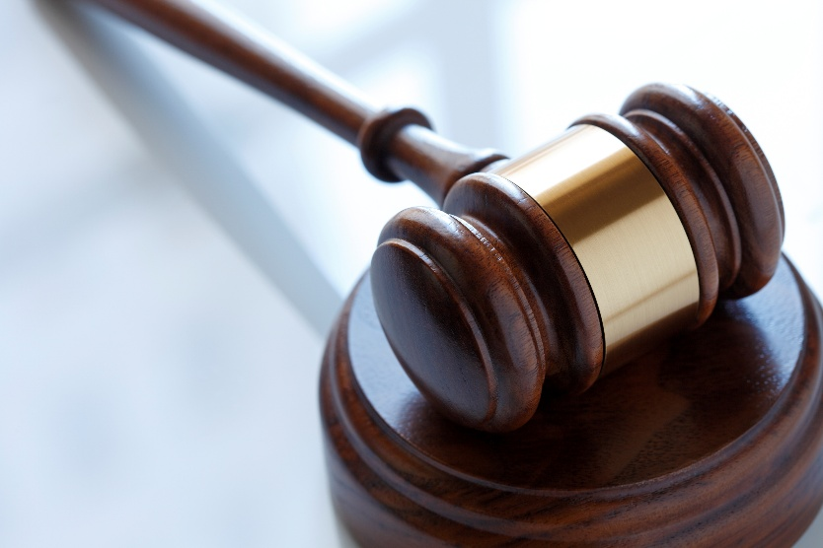
Competency four
Understanding of landmark Supreme Court cases, landmark legislation, and landmark executive actions and their impact on law and society

Slide 3
Goal
Students will be able to create an ASL video expressively demonstrating information related to five Civil Literacy competency four cases
Student Learning Styles: visual, kinesthetic, tactile

Slide 4
Lesson steps:
Students review ASL ABC’s Power Point, watching each signed video demonstration
While watching, students will create a notetaking foldable that includes signed vocabulary, identifying “memory tips” or parameter descriptions for the signs related to the competency court cases
Students will choose five cases to expressively demonstrate
Work in pairs to practice and gloss lesson vocabulary from cases chosen
Create a signed video of the case lesson vocabulary from five court cases

Slide 5
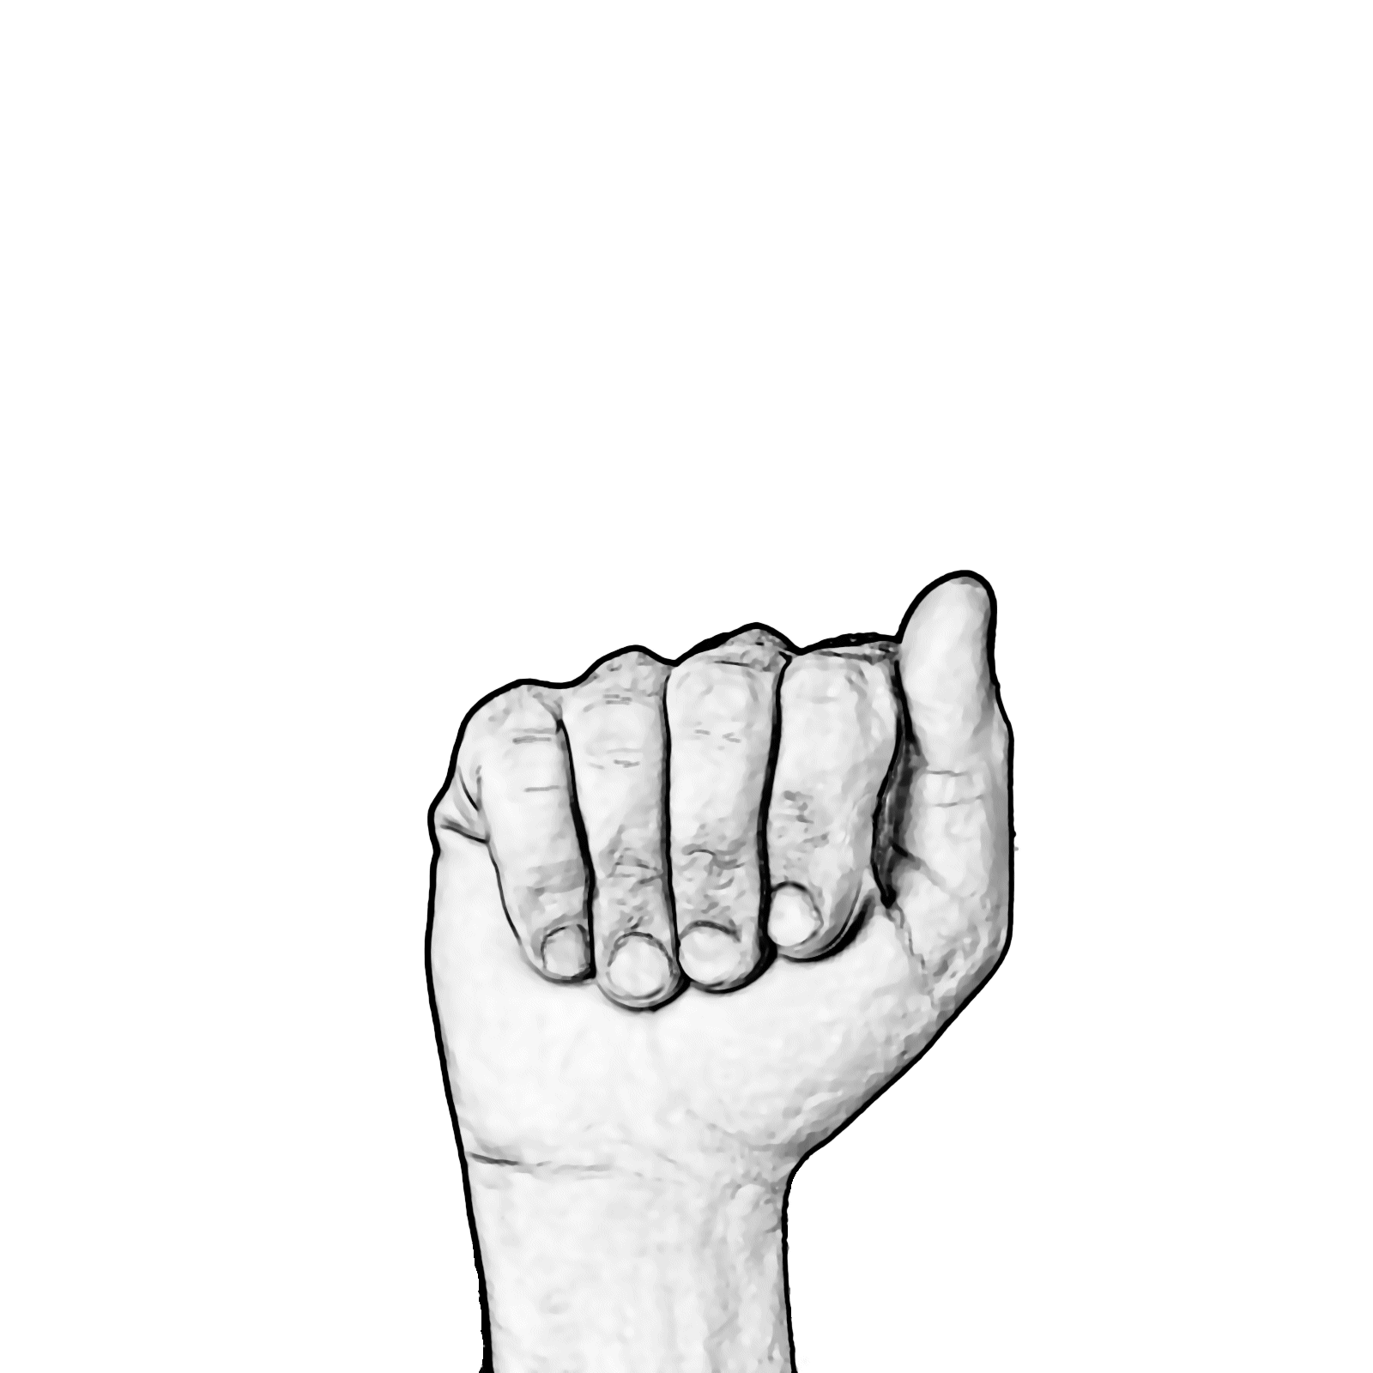
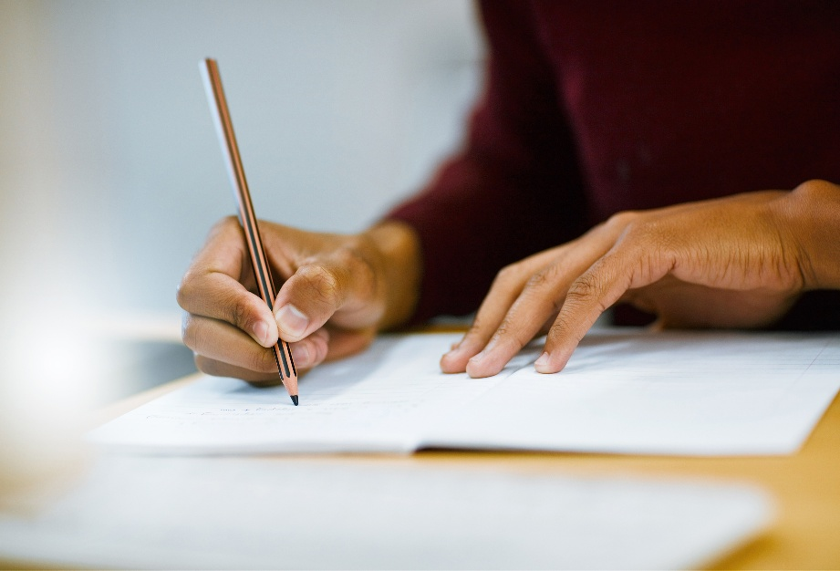
A – miranda v. Arizona (1966)
5TH AMENDMENT
WARNING
RIGHTS
https://youtu.be/YIAUNn0dX-8

Slide 6
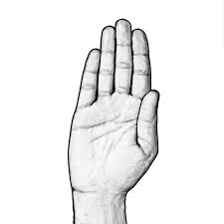
B- Brown v. board (1954)
SCHOOL
SEPARATE EQUAL
NOT
https://youtu.be/Aq1Niyay2l4

Slide 7
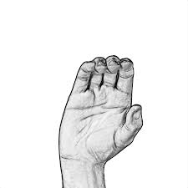
C- district of Columbia v. Heller (2008)
2ND AMENDMENT
INDIVIDUAL
FIREARM
https://youtu.be/v8C-p1TRDjg

Slide 8
D- dred scott v. SanDford (1857)
WHO
AMERICAN CITIZEN
NOT
AFRICAN AMERICAN BORN
https://youtu.be/NAkT2CLFpJY

Slide 9
E- engeL v. vitale (1962)
GOVERNMENT LEADER
STUDENT PRAY CAN
LEADER CAN’T
https://youtu.be/YEnyNycNLzA

Slide 10
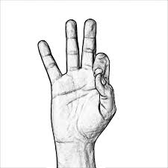
F- citizens united v. fec (2010) FEDERAL ELECTION COMISSION
1ST AMENDMENT – EXPRESSIVE SPEECH
CAMPAIGN SPENDING PROTECTED
https://youtu.be/dP6JHjewmoc

Slide 11
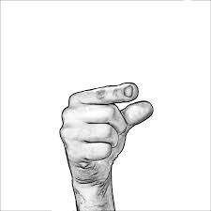
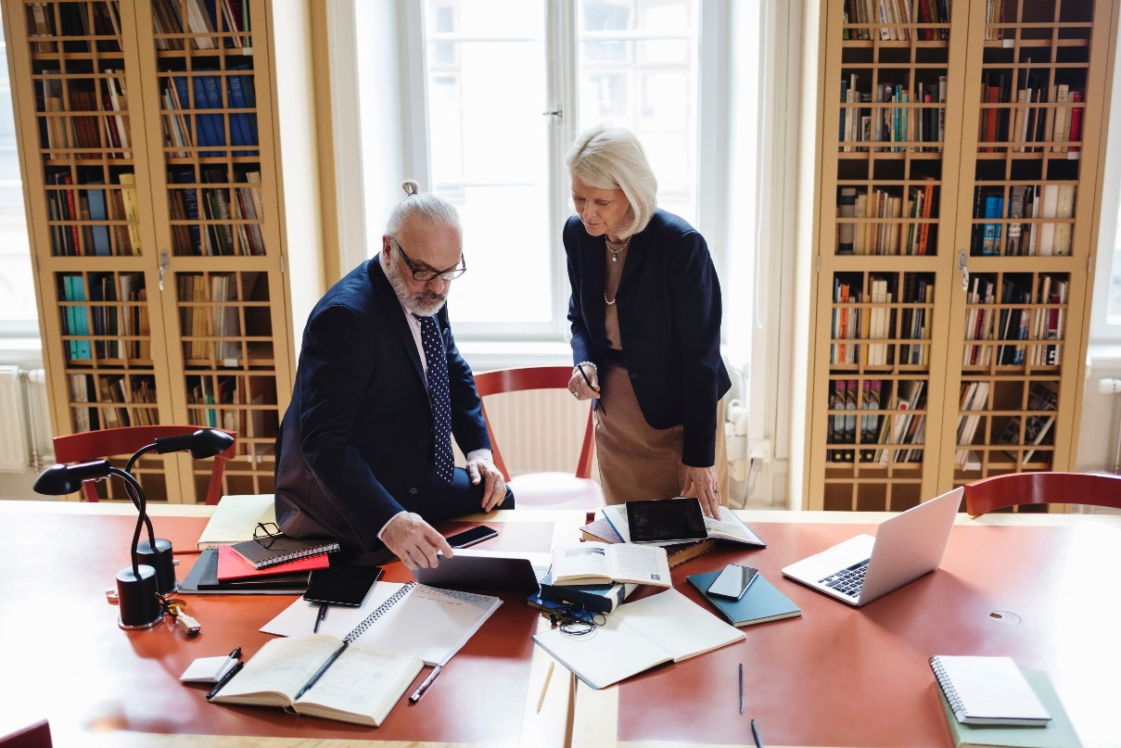
G-Gideon v. wainwright (1963)
6TH AMENDMENT
LAWYER
FAIR TRIAL
https://youtu.be/zlJXxNZ7nXw

Slide 12
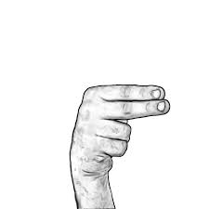
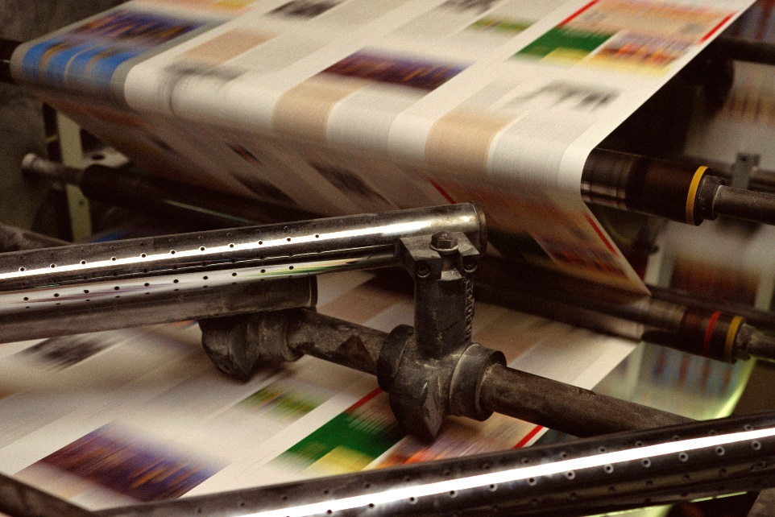
H- hazelwood v. Kuhlmeier (1988)
FREE SPEECH
STUDENTS
CAN
NEWSPAPER
LIMITS
https://youtu.be/k5nXjCVHViw

Slide 13
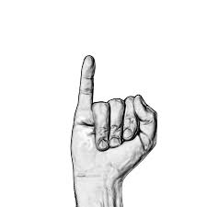
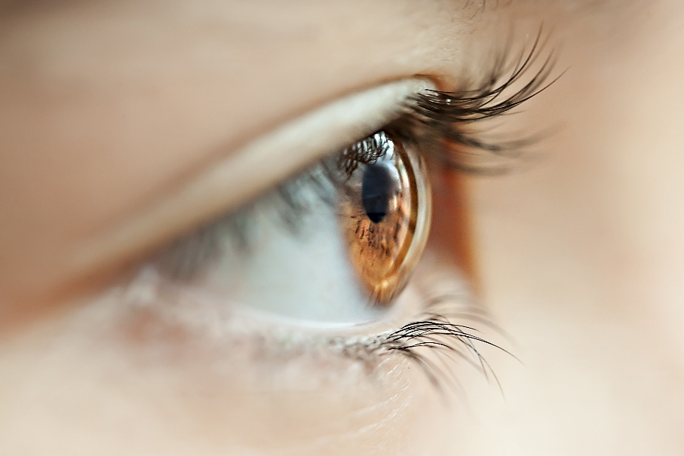
i- In re Gault (1967)
Rights
LAWYER
WITNESSES
https://youtu.be/VdnANUvFqQA
JUVENILE DEFENDENTS
SAME
DUE PROCESS

Slide 14
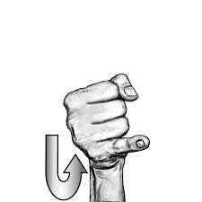
J- Justiciability baker v. carr (1962)
FEDERAL
COURT | 1 PERSON 1 VOTE
ACCEPT | https://youtu.be/E9bNE8ZuJOc
CASE
DECIDE

Slide 15
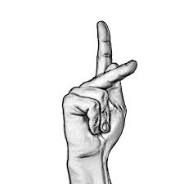
K- Korematsu v. united states
JAPANESE AMERICANS
INTERNMENT (GOVERNMENT PRISON) CAMPS
PERMITTED/ALLOWED
https://youtu.be/i0UfPpCpGnc
5TH AMENDMENT
VIOLATES (BREAK LAW)
DUE PROCESS

Slide 16
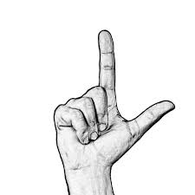
L- us v. lopez
https://youtu.be/g7cotcx4kVA
CONGRESSIONAL POWER LIMITS

Slide 17
M – Marbury v. Madison (1803)
Power of the courts to declare laws passed by Congress unconstitutional if they violate the Constitution
JUDICIAL REVIEW
COURT
POWER
https://youtu.be/AnbOunLI3BY

Slide 18
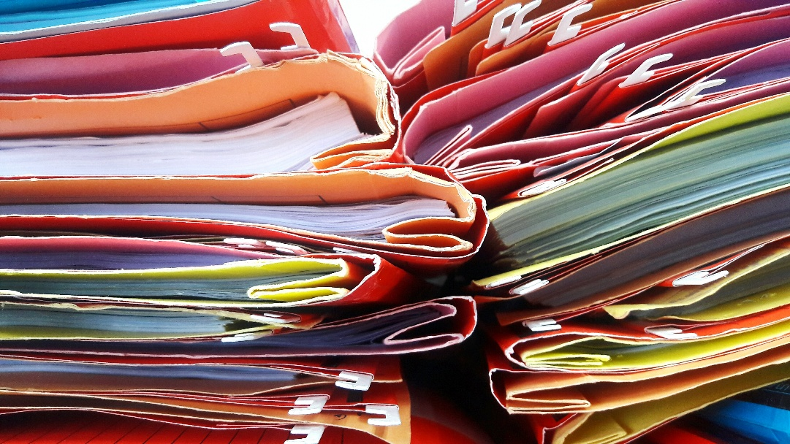
N- new York times v. United states (1971)
GOVERNMENT
LIMIT
INFORMATION
PRESS
ILLEGAL
https://youtu.be/tMYZV0HCw6g

Slide 19
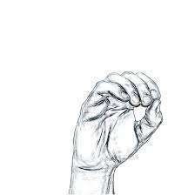
O- mapp v. ohio (1961)
4TH AMENDMENT
POLICE SEARCH
EVIDENCE COLLECT
NO WARRANT
https://youtu.be/lABEaQe26cQ

Slide 20
P- Plessy v. ferguson (1896)
CONNECTION RACE
SCHOOL SEPERATE EQUAL
ACCEPT FINE
https://youtu.be/yq3yZLD8TRU

Slide 21
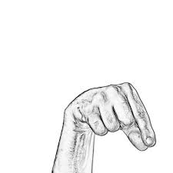
Q- quotas regents of the university of California v. Bakke (1978)
QUOTA: HOW-MANY
PERCENTAGE
RACE
ILLEGAL
https://youtu.be/xB-rcPk8HzU

Slide 22
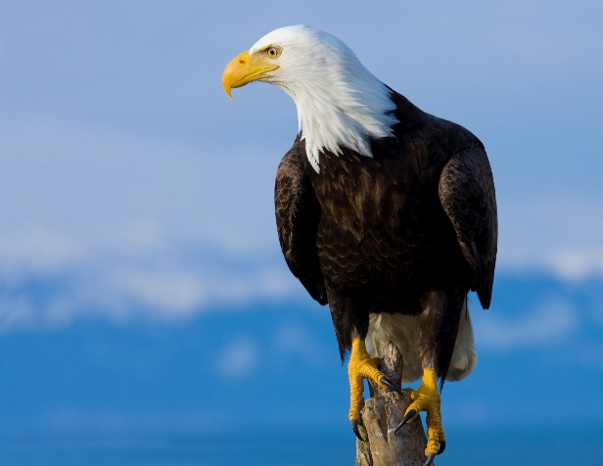
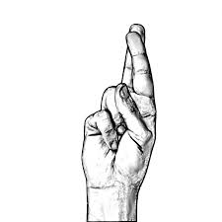
R – roe v. wade (1973)
RIGHT PRIVACY
ABORTION LAW
THROW-OUT
TRIAL- COURT MEETING
D-O-B-B-S
https://youtu.be/G7HLj422c0s

Slide 23
S – schenck v. Us (1919)
CONGRESS AUTHORITY DURING WAR
IF DANGER HAPPEN
1ST AMENDMENT NOT PROTECT SPEECH
E-S-P-I-O-N-A-G-E #ACT
https://youtu.be/fO5zzIwmUNk

Slide 24
T- tinker v. des moines (1969)
BROTHER, SISTER
ARMBAND-CL:C SYMBOLIC SPEECH
PROTEST VIETNAM WAR
PERMIT
https://youtu.be/tpLDc4rSGSE

Slide 25
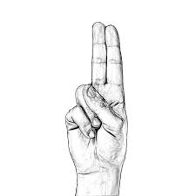
U – United states v. Nixon (1974)
PRESIDENT ACTION
PRIVELIDGE - PRIVATE COMMUNICATION, HIDE NOT SHARE
ILLEGAL
LIMIT
https://youtu.be/bWt6wzaHF3U

Slide 26
V – voting bush v. gore (2000)
#FLA
“ELECTORAL COLLEGE” - GROUP PEOPLE VOTE
PROCESS VOTE COUNT
SAME
https://youtu.be/8IIFobf_c6Y

Slide 27
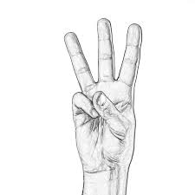
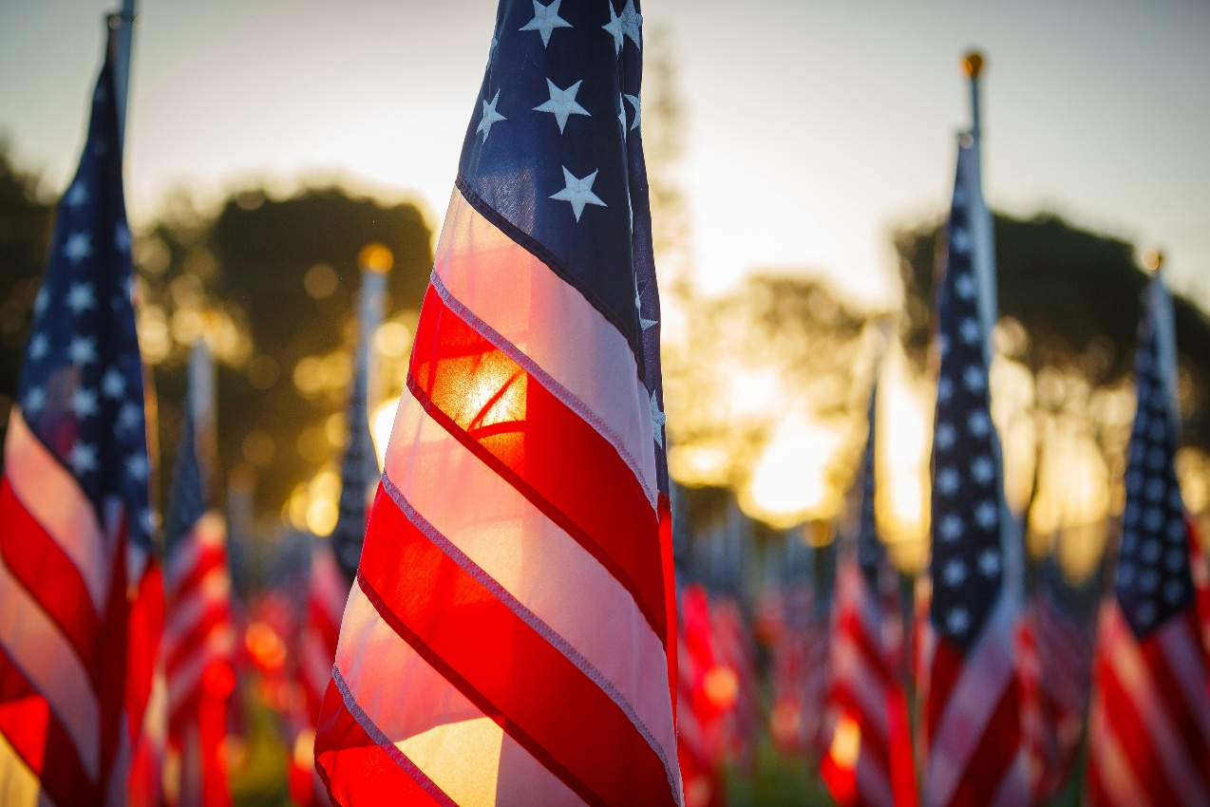
W – west vIRGINIA v. BarnettE (1943)
PLEDGE-OF-ALLEGIANCE
FLAG
CANNOT FORCE
FREEDOM-OF-EXPRESSION (Speech)
https://youtu.be/5WhiR41de_0

Slide 28
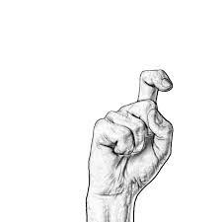
X - Texas v. johnson (1989)
TEXAS
RELATED-TO FLAG BURNING
FREEDOM-OF-EXPRESSION
https://youtu.be/GyMyky1mmk0

Slide 29
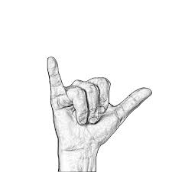
Y – Wisconsin v. yoder (1972)
AMISH CHILDREN
SCHOOL BEYOND 8TH GRADE
DON’T-HAVE-TO
FREEDOM-OF-RELIGION
https://youtu.be/NYDHFUSJZYc

Slide 30
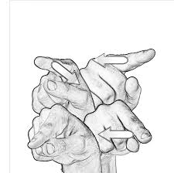
Z - Zelman v. simmons-harris (2002)
STATE
TUITION VOUCHER
GIVE-TO FAMILY
GO-TO
PRIVATE, RELIGION
https://youtu.be/RLJqc4i3jU8

Slide 31
SOURCES
www.lifeprint.com

