Slide 1
Kindergarten Matching Game
Cut out the boxes and match the civics terms or concepts to the correct descriptions and photos

Slide 2
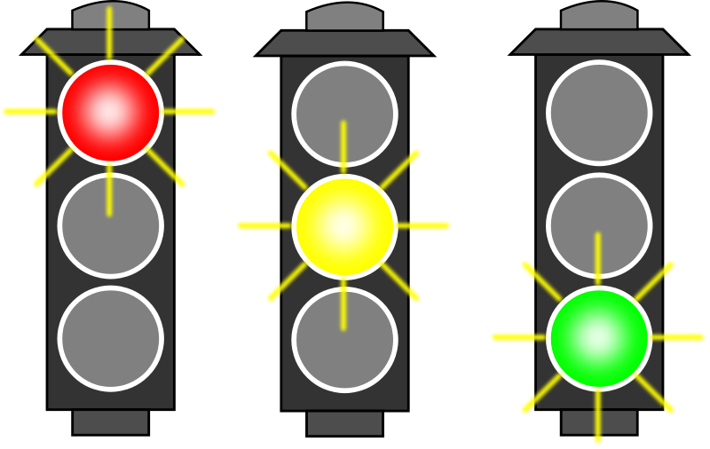
Rules | The do/don’t for our behavior like: No ball in the house, Raise hand, No running in the hall, Limiting screen time, No yelling at others, Keep hands to self
Laws | A group of rules that protect people like: Speed limits, Traffic lights, Wearing seatbelts, No stealing, No hurting others

Slide 3
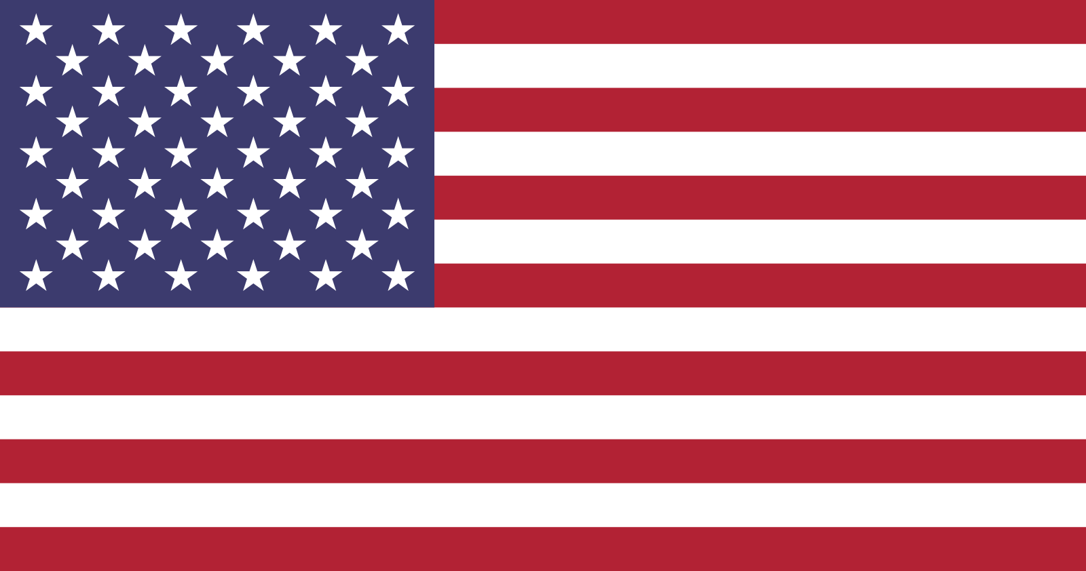
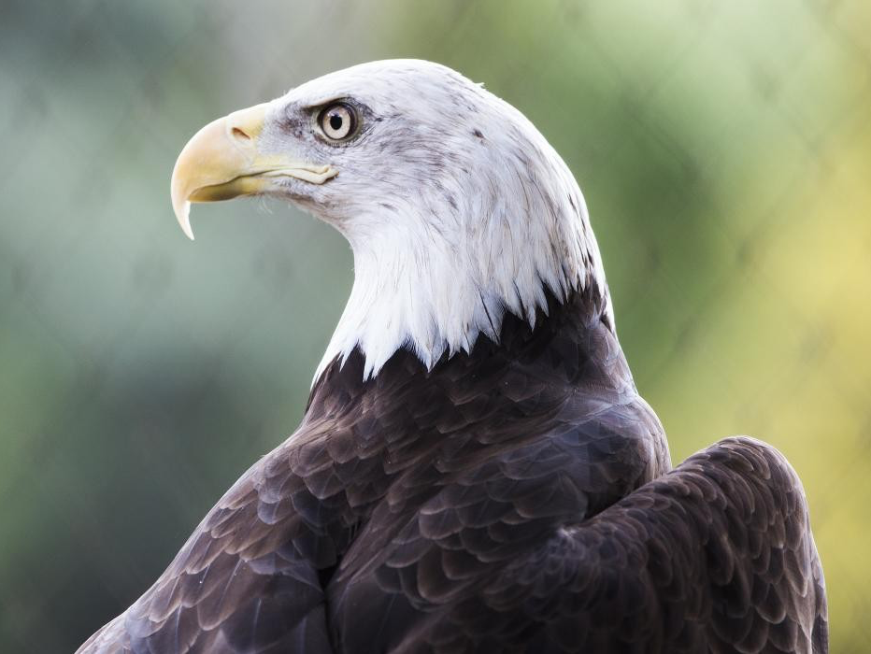
American Flag | A symbol for the U.S. that we pledge to
Bald Eagle | National bird of the U.S.

Slide 4
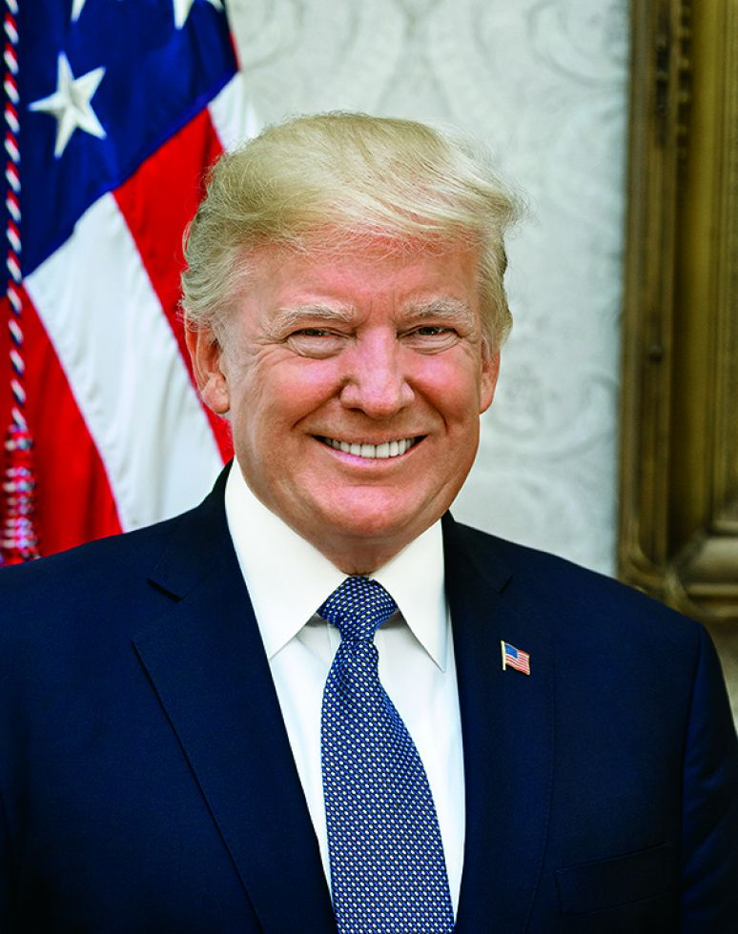
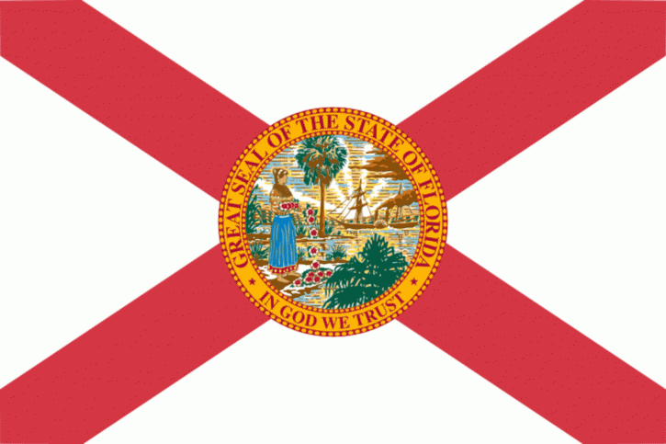
U.S. President | Leader of the U.S.
Florida’s Flag | A symbol for our state

Slide 5
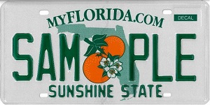
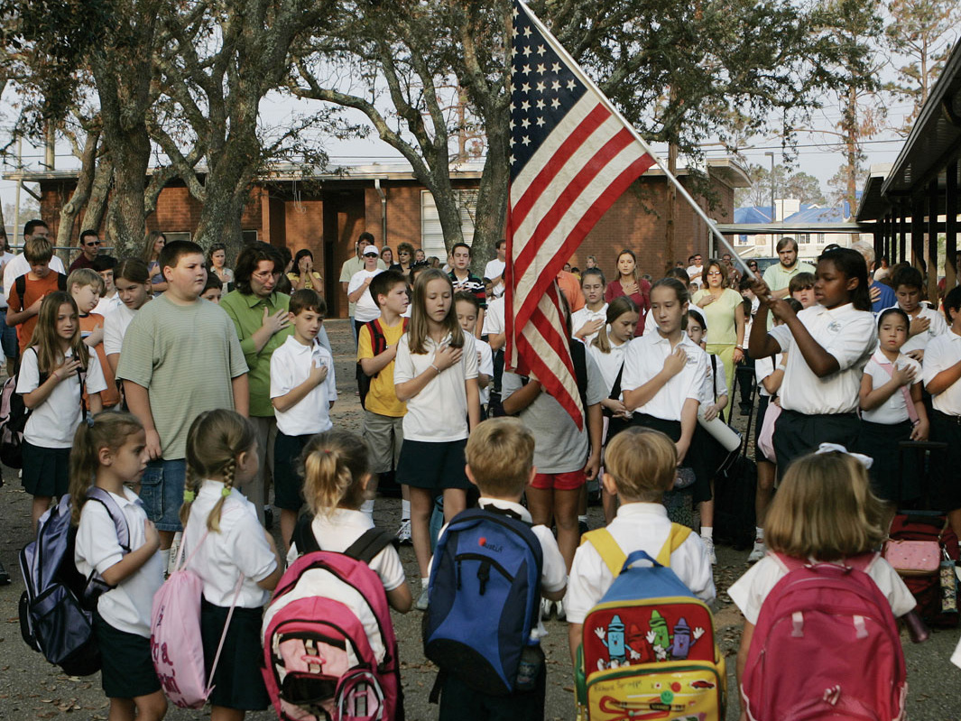
Florida’s State Nickname | The Sunshine State
The Pledge of Allegiance | A promise (oath) to the U.S.

Slide 6
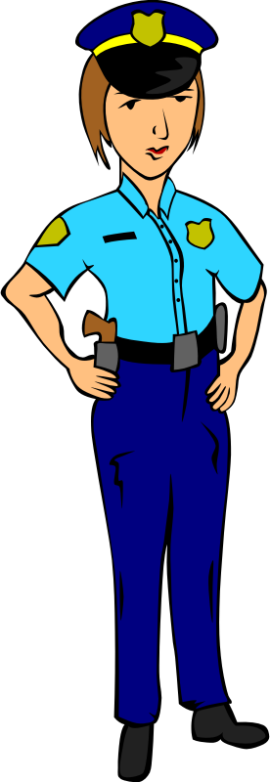
Authority Figures | Trusted leaders that make sure we follow rules and laws
Patriotism | Showing love, loyalty, and respect for your country

Slide 7
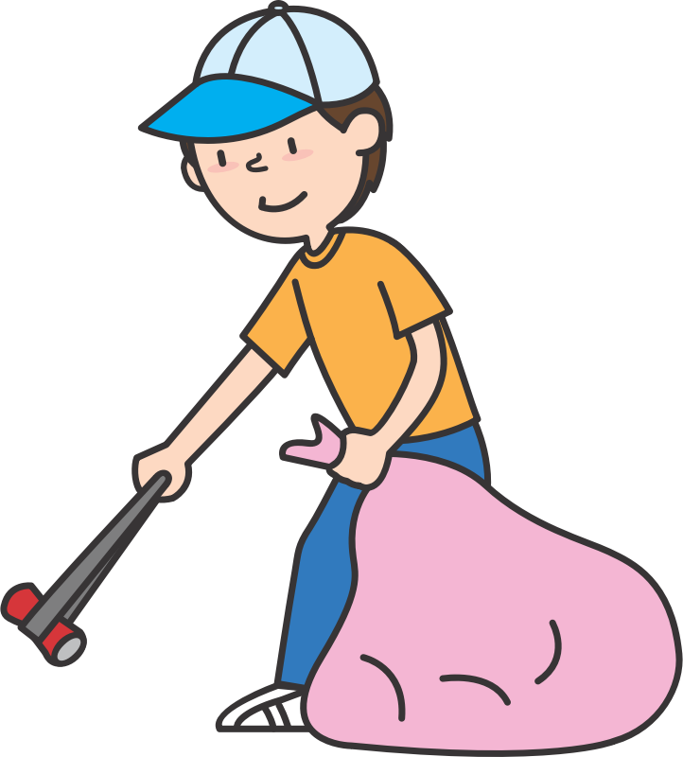
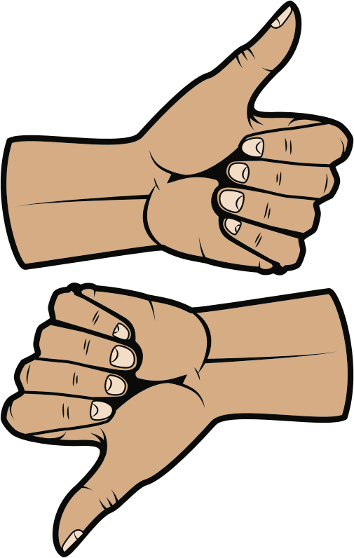
Responsible Citizen | Someone whose actions and behaviors make their community better
Good Decision Making | Raising hands, Voting, Taking turns, Class meetings, Listening to others, Sharing

Slide 9
Additional Ways to Play
Start with just the images and correctly match the terms and/or descriptions
Start with just the descriptions and correctly match the terms and/or images
Start with just the terms and correctly match the descriptions and/or images
Read a description aloud and have your child hold up the correct image and/or term
Have your child find two matches they think are similar or “go together” and explain why
Have your child look at the two flag matches and have them explain similarities and differences between them
Have your child look at the rules and laws matches and have them explain similarities and differences between them

Slide 10
Sources
“Male teacher #2” by oksmith from OpenClipart is under the Public Domain
“Woman police officer” by Gerald_G from OpenClipart is under the Public Domain
“Picking up trash” by oksmith from OpenClipart is under the Public Domain
“Right wrong button thumbs up” by Artsybee is licensed under the Pixabay license
“Traffic light” by algotruneman from Openclipart is under the Public Domain
“Flag of the United States” is under the Public Domain
“Joe Biden” from The White House is licensed under CC BY 3.0 US
“Bald Eagle” from the Smithsonian’s National Zoo and Conservation Biology Institute is under the Public Domain
“Florida State Flag” from the Florida Department of State
“Sunshine State” from Florida Highway Safety and Motor Vehicles
“I Love USA (Stars and Stripes)” from ClipArt Best has no known copyright restrictions
“Girl Holding the American Flag” in the The World Almanac for Kids, Infobase Learning
“Handshake green” by Issi from OpenClipart is under the Public Domain
“Simple ear” by rematuche is under the Public Domain
“Up and down” by locksmith is under the Public Domain
“Collection of discussion clipart” from Clipartkey has no known copyright restrictions

