Slide 1
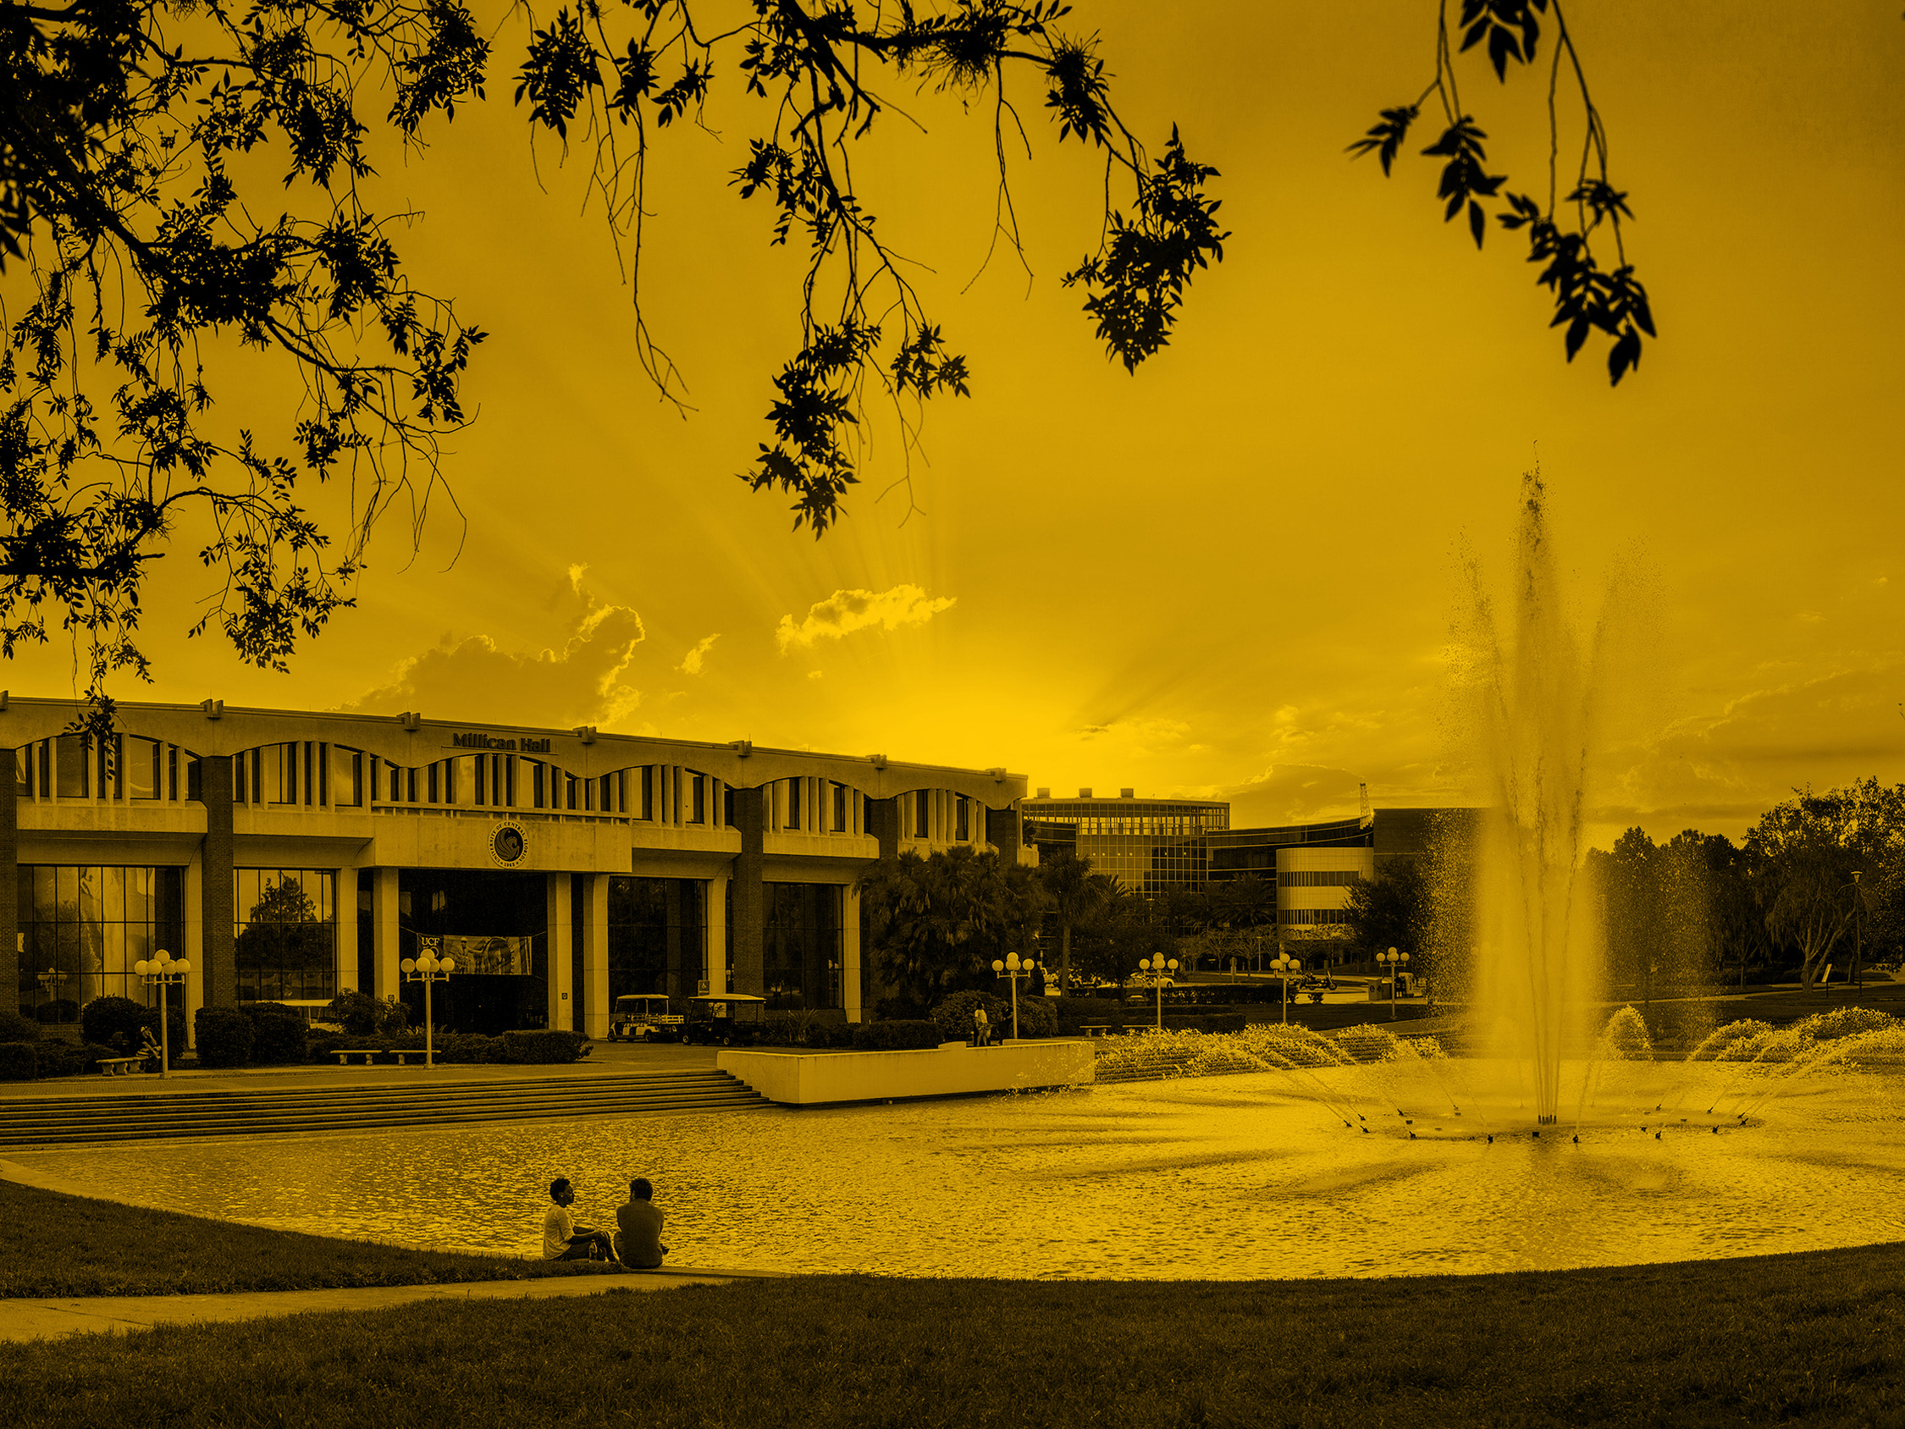
The Florida Civic Literacy Examination An Overview of Competency Four Lou Frey Institute/Florida Joint Center for Citizenship Contact: Stephen.masyada@ucf.edu Floridacitizen.org Civics360.org r

Slide 2
Purpose of this resource
Provide teachers and students a simple overview of each U.S. Supreme Court case that might appear on the Florida Civic Literacy Examination
Cases are drawn from the K-12 Civics, Government, and US History benchmarks as well as AP Government standards
A relevant web-based resource for each case is linked in the case name on each slide

Slide 3
Four ‘Competencies’ on the Civics Literacy Examination
An understanding of the basic principles of American democracy and how they are applied in our republican form of government.
An understanding of the United States Constitution and its application.
Knowledge of the founding documents and how they have shaped the nature and functions of our institutions of self-governance.
An understanding of landmark Supreme Court cases, landmark legislation, and landmark executive actions, and their impact on law and society.
Notes:
Our focus will be on competency four, highlighted on this slide.

Slide 4
Landmark Legislative Actions
Landmark legislation that students should be familiar with, as identified primarily in the Florida K-12 civics, U.S. government, or U.S. history benchmarks, involves conflicts and compromises (e.g., the Compromise of 1850 or the Kansas-Nebraska Act of 1854); territorial expansion and the structure and function of government (e.g., Homestead Act of 1862, Pendleton Act of 1883); expansion or restrictions of civil rights and liberties (e.g., various civil rights acts between the 19th and 21st centuries; Alien and Sedition Acts of 1798; USA PATRIOT ACT of 2001); expansions or restrictions in social programs (e.g., various Great Society-related acts; New Deal-related acts; Patient Protection and Affordable Care Act of 2010); environmental protections (e.g., Clean Air Act of 1970); expansions of presidential and war powers (e.g., Tonkin Gulf Resolution of 1964).
Notes:
NOTE: Most legislative actions will have appeared in the 7th grade civics, 9-12th grade U.S. government, or 8th grade and 9th-12th grade U.S. history course content.

Slide 5
Landmark Executive Actions
Landmark executive actions that students should be familiar with, as identified primarily in the Florida K-12 civics, U.S. government, or U.S. history benchmarks, primarily involve efforts at foreign policy (e.g., various treaties that ended wars, such as the Treaty of Paris of 1898); territorial expansion (e.g., treaties and agreements that expanded the United States, such as the Adams-Onis Treaty of 1821 or the Louisiana Purchase of 1803); restrictions or expansions of civil rights and liberties (e.g., suspensions of habeas corpus, Japanese-American internment, enforcement of civil rights-related Supreme Court decisions); the use of executive orders (e.g., military desegregation, affirmative action); the presidential “bully pulpit” (e.g., advocacy for various programs and reforms, particularly in the 20th and 21st centuries); presidential war powers.
Notes:
NOTE: Most executive actions will have appeared in the 7th grade civics, 9-12th grade U.S. government, or 8th grade and 9th-12th grade U.S. history course content.

Slide 6
Landmark U.S. Supreme Court Cases
Landmark cases that students should know, as identified primarily in the Florida K-12 civics, U.S. government, or U.S. history benchmarks, involve the expansion or restriction of civil rights and liberties, the power of the federal government (including the various and specific powers and authority of the different branches), and how the U.S. Supreme Court has interpreted clauses of the U.S. Constitution. Be sure to consider the impact of selective incorporation (a principle that students should know for Competency Two) within the context of federalism, as well as sources and types of law. Most cases will have appeared in the 7th grade civics, 9-12th grade U.S. government, or 8th grade and 9th-12th grade U.S. history course content.

Slide 7
U.S. Landmark Cases That May Appear on the FCLE
Marbury v. Madison (1803)
McCulloch v. Maryland (1819)
Dred Scott v. Sandford (1857)
Plessy v. Ferguson (1896)
Schenck v. U.S. (1919)
West Virginia v. Barnette (1943)
Korematsu v. United States (1944)
Brown v. Board (1954)
Mapp v. Ohio (1961)
Baker v. Carr (1962)
Engel v. Vitale (1962)
Gideon v. Wainwright (1963)
Miranda v. Arizona (1966)
Tinker v. Des Moines (1969)
New York Times v. United States (1971)
Wisconsin v. Yoder (1972)
Roe v. Wade (1973)
United States v. Nixon (1974)
Regents of the University of California v. Bakke (1978)
Hazelwood v. Kuhlmeier (1988)
Texas v. Johnson (1989)
Shaw v. Reno (1993)
U.S. v. Lopez (1995)
Bush v. Gore (2000)
District of Columbia v. Heller (2008)
McDonald v. Chicago (2010)
Citizens United v. FEC (2010)

Slide 8
The Power and Reach of the Judicial Branch

Slide 9
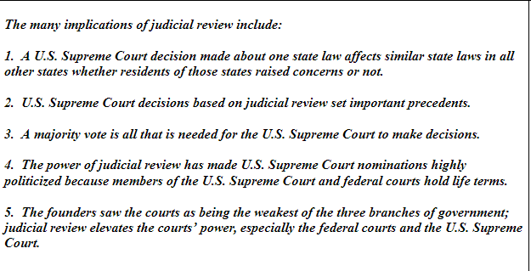
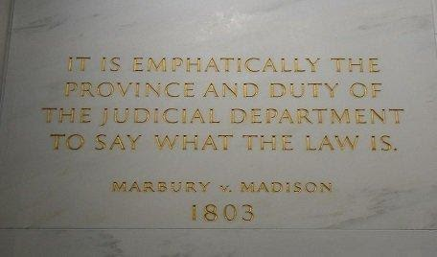
Marbury v. Madison (1803)
Concept of judicial review
Notes:
Marbury v. Madison is a difficult case to teach because it involves a power that is not enumerated in the U.S. Constitution. The implications outlined here provide insight as to why Marbury v. Madison is called the most important U.S. Supreme Court decision in U.S. history.

Slide 10
Baker v. Carr (1962)
“Justiciability”---can we actually decide this case?
One Person, One Vote
While we often connect Baker v. Carr with the “one-person, one-vote principle”, the U.S. Supreme Court first had to decide if it had the power to decide the case, which is the principle of “justiciability”. The U.S. Supreme tends to avoid “political questions”, conflicts between branches of levels of government, instead focusing on constitutional questions. Before the U.S. Supreme Court examined the constitutional question in Baker v. Carr, it decided, first, that it has the power to make a specific decision.
Notes:
The next case, decided in 1962, focused on the type of case that the U.S. Supreme Court could decide. In Baker v.Carr, the U.S. Supreme Court was asked to rule on whether the state of Tennessee was required to redraw state legislative districts having not done so since 1901. Due to population distribution from rural Tennessee to the cities, some state legislative districts had far fewer people living in them compared with other districts, yet each district was represented by one person.

Slide 11
Citizenship

Slide 12
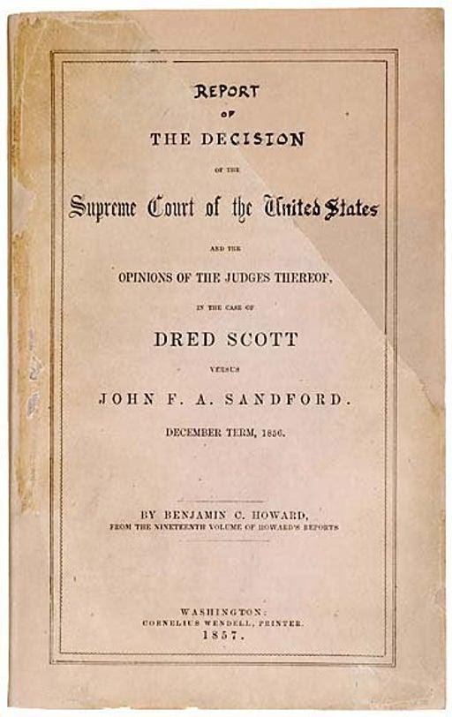
Dred Scott v. Sandford (1857)
With Dred Scott, the U.S. Supreme Court did not decide who was a citizen although the Court was clear in deciding who was not a citizen, including an entire class of persons (African-Americans) born in the United States.

Slide 13
The Article I Powers of Congress under Clauses of the Constitution

Slide 14
McCulloch v. Maryland (1819)
Necessary and Proper/Elastic Clause
Supremacy Clause
First case to address both of these clauses and reinforce the power of Congress
How has Congress used this power to augment federal government functions?
How has Congress used this power to create government agencies?
Notes:
In one case, McCulloch v. Maryland, the U.S. Supreme Court reinforced Congress’ power under the “necessary and proper” clause, often called the “elastic” clause.

Slide 15
US v. Lopez (1995)
Dealt with the Gun Free School Zones Act of 1990
Limits of the Commerce Clause
Congress could not use the Commerce Clause to make possession of a gun in a school zone a federal crime
Court emphasized that the Commerce Clause had to deal with economic issues. Limits Congressional power.

Slide 16
Article II, the Presidency, and Election Law

Slide 17
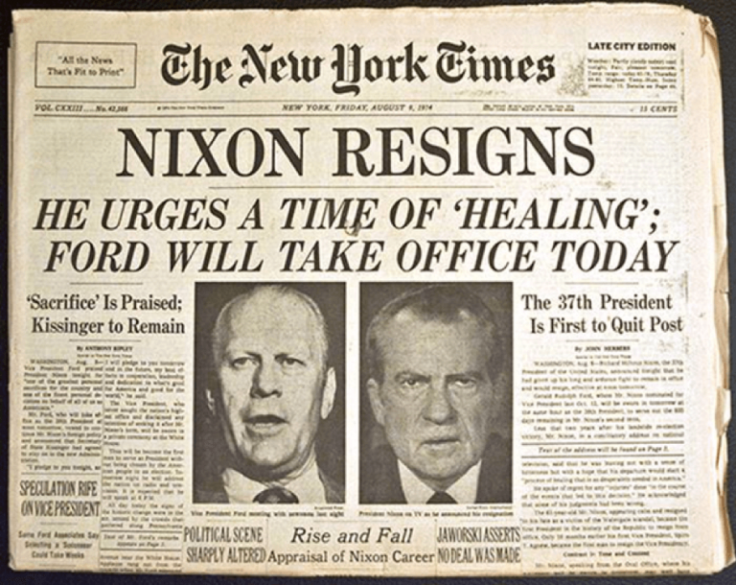
US v. Nixon (1974)
Executive privilege
Not absolute!
Notes:
In one case, U.S. v. Nixon, the U.S. Supreme Court determined that the president enjoyed executive privilege but that executive privilege was not absolute, especially when connected to potentially criminal matters. For President Nixon, this meant that he had to turn over tapes of conversations taking place in his office which the president claimed were confidential. The U.S. Supreme Court’s decision led to Nixon’s resignation.

Slide 18
Bush v. Gore (2000)
Electoral College connection
Uniform standard for voting and vote counting
Notes:
More recently, the U.S. Supreme Court focused on the Electoral College, also in Article II. The Electoral College is responsible for electing the president. The Florida Supreme Court ordered a manual recount across the state of all “undervotes” (those ballots recording no vote for president) in 2000. George W. Bush, the Republican nominee, questioned if the Florida Supreme Court violated Article II of the U.S. Constitution by making new election law when it mandated manual recounts of undervotes (and not all a manual recount of all votes).

Slide 19
The Concept of Selective Incorporation
The Supreme Court has, over time, ‘incorporated’ the Bill of Rights to apply to the states.
Selective incorporation was first used in 1925 in Gitlow v. New York. Below is an excerpt from the U.S. Supreme Court syllabus of the decision in Gitlow.
Syllabus
1. Assumed, for the purposes of the case, that freedom of speech and of the press are among the personal rights and liberties protected by the due process clause of the Fourteenth Amendment from impairment by the States
2. Freedom of speech and of the press, as secured by the Constitution, is not an absolute right to speak or publish without responsibility whatever one may choose or an immunity for every possible use of language.
3. That a State, in the exercise of its police power, may punish those who abuse this freedom by utterances inimical to the public welfare, tending to corrupt public morals, incite to crime or disturb the public peace, is not open to question.
Notes:
Since 1925, the U.S. Supreme Court has decided, on a case by case basis, to incorporate, or apply, the Bill of Rights to the states. This process, called “selective incorporation, occurs when the U.S. Supreme Court decides that there are rights that should apply to all persons no matter where they live. “Selective incorporation” takes power from the states. As an example, if the U.S. Supreme Court determines that a state law violates a protection in the Bill of Rights, the decision applies to all states and not the individual state whose law was challenged. The process of selective incorporation is best understood when one analyzes the meaning of each word within the phrase. In this context, “Selective” means that the U.S. Supreme Court has chosen to take an action and is not required to do so by any constitutional mandate. “Incorporation” means that the Bill of Rights is linked with state government actions even though the Bill of Rights was first added to the U.S. Constitution to protect the people from the federal government and not the state governments. This means that selective incorporation normally takes power from the states. Three amendments have never been incorporated: the Third Amendment, the Seventh Amendment and the Tenth Amendment.
NOTE THAT STUDENTS ARE NOT REQUIRED TO KNOW GITLOW, BUT IT’S A USEFUL WAY TO APPROACH THIS CONCEPT.

Slide 20
Bill of Rights and Selective Incorporation
Amendment I: Congress shall make no law respecting an establishment of religion, or prohibiting the free exercise thereof; or abridging the freedom of speech, or of the press; or the right of the people peaceably to assemble, and to petition the Government for a redress of grievances (1791).
Amendment 14, Section 1: No state shall make or enforce any law which shall abridge the privileges or immunities of citizens of the United States; nor shall any state deprive any person of life, liberty, or property, without due process of law; nor deny to any person within its jurisdiction the equal protection of the laws (1868).
Notes:
The Bill of Rights is the first ten amendments to the U.S. Constitution. As you can see from the First Amendment displayed here, the first word of the First Amendment is “Congress”. Congress is the national legislature. Using the term “Congress”, and not “government”, the authors of the Bill of Rights made it clear that the Bill of Rights was intended to protect the people from the national government. The Fourteenth Amendment includes both a state-level due process clause and the equal protection clause. The Bill of Rights also includes a due process clause in the 5th Amendment focusing on the federal government.
Due process is the concept that government must operate within the law and that fair procedures be followed.

Slide 21
The First Amendment and Free Speech

Slide 22
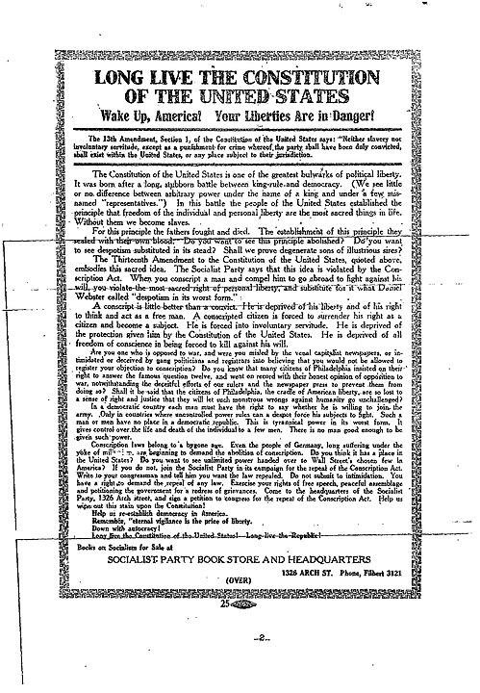
Schenck v. US (1919)
‘Clear and Present Danger’
The question in every case is whether the words used are used in such circumstances and are of such a nature as to create a clear and present danger that they will bring about the substantive evils that the United States Congress has a right to prevent. It is a question of proximity and degree. When a nation is at war, many things that might be said in time of peace are such a hindrance to its effort that their utterance will not be endured so long as men fight, and that no Court could regard them as protected by any constitutional right.—Justice Oliver Wendell Holmes
Note that this case has essentially been overturned by Brandenburg v. Ohio (1969), but it remains a common touchpoint concerning limits on speech
Notes:
Key Takeaway from this case is that there can be limits on free speech if it threatens national security, though this case has essentially been overturned by Brandenburg v. Ohio (1969). Free speech is not absolute. TRY NOT USE THE ‘FIRE IN A CROWDED THEATER’ EXAMPLE. https://www.theatlantic.com/national/archive/2012/11/its-time-to-stop-using-the-fire-in-a-crowded-theater-quote/264449/

Slide 23
West Virginia v. Barnette (1943)
Forcing students to say the Pledge of Allegiance and salute the flag violates freedom of speech (NOT FREEDOM OF RELIGION).
“If there is any fixed star in our constitutional constellation, it is that no official, high or petty, can prescribe what shall be orthodox in politics, nationalism, religion, or other matters of opinion or force citizens to confess by word or act their faith therein.“—Justice Robert Jackson
Notes:
the words “Under God” were added to the Pledge of Allegiance on June 14, 1954. June 14 is now observed as Flag Day because it recognizes the day that these two words were added to the Pledge of Allegiance. Students are often confused about the West Virginia v. Barnette case, decided 11 years before “Under God” was added to the Pledge of Allegiance, because it involves saluting the flag. In our students’ own experience, they may assume that the Pledge of Allegiance has always included “Under God” and that a constitutional challenge to the Pledge is a free exercise challenge.
Note that in this case, Justice Jackson, in the majority opinion, emphasized the compelled speech component over the religious component, as those who did not share the faith of Jehovah’s Witnesses could also have a constitutional claim that would relate to freedom of speech.

Slide 24
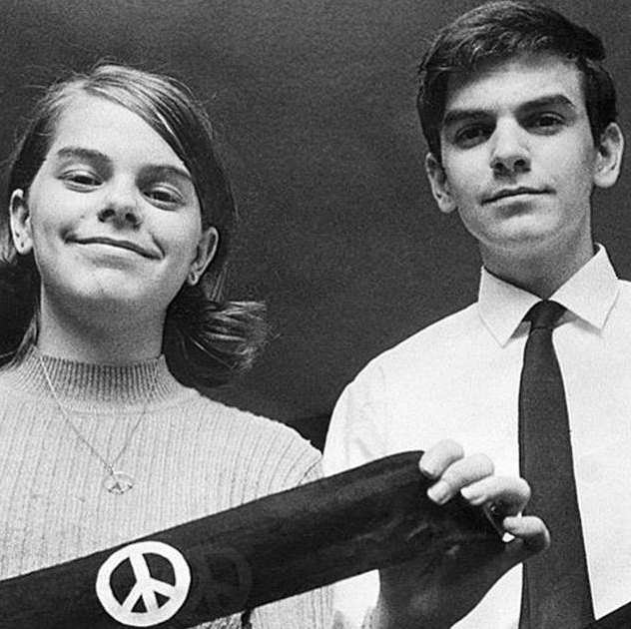
Tinker v. Des Moines (1969)
Symbolic speech is protected speech
"It can hardly be argued that either students or teachers shed their constitutional rights to freedom of speech or expression at the schoolhouse gate.“ –Justice Abe Fortas

Slide 25
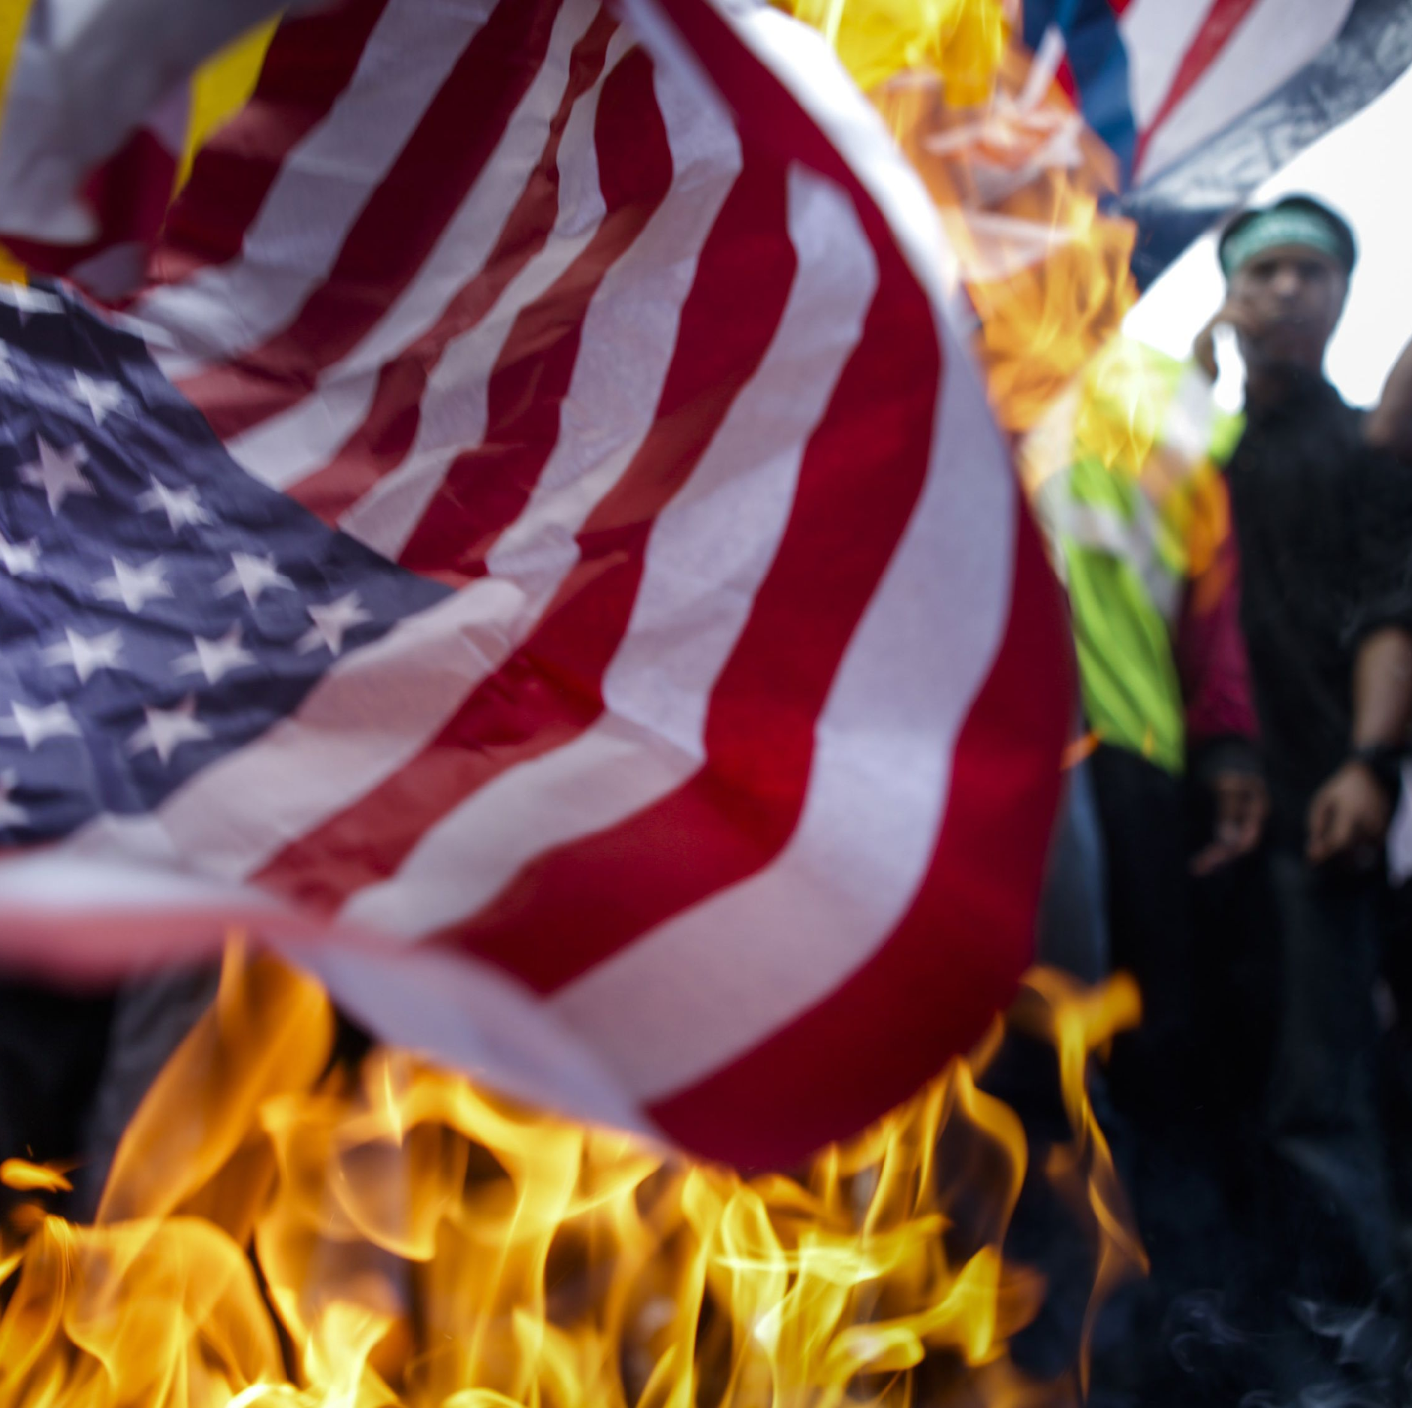
Texas v. Johnson (1989)
Expressive speech is free speech (flag burning case)
If there is a bedrock principle underlying the First Amendment, it is that the government may not prohibit the expression of an idea simply because society finds the idea itself offensive or disagreeable.“---Justice William Brennan

Slide 26
Citizens US v. Federal Election Commission (2010)
Campaign spending by corporations is a form of expressive speech that is protected under the First Amendment

Slide 27
First Amendment and Religion

Slide 28
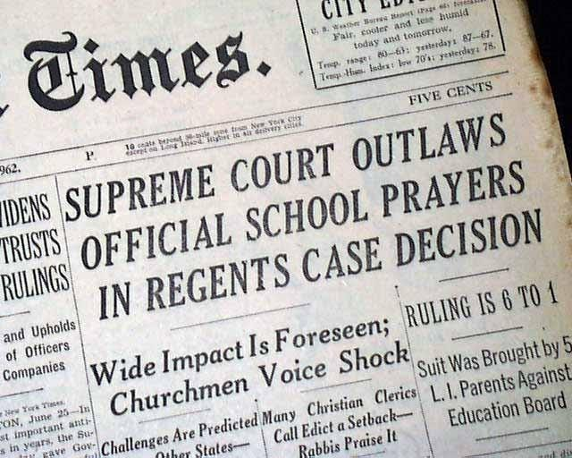
Engel v. Vitale (1962)
State officials may not encourage students to recite or otherwise participate in prayers developed by government officials.
Violates Establishment Clause
Notes:
Remember that this case does NOT ban school prayer. Rather, it simply requires that anyone representing the state not encourage or lead the prayers. Both teachers and students may still pray in schools under this decision. NOTE: KENNEDY v. BREMERTON WEAKENS THIS DECISION SIGNIFICANTLY. SEE https://floridacitizen.org/dlp_document/the-docket-the-case-of-the-praying-football-coach/

Slide 29
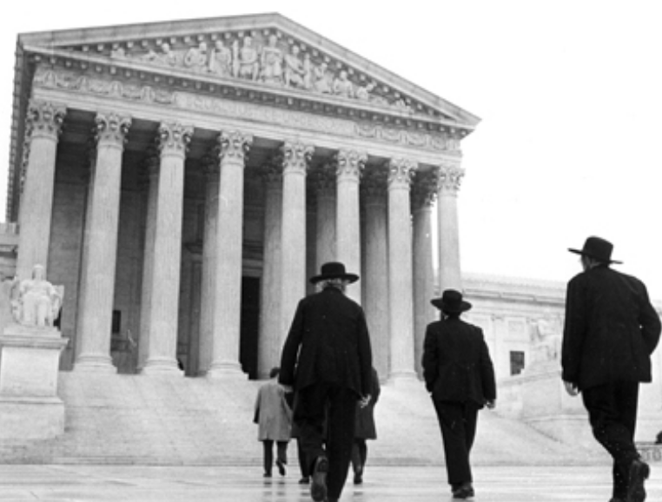
Wisconsin v. Yoder (1972)
Requiring Amish children to attend public school past the 8th grade violates the Free Exercise Clause

Slide 30
First Amendment and Freedom of the Press

Slide 31
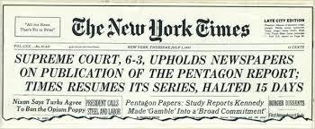
New York Times v. US (1971)
The U.S. Supreme Court decided that the federal government exercising “prior restraint” by prohibiting the New York Times from publishing the classified material violated the right to freedom of the press.

Slide 32
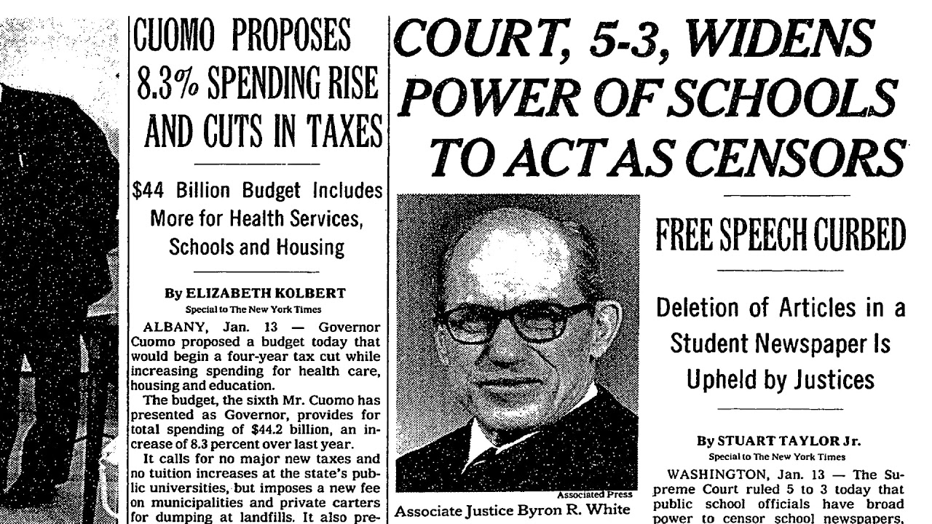
Hazelwood v. Kuhlmeier (1988)
Supreme Court ruled that limits of student free speech and press are permissible as long as the limitation is "reasonably related to legitimate pedagogical concerns."

Slide 33
Second Amendment Cases

Slide 34
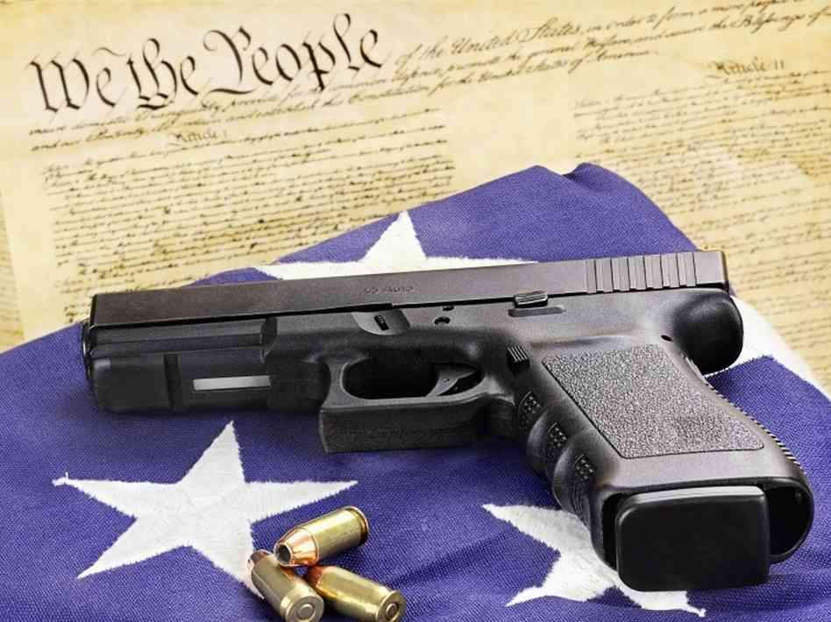
DC v. Heller (2008)
The Second Amendment protects an individual’s right to possess a firearm unconnected with service in a militia, and to use that firearm for traditionally lawful purposes, such as self-defense within the home.
This Photo by Unknown Author is licensed under CC BY

Slide 35
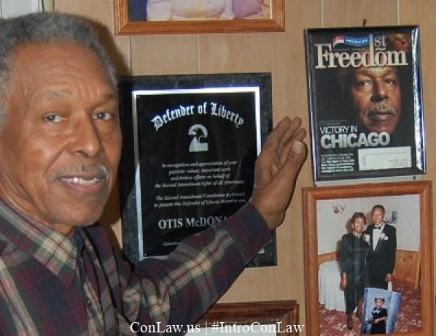
McDonald v. Chicago (2010)
The Fourteenth Amendment makes the Second Amendment right to keep and bear arms fully applicable to the states.
“It is clear that the Framers and ratifiers of the Fourteenth Amendment counted the right to keep and bear arms among those fundamental rights necessary to our system of ordered liberty” –Justice Samuel Alito

Slide 36
Civil Rights and Liberties (4th, 5th, 6th Amendments)

Slide 37
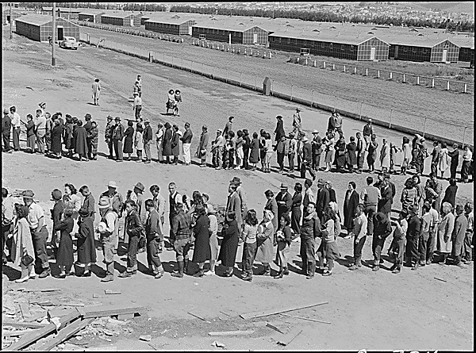
Korematsu v. United States (1944) (5th Amendment)
Challenge to Executive Order 9066, which relocated Japanese-Americans away from the West Coast and into internment camps
Fred Korematsu, a native born U.S. citizen of Japanese descent, challenged this order as a violation of the 5th Amendment’s federal due process clause simply because he was Japanese
Supreme Court ruled that this was a constitutional order because the US was at war with Japan
Justice Robert Jackson’s dissent: “But once a judicial opinion rationalizes such an order to show that it conforms to the Constitution, or rather rationalizes the Constitution to show that the Constitution sanctions such an order, the Court for all time has validated the principle of racial discrimination in criminal procedure and of transplanting American citizens. The principle then lies about like a loaded weapon, ready for the hand of any authority that can bring forward a plausible claim of an urgent need.”

Slide 38
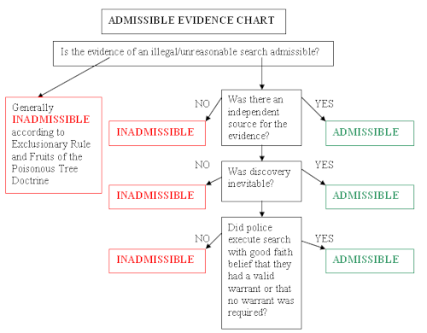
Mapp v Ohio (1961) (4th Amendment)
Since the Fourth Amendment's right of privacy has been declared enforceable against the States through the Due Process Clause of the Fourteenth, it is enforceable against them by the same sanction of exclusion as is used against the Federal Government…
"The right to privacy, no less important than any other right carefully and particularly reserved to the people, would stand in marked contrast to all other rights declared as "basic to a free society." ….And nothing could be more certain than that, when a coerced confession is involved, "the relevant rules of evidence" are overridden without regard to "the incidence of such conduct by the police," slight or frequent. Why should not the same rule apply to what is tantamount to coerced testimony by way of unconstitutional seizure of goods, papers, effects, documents, etc.? …”--Justice Tom Clark
EXCLUSIONARY RULE
From Public Safety Magazine
Notes:
https://supreme.justia.com/cases/federal/us/367/643/#tab-opinion-1943405
Image from https://publicsafetymagazine.com/wp-content/uploads/2022/04/ADMISIBLE-EVIDENCE-CHART.png

Slide 39
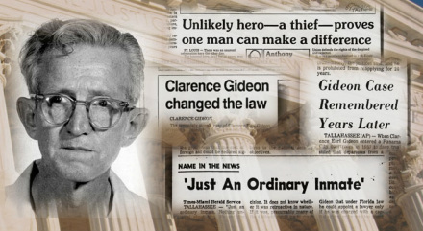
Gideon v. Wainwright (1963) (6th Amendment)
“Without a lawyer, the defendant cannot properly evaluate the legality of his arrest, he cannot determine the validity of the indictment, whether a search and seizure has been lawful, or whether a confession is admissible. He cannot determine whether he is responsible for the crime charged or for a lesser offense. At the trial, the defendant is not qualified to make objections to evidence or to cross-examine witnesses. He is unable to act as a lawyer would in the sentencing process. In short, the assistance of a lawyer is essential to a fair trial and, accordingly, is required by due process of law.” Abe Krash, assistant to Abe Fortas
Right to representation at all phases of a trial

Slide 40
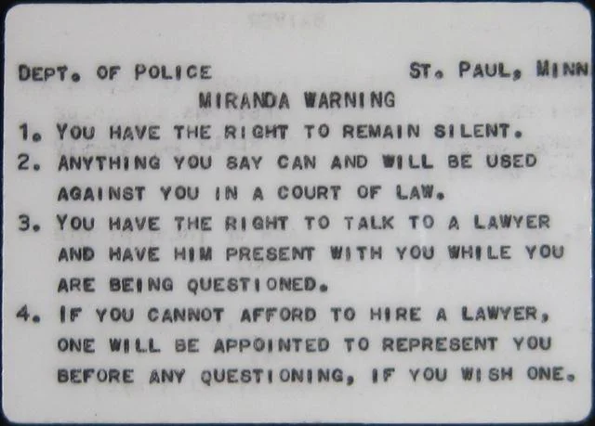
Miranda v. Arizona (1966) (5th Amendment)
Individuals being questioned as part of a criminal prosecution must be notified of their Fifth Amendment protection from self-incrimination.
Notes:
Where is Gideon in this? A copy of a Miranda warning. Some jurisdictions require the arrestee to sign the document showing he was apprised of his rights. From Minnesota Historical Society

Slide 41
14th Amendment and Right to Privacy

Slide 42
Roe v. Wade (1973)
Right to abortion as a component of the right to privacy
“The enumeration in the Constitution, of certain rights, shall not be construed to deny or disparage others retained by the people.”---9th Amendment
14th Amendment contains a ‘fundamental right to privacy’
Right to Privacy
14th Amendment
NOTE THAT THE ABORTION ELEMENT OF THIS CASE HAS BEEN ESSENTIALLY PRE-EMPTED/OVERTURNED BY DOBBS (2022)
Notes:
NOTE THAT THIS CASE HAS BEEN ESSENTIALLY PRE-EMPTED/OVERTURNED BY DOBBS (2022) AND RETURNED ABORTION RESTRICTIONS TO THE STATES. THE RIGHT TO PRIVACY REMAINS.
You may choose to also touch on Griswold and Loving when discussing this case.

Slide 43
14th Amendment and Equal Protection

Slide 44
Plessy v. Ferguson (1896)
“The object of the [Fourteenth] Amendment was undoubtedly to enforce the absolute equality of the two races before the law, but in the nature of things, it could not have been intended to abolish distinctions based upon color, or to enforce social, as distinguished from political equality, or a commingling of the two races upon terms unsatisfactory to either.”-Justice Henry Billings Brown
Note that this created the infamous ‘separate but equal’ doctrine
Notes:
Image from Library of Congress https://www.loc.gov/resource/cph.3c25806/

Slide 45
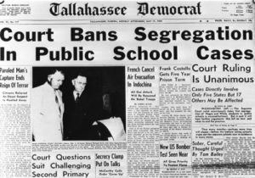
Brown v. Board (1954)
“We conclude that in the field of public education the doctrine of "separate but equal" has no place. Separate educational facilities are inherently unequal. Therefore, we hold that the plaintiffs and others similarly situated for whom the actions have been brought are, by reason of the segregation complained of, deprived of the equal protection of the laws guaranteed by the Fourteenth Amendment.”—Chief Justice Earl Warren

Slide 46
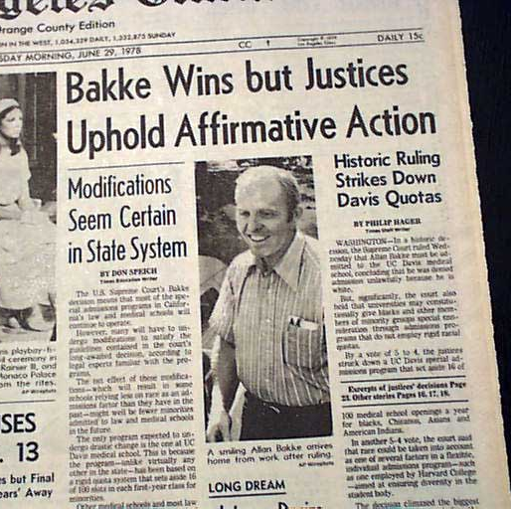
Regents of the University of California v. Bakke (1978)
Challenged the concept of affirmative action and racial quotas in universities as a violation of the 14th Amendment’s Equal Protection clause
Supreme Court upheld affirmative action but rejected racial quotas as a violation of the Civil Rights Act of 1964 and the 14th Amendment

Slide 47
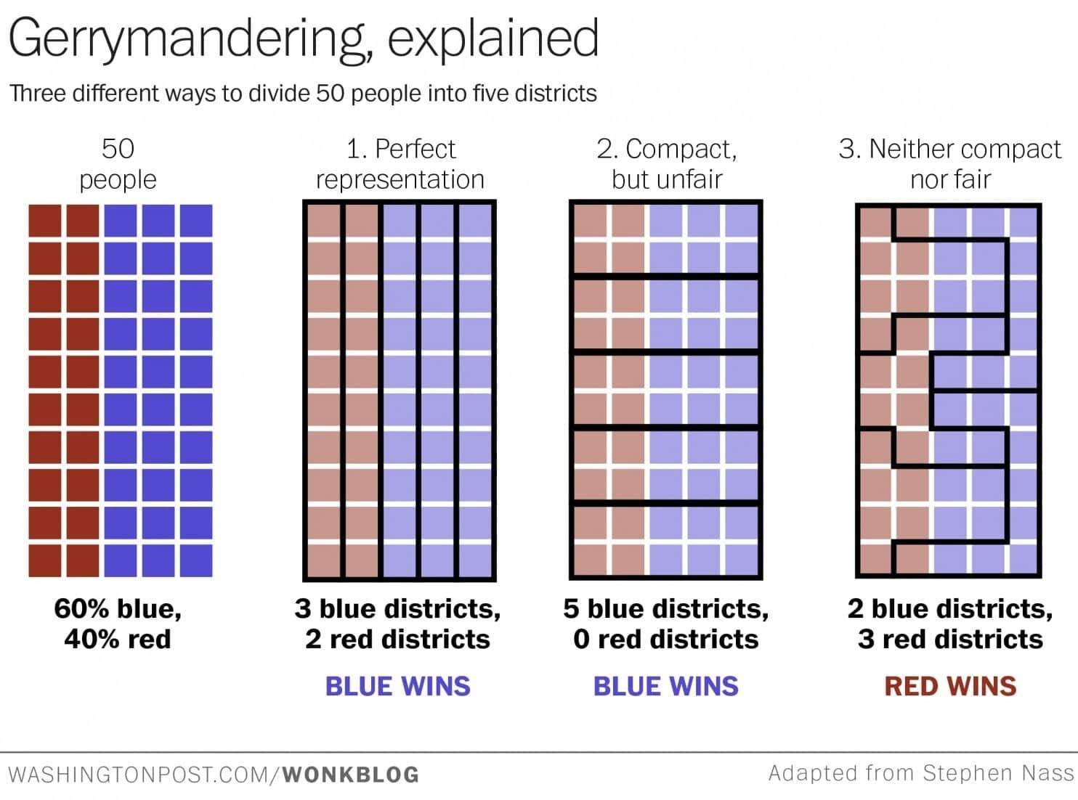
Shaw v. Reno (1993)
Focused on racial gerrymandering
The U.S. Supreme Court decided 5-4 that the Fourteenth Amendment Equal Protection Clause is violated when race alone serves as the basis for drawing legislative districts.

