Slide 1
BIG IDEAS THROUGH POLITICAL CARTOONS
Civics

Slide 2
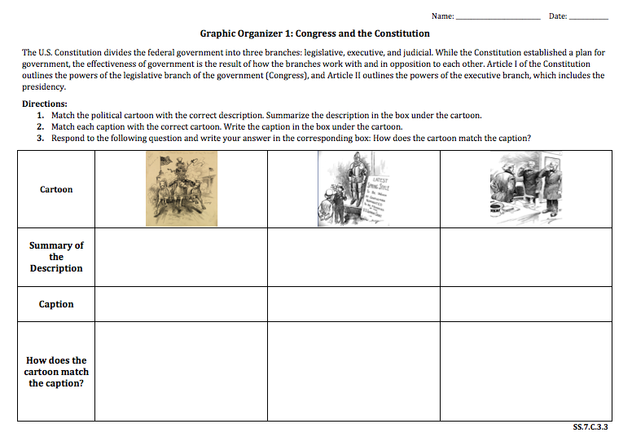
BIG IDEAS THROUGH POLITICAL CARTOONS GRAPHIC ORGANIZERS

Slide 3
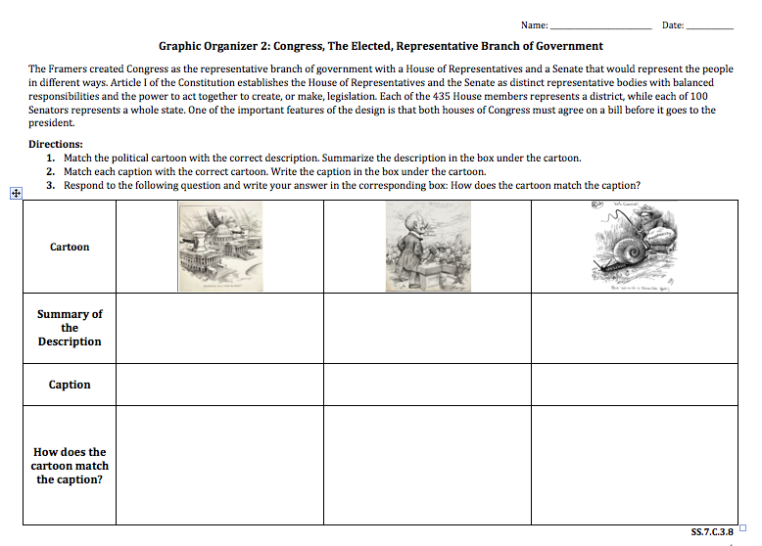
WHAT ARE WE GOING TO DO?
Read and Text Code

Slide 4
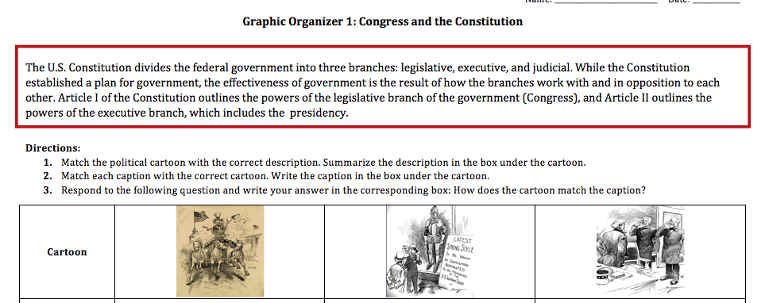
Read the Paragraph on the Graphic Organizer
Circle the Civics Vocabulary Terms

Slide 5
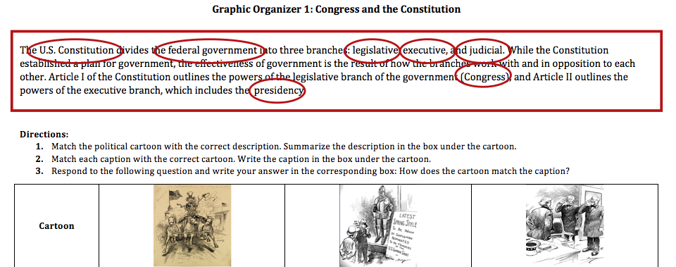
Read the Paragraph on the Graphic Organizer
Circle the Civics Vocabulary Terms

Slide 6
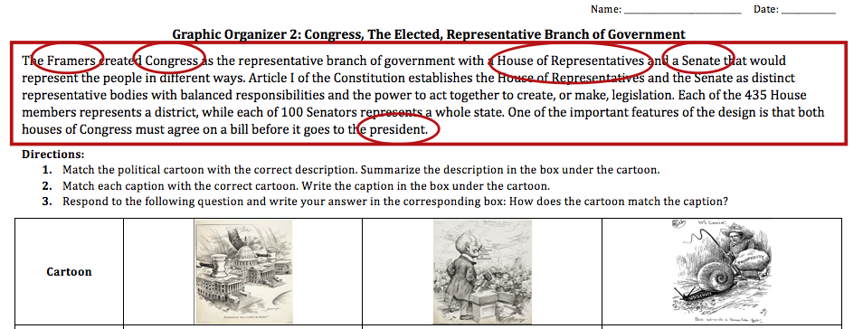
Read the Paragraph on the Graphic Organizer
Circle the Civics Vocabulary Terms

Slide 7
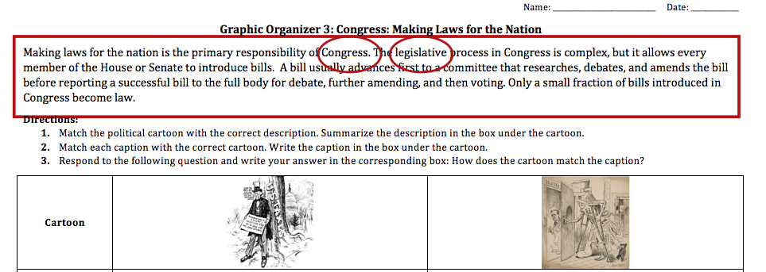
Read the Paragraph on the Graphic Organizer
Circle the Civics Vocabulary Terms

Slide 8
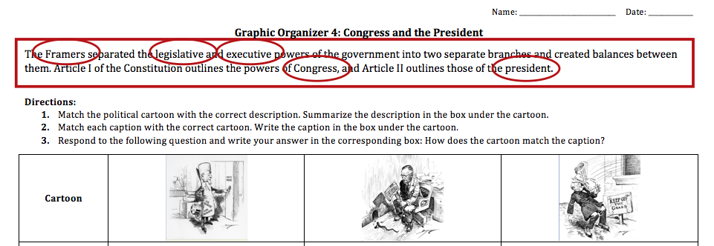
Read the Paragraph on the Graphic Organizer
Circle the Civics Vocabulary Terms

Slide 9
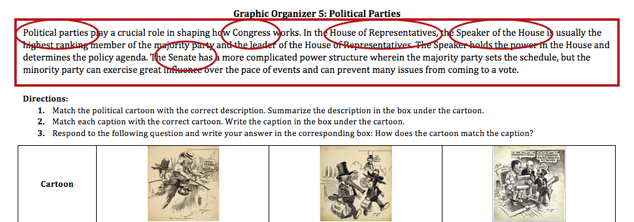
Read the Paragraph on the Graphic Organizer
Circle the Civics Vocabulary Terms

Slide 10
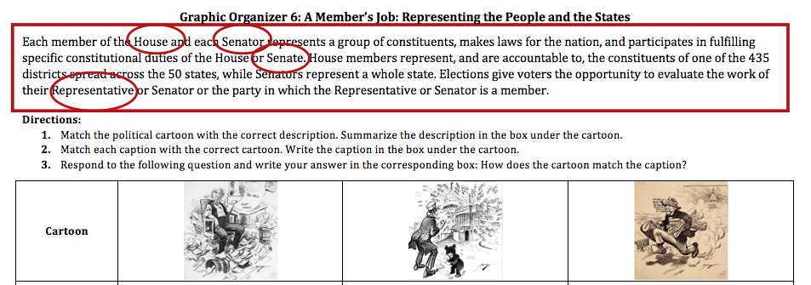
Read the Paragraph on the Graphic Organizer
Circle the Civics Vocabulary Terms

Slide 11
WHAT ARE WE GOING TO DO?
Carousel Stations

Slide 12
Re-Read the Paragraph on the Graphic Organizer
This paragraph provides general information

Slide 13
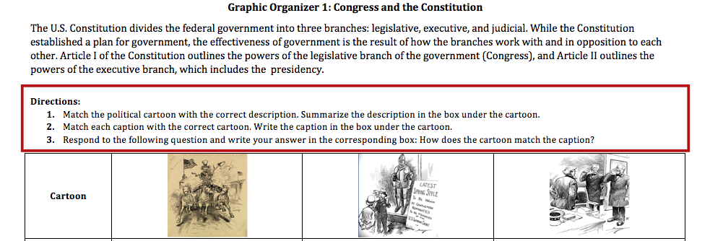
Follow the Directions on the Graphic Organizer
Complete Steps 1-3

Slide 14
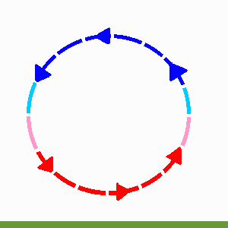
ROTATE TO THE NEXT STATION

