Slide 1
Fifth Grade Matching Game 1
Cut out the boxes and match the civics terms or concepts to the correct descriptions and photos

Slide 2
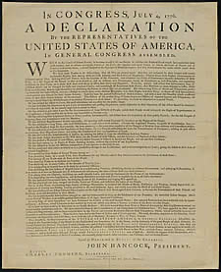
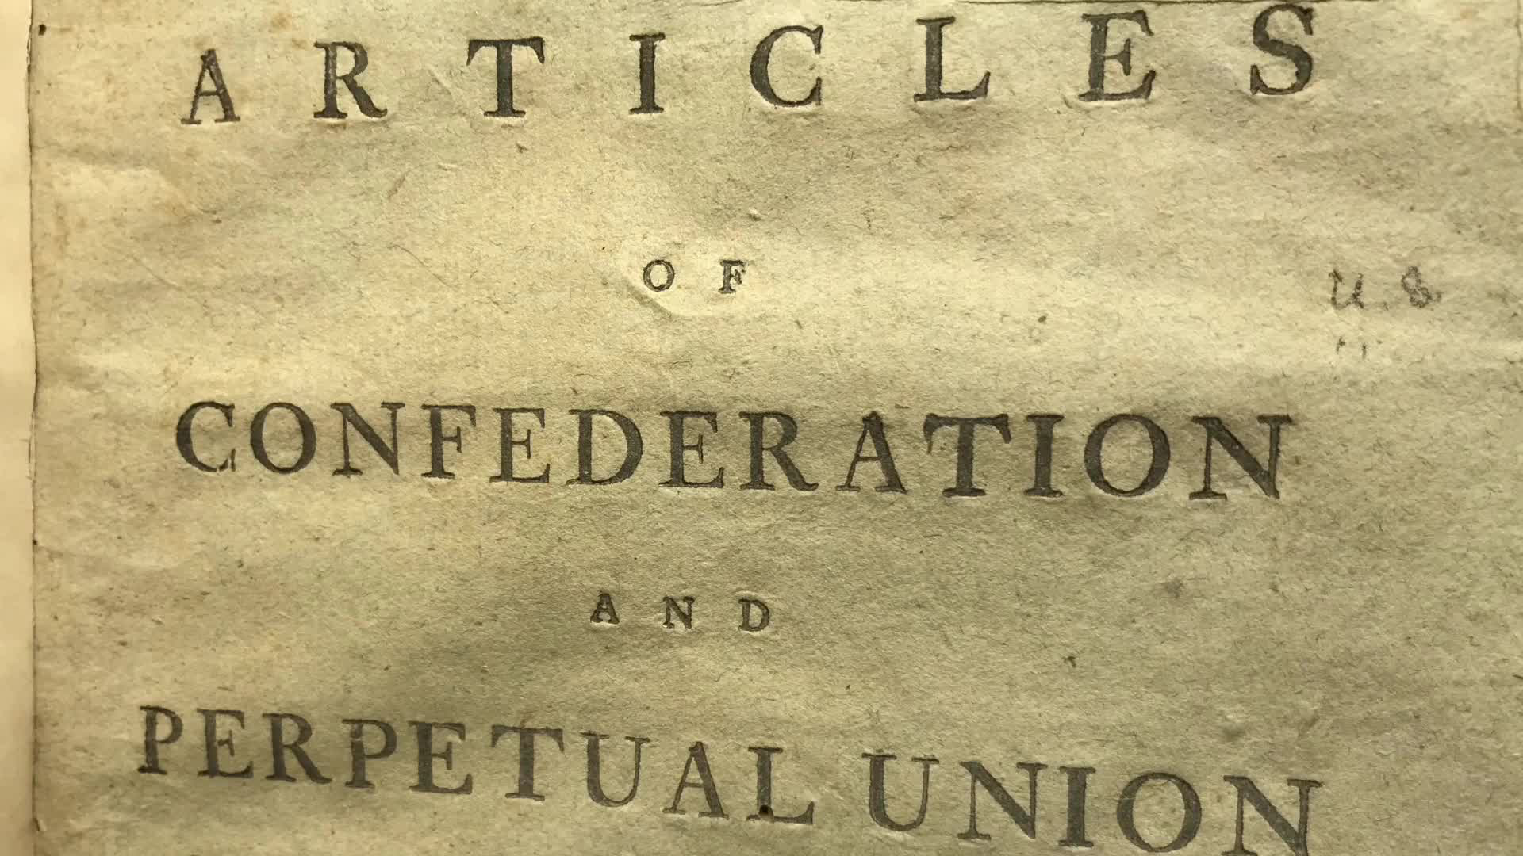
Declaration of Independence | Adopted on July 4, 1776, Written to King George III explaining why the colonies were breaking away from British rule
Articles of Confederation | Served as the first constitution of the United States, Stemmed from the colonial experience with the British government, established more of a “league of friendship” among the 13 colonies with a very weak central government

Slide 3
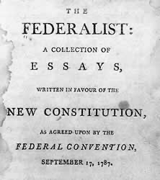
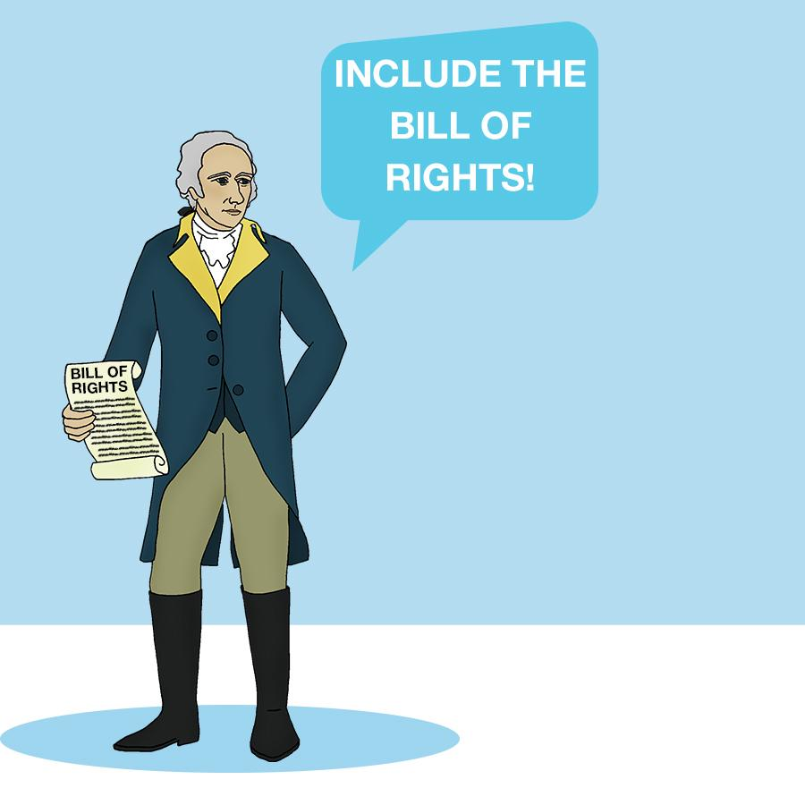
Federalists | Believed in necessity of the Constitution, wanted weaker state governments, wanted stronger national republic, authored the Federalist Papers to share beliefs
Anti- Federalists | Opposed ratification of Constitution, wanted weaker central government, wanted Bill of Rights added

Slide 4
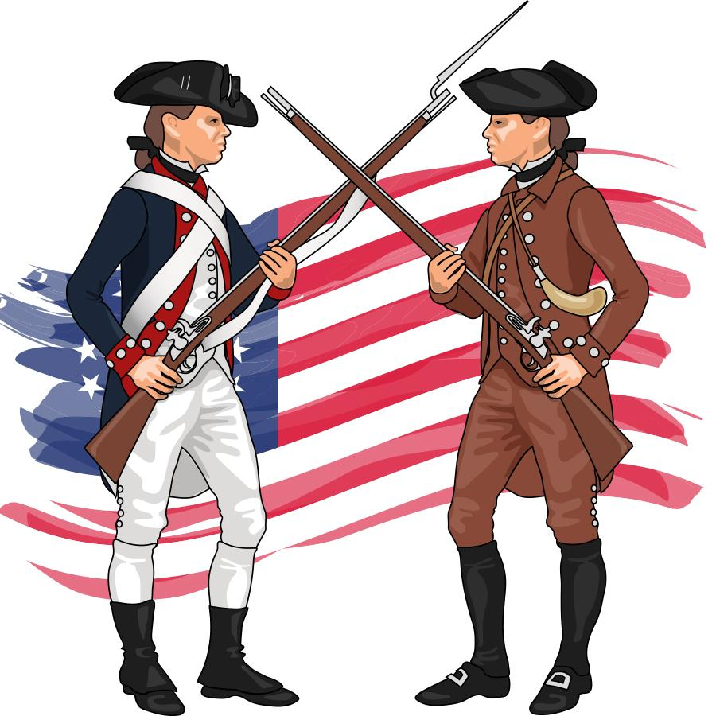
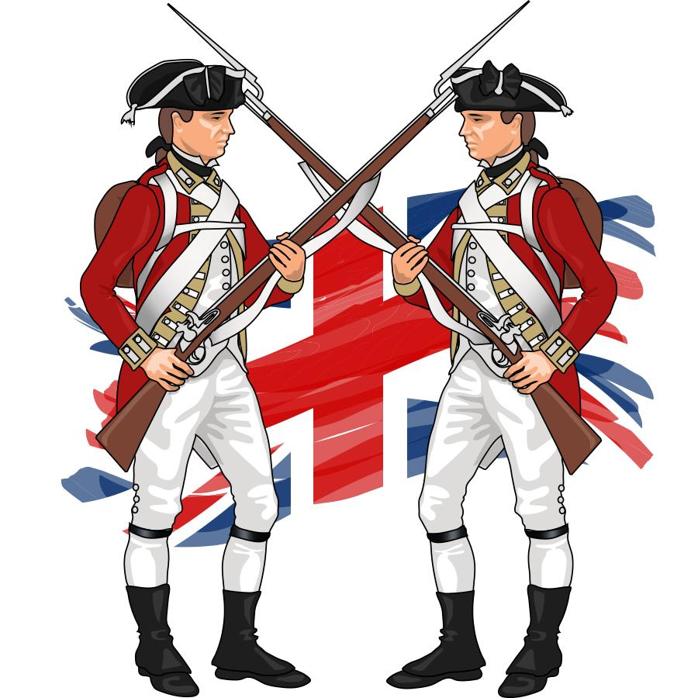
Patriots | Fought for liberty and independence against British monarch, believed in unalienable rights, wanted people to give government its power, wanted limited government, opposed monarchy or aristocracy
Loyalists | Considered themselves loyal British subjects, believed revolution would be treasonous, believed commerce and trade depended on good relations with British Empire

Slide 5
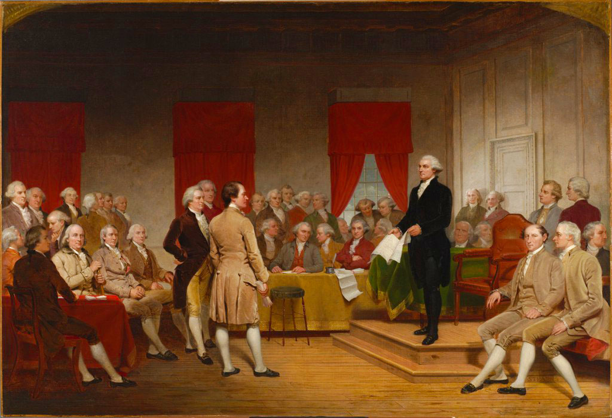
1787 Constitutional Convention | Purpose was to revise the Articles of Confederation, provide fair representation for large and small states, address concerns about individual rights, and determine the structure, function, and powers of central and state government
Civic Duties (Obligations) | Obeying the law, Paying taxes, Serving on jury

Slide 6
Civic Responsibilities | Voting, Keeping informed on public issues, Volunteerism
Great Seal of the U.S. | National symbol featured on government buildings, official documents, passports, and the $1 Bill

Slide 7
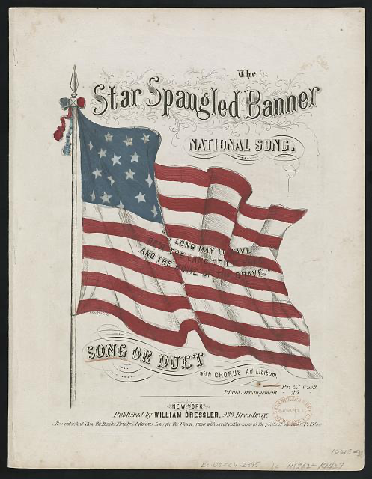
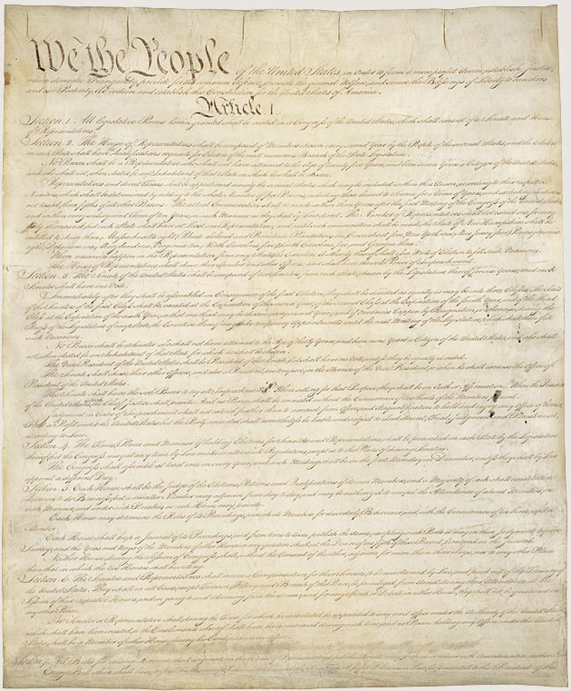
Star-Spangled Banner | The national anthem of the U.S., Written by Francis Scott Key in 1814
U.S. Constitution | An agreed-upon set of rules/laws, supreme law of the land, starts with “We the People”, establishes a constitutional republic

Slide 8
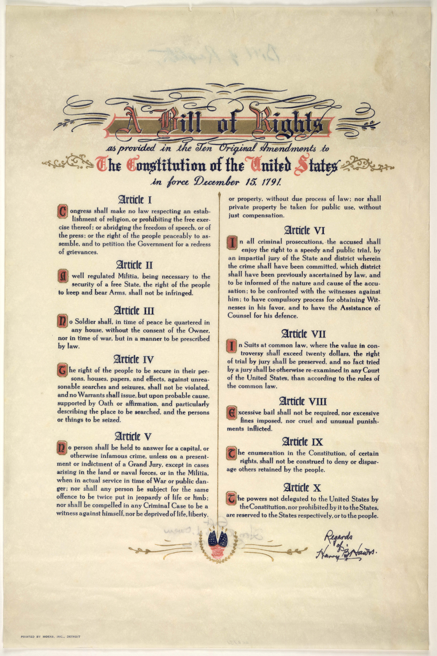
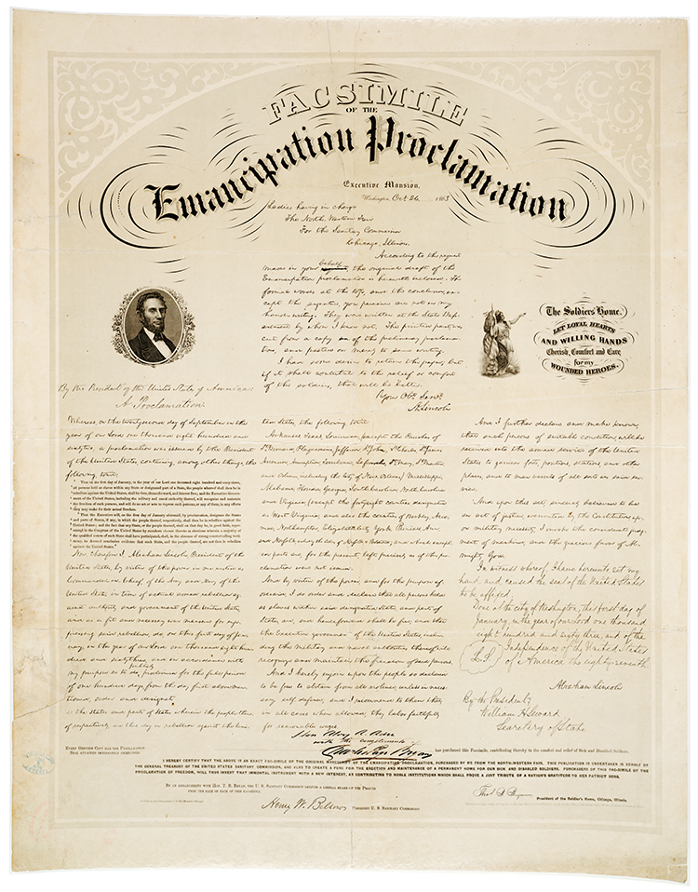
Bill of Rights | First ten amendments to the U.S. Constitution, ratified December 15, 1791, ensures greater protection of individual rights
Emancipation Proclamation | January 1, 1863, issued by Abraham Lincoln, issued during the third year of Civil war, declared “all persons held as slaves are, and henceforward shall be free”, applied to the states that had seceded from the union and was dependant on a Union victory

Slide 9
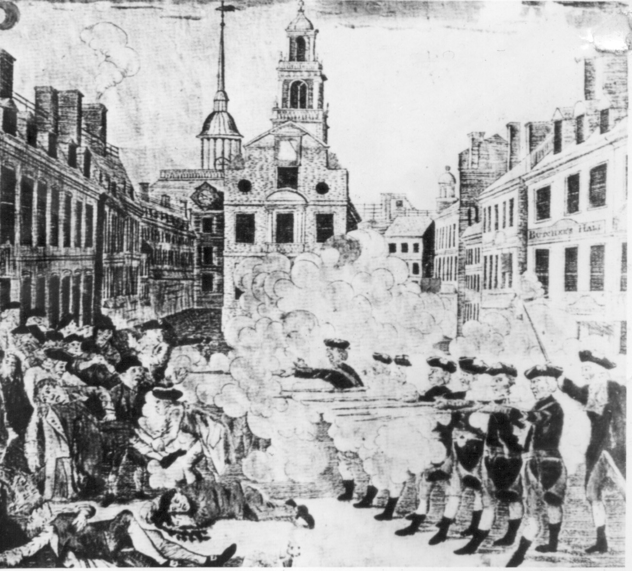
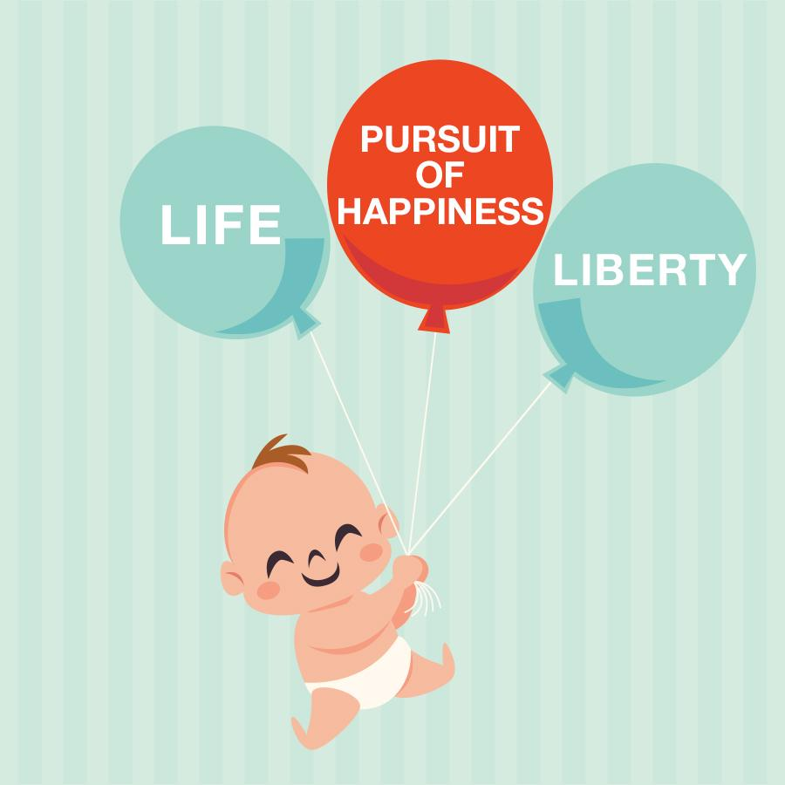
American Revolution | War that was fought from 1775-1783 between American colonists and the British empire over issues of government authority and unalienable rights
Unalienable Rights | Rights someone is born with that cannot be given or taken away, Life, liberty, and the pursuit of happiness

Slide 10
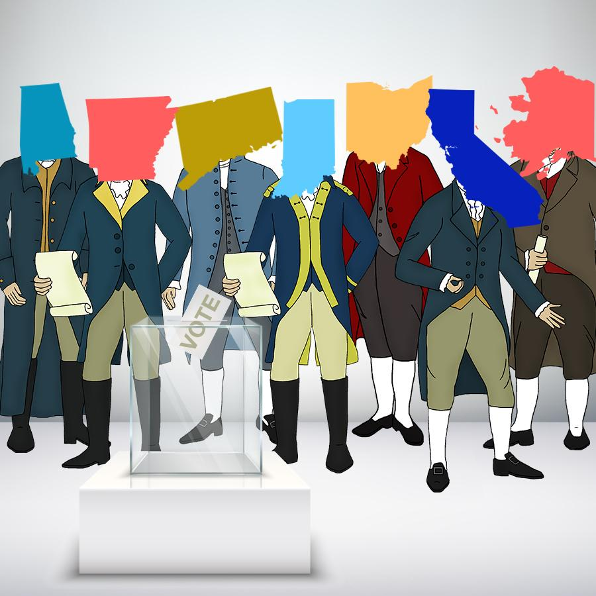
Representative Government | Elected individuals represent groups of people and make laws on their behalf
Constitutional Republic | A form of government in which there is democratic voting, but governmental power is limited by the existence of a constitution that protects the rights of citizens

Slide 11
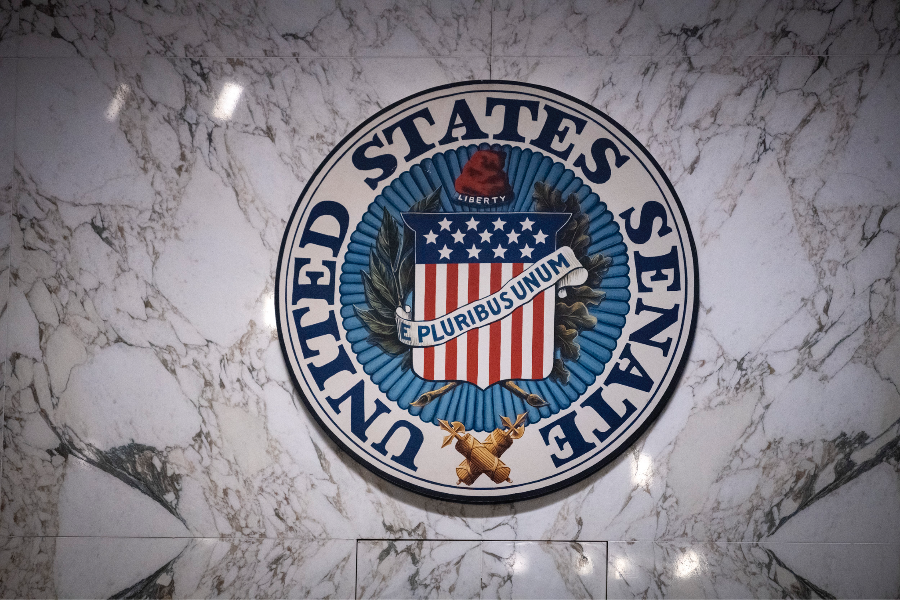
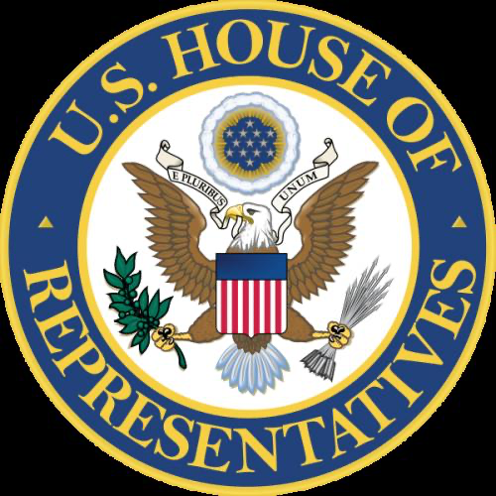
U.S. Senator | 100 elected individuals (2 from each state), serves six year terms in Washington D.C., represents their state, creates and votes on legislation
U.S. Representative | 435 elected individuals, serves two year terms in Washington, D.C., represents their state, creates and votes on legislation

Slide 12
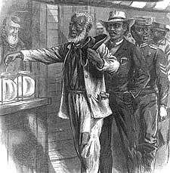
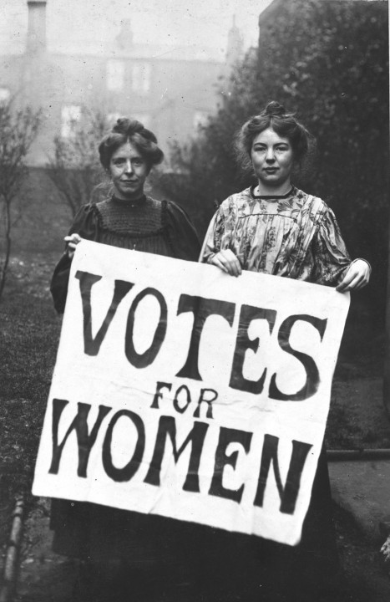
15th Amendment | Granted African-American men the right to vote (1870)
19th Amendment | Granted women the right to vote (1920)

Slide 13
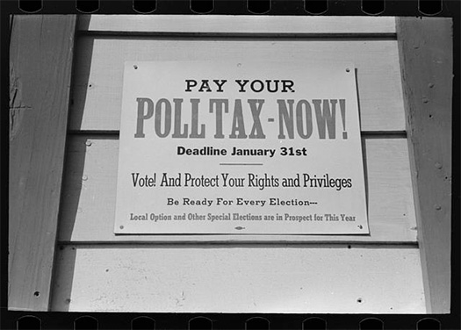
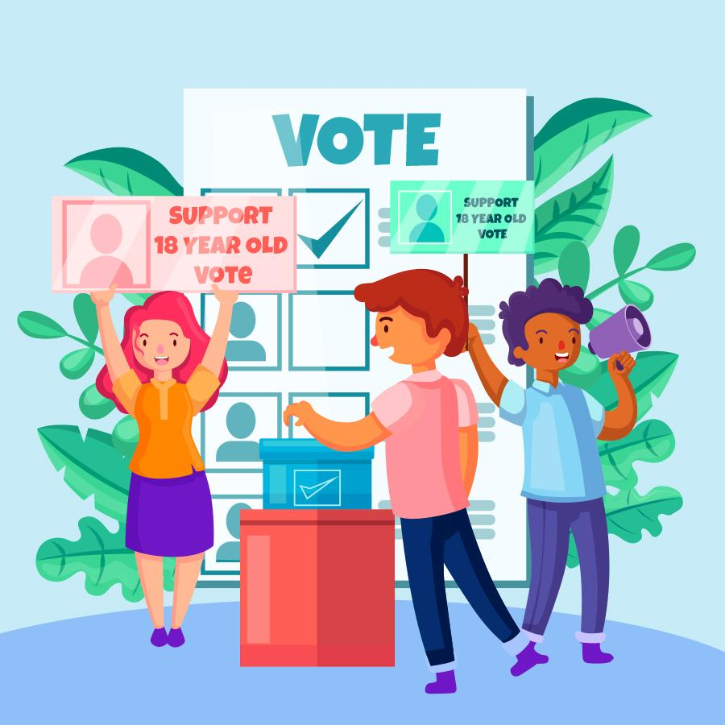
24th Amendment | Abolished charging poll taxes or any other taxes for voting (1964)
26th Amendment | Granted every citizen over the age of 18 the right to vote (1971)

Slide 14
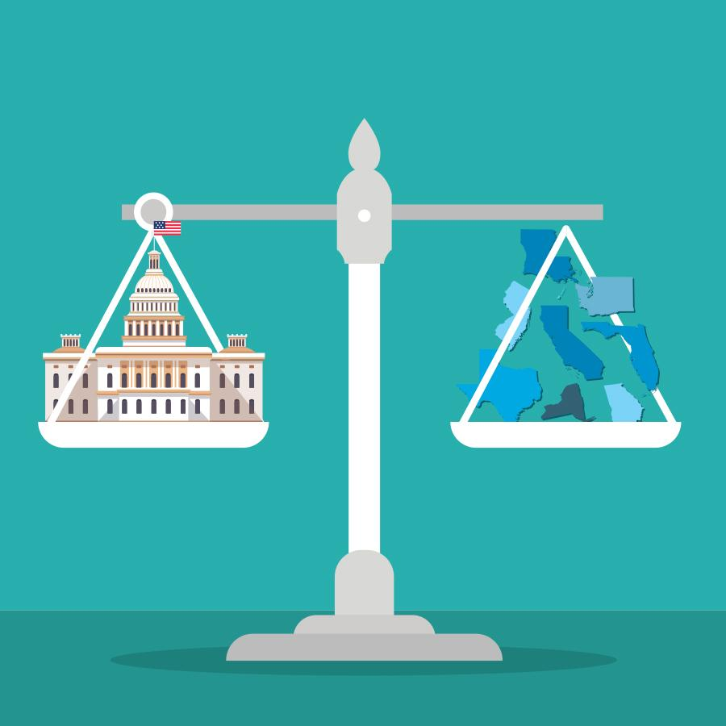
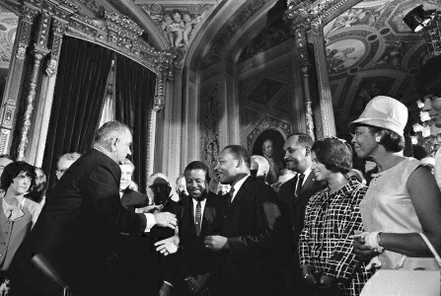
Federalism | The division of power between the national, state, and local governments
Voting Rights Act of 1965 | Outlawed discriminatory voting practices directed against African-Americans, Outlawed the use of literacy tests as a condition of voter registration, Established federal oversight of election administration

Slide 15
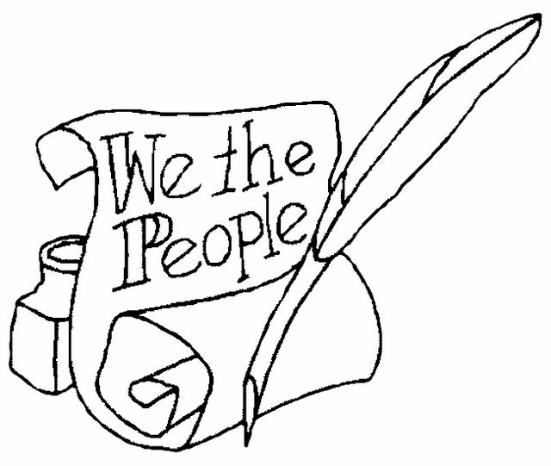
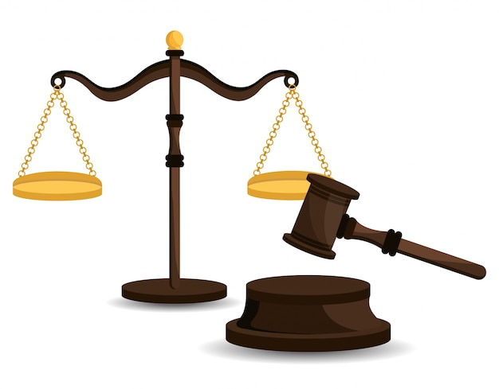
Popular Sovereignty | Government authority is based on the consent of the people
Rule of Law | The idea that laws must be followed by everyone; no one is above the law

Slide 16
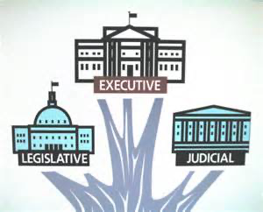
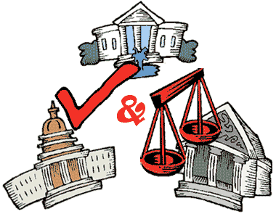
Separation of Powers | The establishment of three branches of government (legislative, executive, and judicial) each with their own distinct structure, function, and powers/responsibilities
Checks and Balances | The ability of each branch of government to limit the power of the other branches

Slide 17
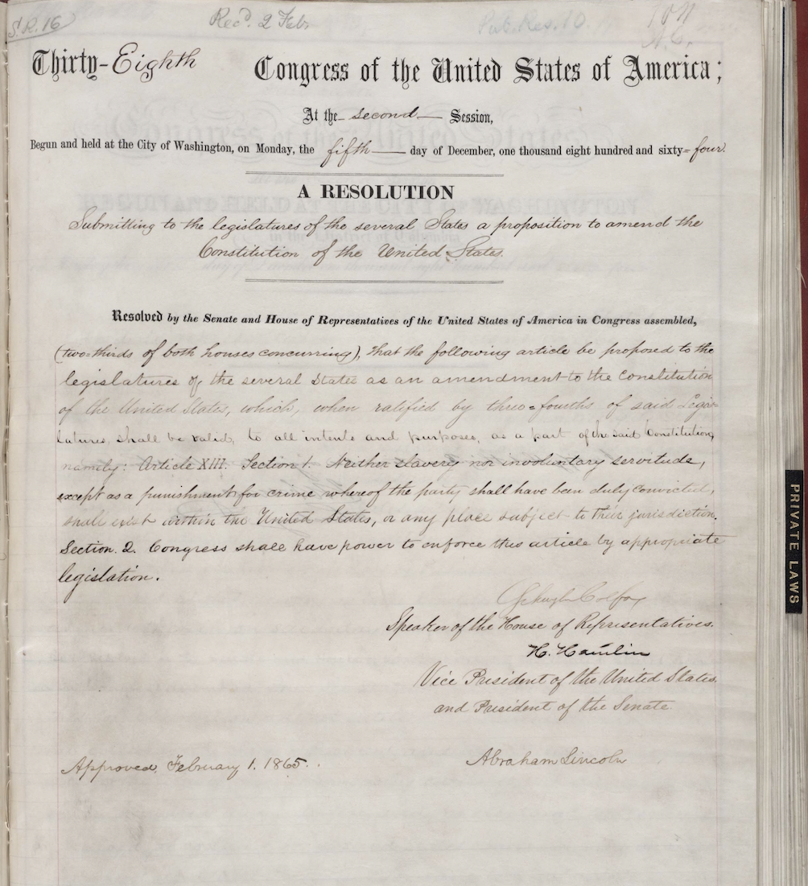
Amendment Process | The act of making a change to the U.S. Constitution outlined in Article V

Slide 19
Additional Ways to Play
Start with just the images and correctly match the terms and/or descriptions
Start with just the descriptions and correctly match the terms and/or images
Start with just the terms and correctly match the descriptions and/or images
Read a description aloud and have your child hold up the correct image and/or term
Have your child find two matches they think are similar or “go together” and explain why
Try and create a timeline or chronology with some of the cards
Ask “Which term/match do you think is the most interesting/important?” “Why?” “Least interesting/important?”

Slide 20
Sources
“Declaration of Independence” from the Library of Congress is under the Public Domain
“The Articles of Confederation” [extracted image] from the Library of Congress has no known copyright restrictions
“Federalist papers title page” from the Library of Congress has no known copyright restrictions
“1787 Constitutional Convention” from the National Archives has unrestricted access
“Law order 2x2 design concept” by macrovector is licensed under the Freepik license
“Great Seal of the United States” from The American Revolution Institute is under the Public Domain
“Star Spangled Banner” from the Library of Congress has no known copyright restrictions
“U.S. Constitution” from The National Archives is under the Public Domain
“Bill of Rights” from The Library of Congress is under the Public Domain
“Emancipation Proclamation” from The National Archives has unrestricted access
“Revolutionary War” from the National Archives has unrestricted access
“U.S. Senate Seal” from the Department of Homeland Security is under the Public Domain
“Seal of the United States House of Representatives” from City of Grove, Oklahoma is under the Public Domain
“15th Amendment” from the Library of Congress has no known copyright restrictions
“19th Amendment” from the National Archives is under the Public Domain
“24th Amendment” from the Library of Congress has no known copyright restrictions
“Voting Rights Act of 1965” from the Reagan Library is under the Public Domain
“Vector law design” by studiogstock is licensed under the Freepik license
“Legislative branch clipart image” from ClipartArtix has no known copyright restrictions
“Legislative branch image” from ClipartArtix has no known copyright restrictions
“Amendment 13 Page 1” from the National Archives is under the Public Domain

