Slide 1
Third Grade Matching Game
Cut out the boxes and match the civics terms or concepts to the correct descriptions and photos

Slide 2
Civility, Cooperation, & Volunteerism | Food/Book drives, Community Clean-ups, Voting, Blood Drives, Volunteer Fire Dept., Neighborhood Watch
Civic Virtues | Courage, fairness, compassion, self-discipline, tolerance, wisdom, contributions, humility, integrity, justice, perseverance, respect, responsibility, tolerance, etc.
Integrity
Civility
Cooperation
Integrity

Slide 3
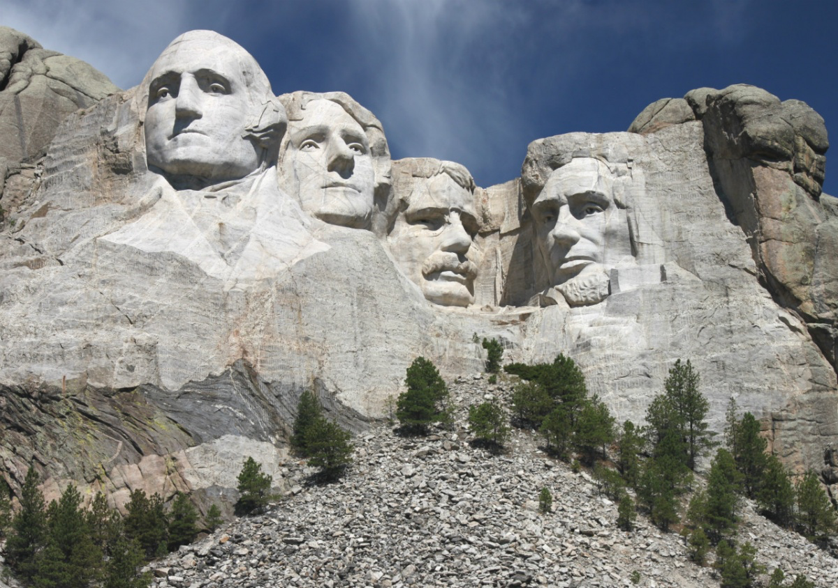
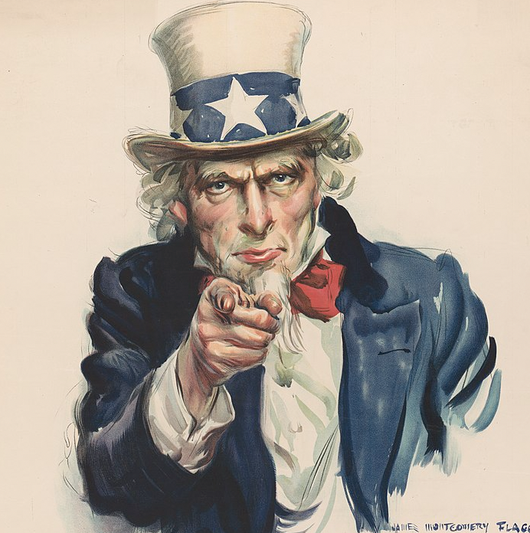
Mount Rushmore | George Washington, Thomas Jefferson, Theodore Roosevelt, and Abraham Lincoln carved into the Black Hills of South Dakota; Symbolizes the founding, expansion, preservation, and unification of the United States
Uncle Sam | Cartoon used to represent the United States, Named after Samuel Wilson for his help in the War of 1812, Became a national symbol in 1961

Slide 4
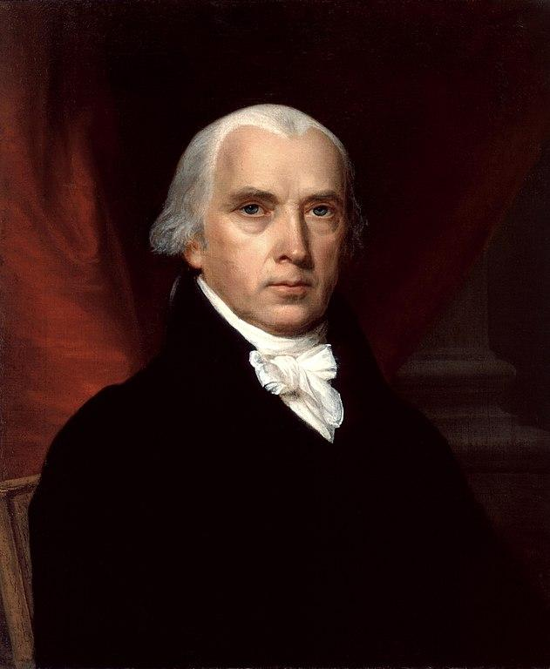
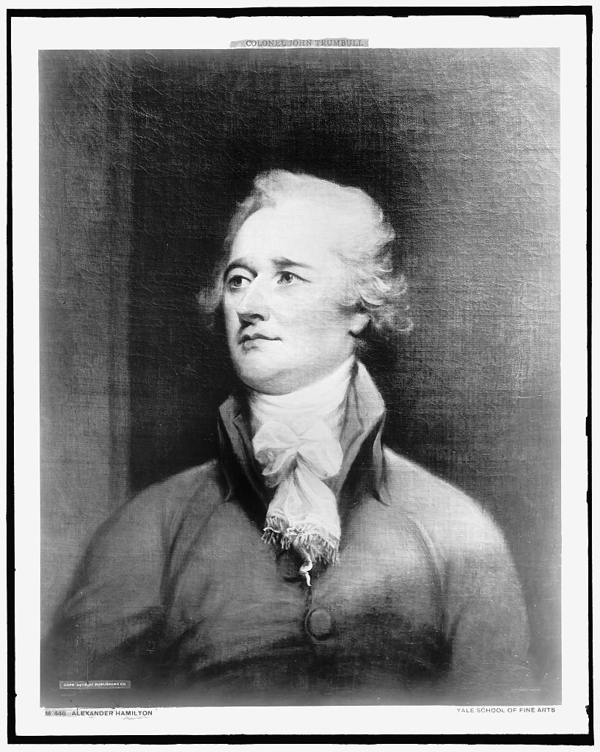
James Madison | 4th president of the United States, author of the Federalist Papers, known as “The Father of the U.S. Constitution”
Alexander Hamilton | First Secretary of the Treasury, author of the Federalist Papers, Founding Father

Slide 5
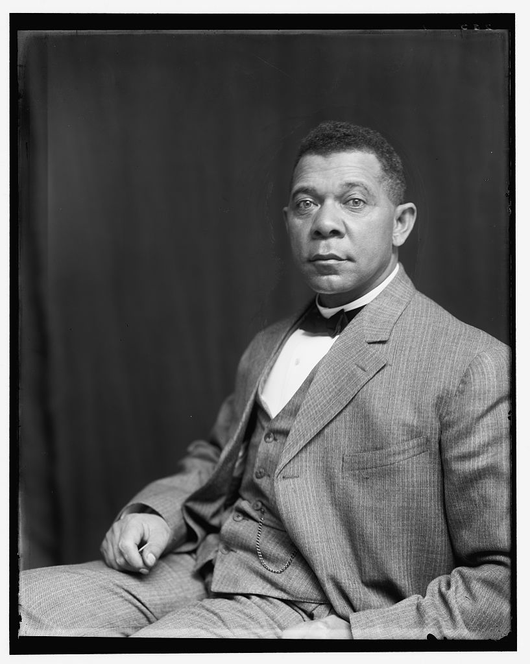
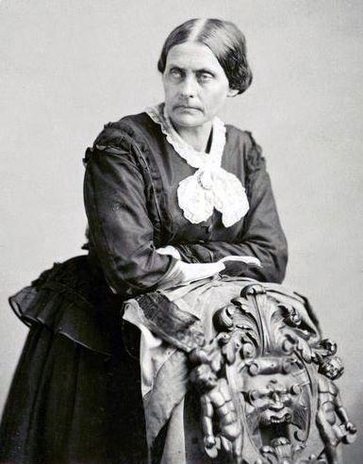
Booker T. Washington | Civil Rights activist, Educator, Reformer, Influential spokesman for Black Americans from 1895-1915
Susan B. Anthony | Women’s rights activist, made public speeches against slavery, co-founded the American Equal Rights Association and the National Woman’s Suffrage Association

Slide 6
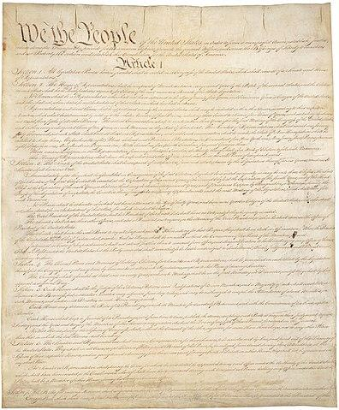
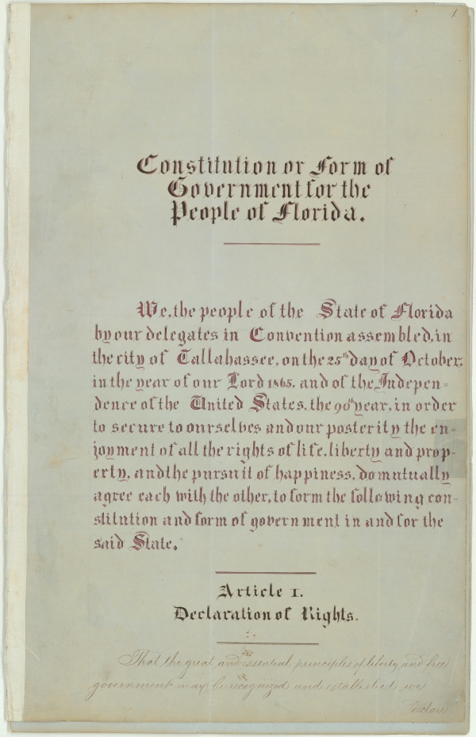
U.S. Constitution | Establishes the structure, function, powers and limits of the U.S. government
Florida Declaration of Rights | Listed in Article I of the Florida Constitution, outlines the rights all Florida citizens have, similar to the U.S. Bill of Rights

Slide 7
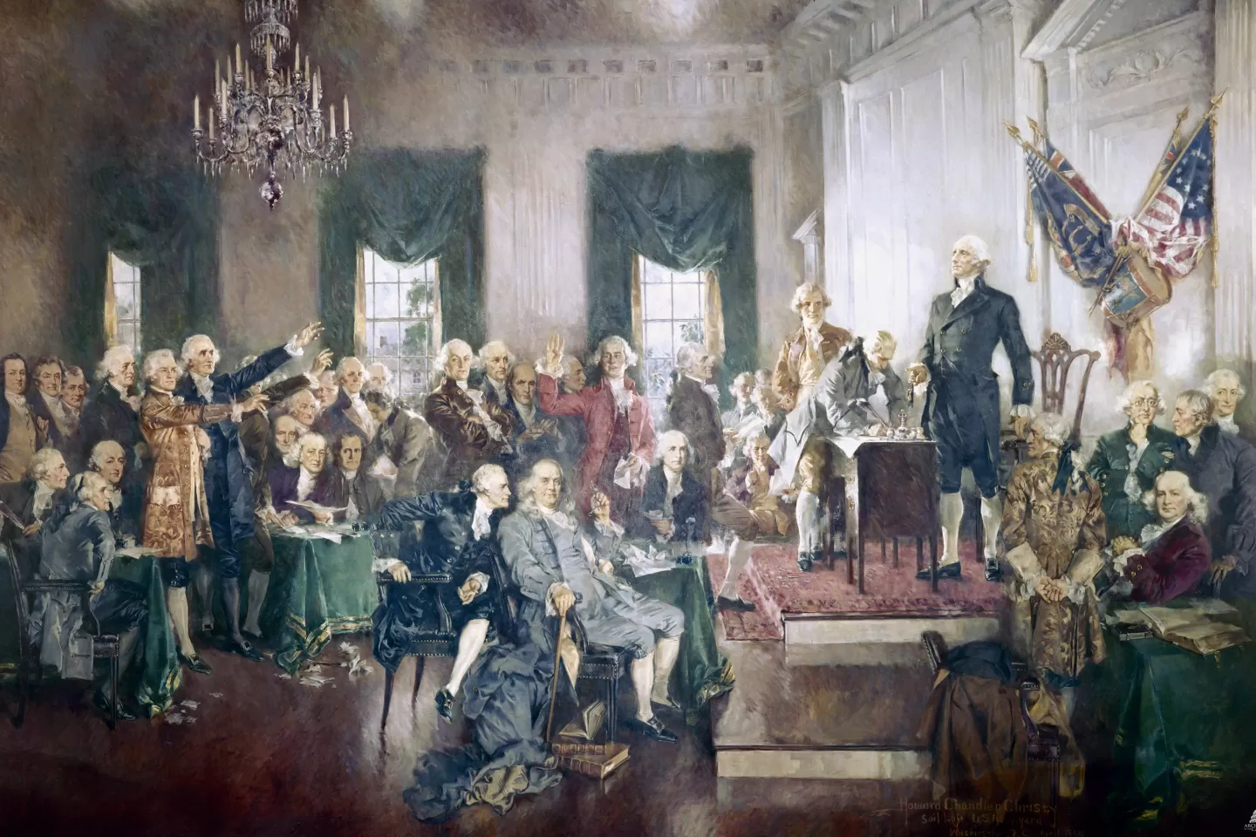
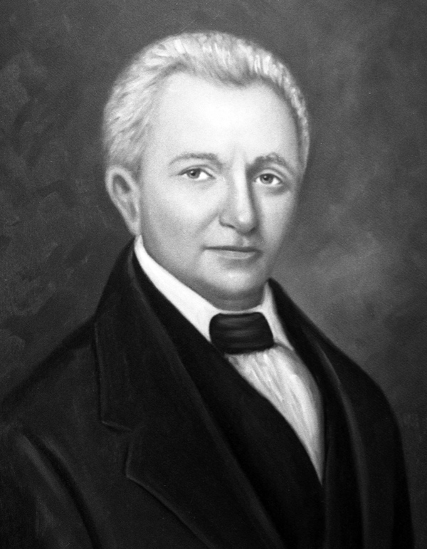
Constitutional Convention | May 1787- September 1787, Delegates from 12 colonies came to revise Articles of Confederation, Located in Philadelphia, PA, many debates and compromises happened, 39 delegates signed, Established the new framework for the U.S. government
William Pope Duval | First civilian territorial governor (1822-1834); lawyer and judge; helped establish more peaceful relations with local tribes of Native Americans; established Tallahassee as state capitol

Slide 8
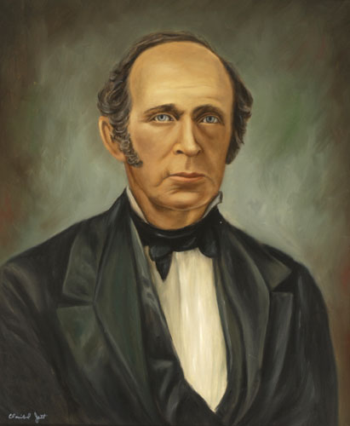
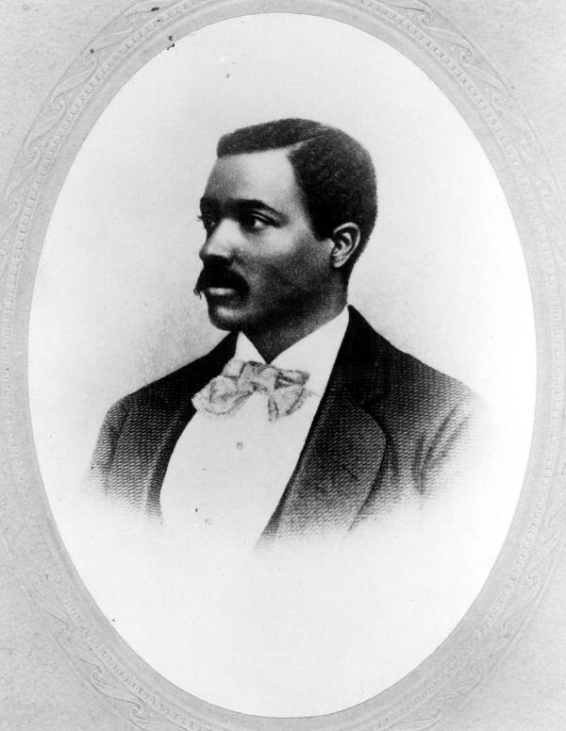
William Dunn Moseley | First governor under statehood (1845-1849), state Capitol building completed while in office, encouraged agriculture production of citrus, avocados, tobacco, and cotton
Josiah T. Walls | First Black congressman elected in Florida (1870); Delegate to the state constitutional convention; Served in both the Florida House of Representatives and the Florida Senate

Slide 9
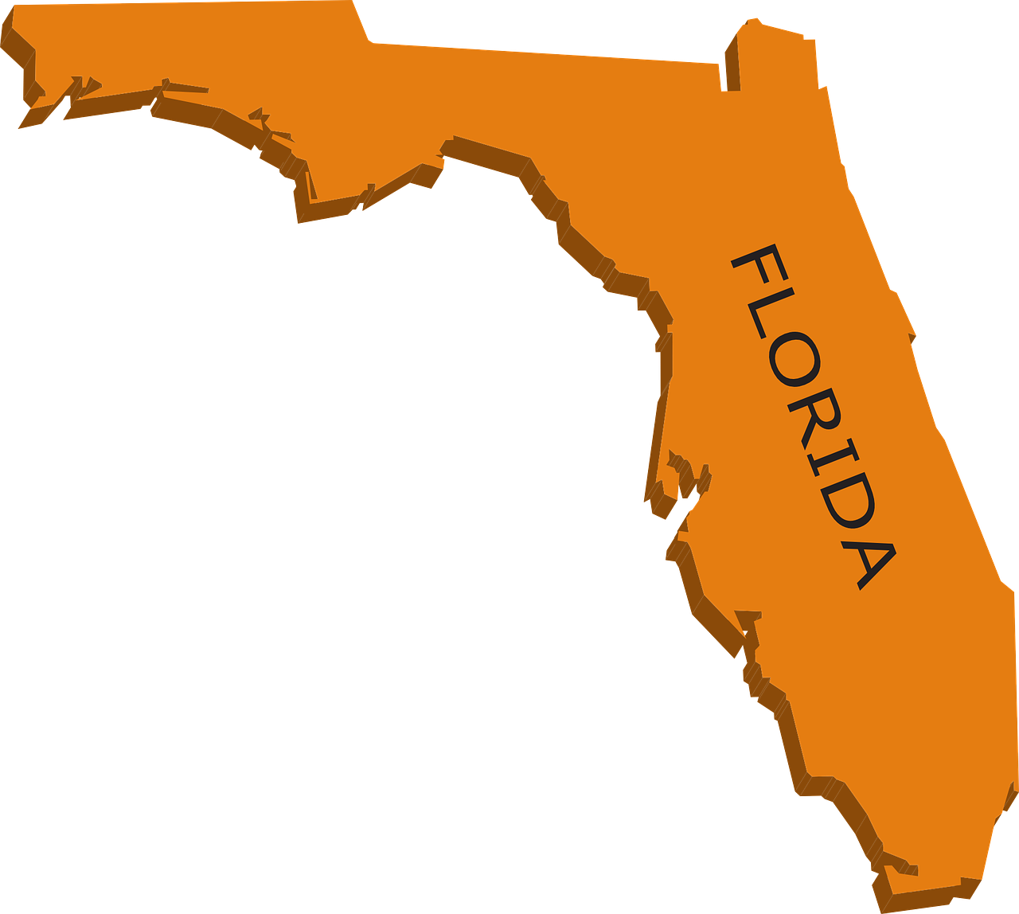
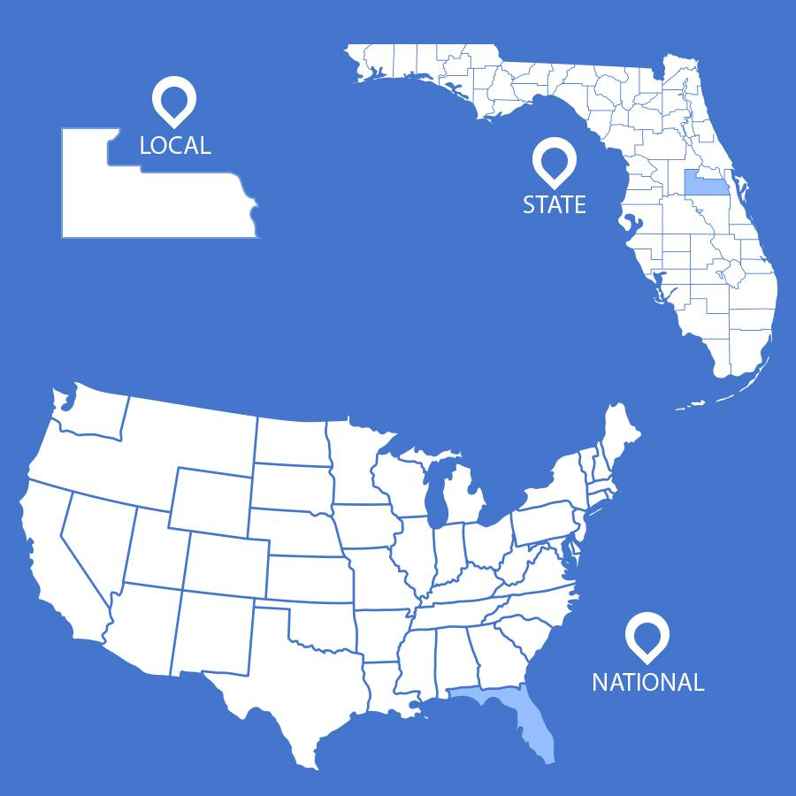
Florida Statehood | On March 3, 1845 this became the 27th state
Levels of Government | Local State National

Slide 10
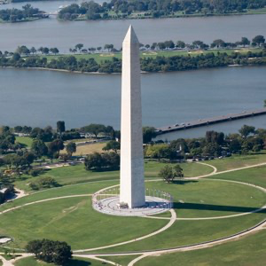
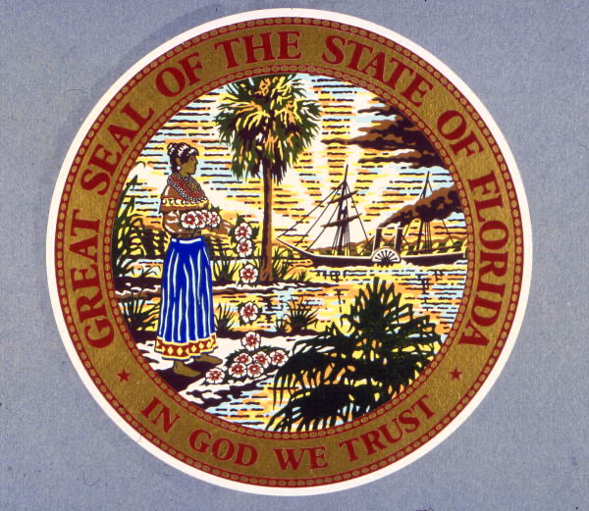
Washington Monument | Located in Washington, D.C., Built to honor former president George Washington
Florida’s State Seal | Used on official state government documents and legislation; Displayed at state government buildings and on the state flag; Includes a Seminole woman, steamboat, sabal palms, and the state motto “In God We Trust”

Slide 11
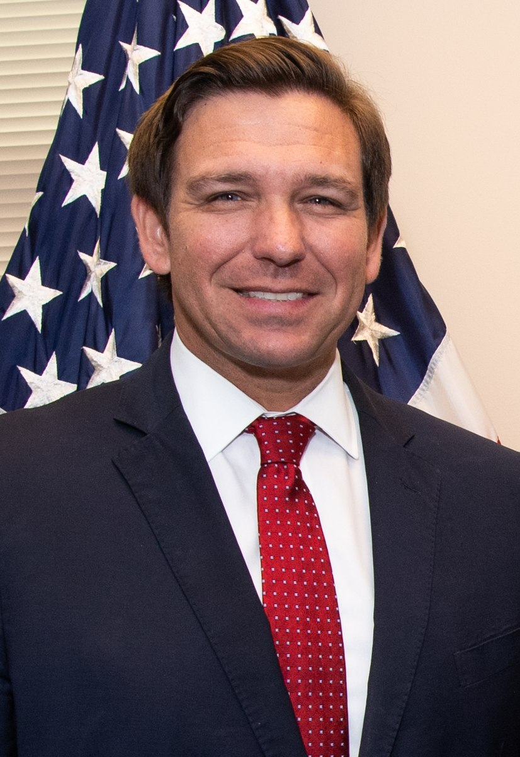
Florida’s Governor | Leader of the state, head of the state executive branch, enforces rules and laws in the state
Patriotism | Showing love, loyalty, and respect for one’s country

Slide 12
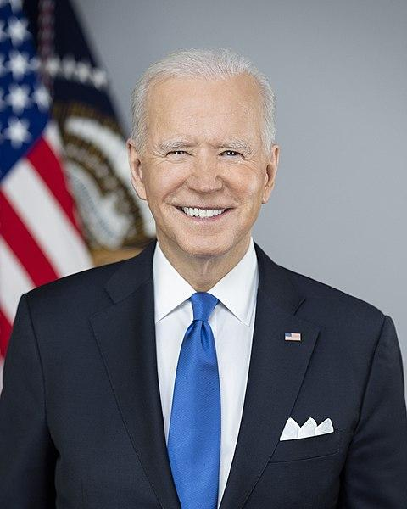
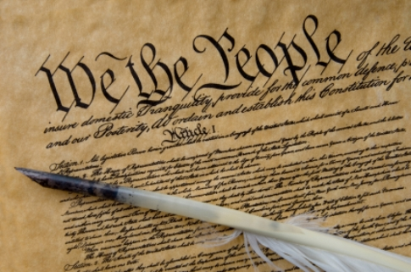
U.S. President | Leader of the U.S., head of the national executive branch, enforces rules and laws of the country
“We the People” | Start of the U.S. Constitution; Means that government gains its power from the people

Slide 13
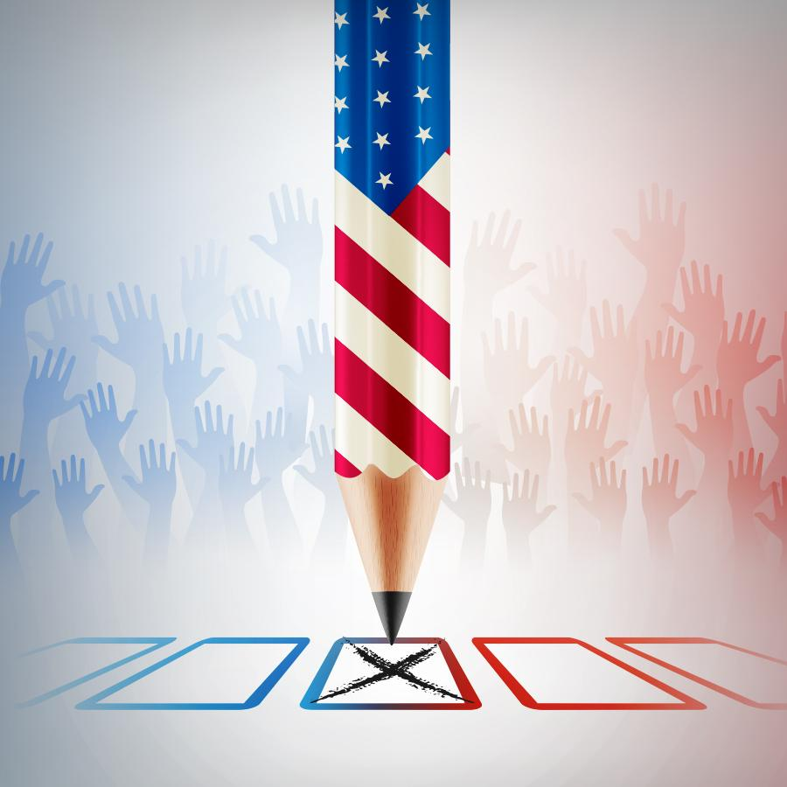
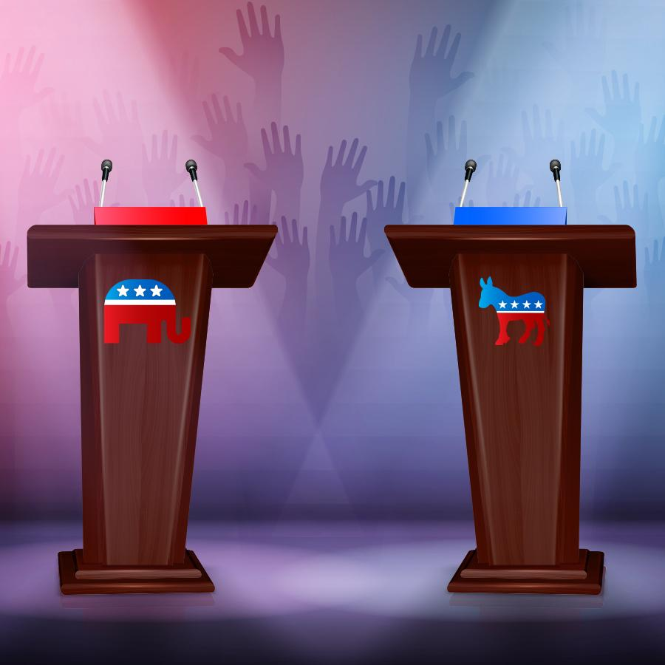
Voting | An important act of citizenship where one selects their choices in national, state, and local elections
Elections | Collaborative decision making through voting where individuals are chosen to represent various official positions

Slide 14
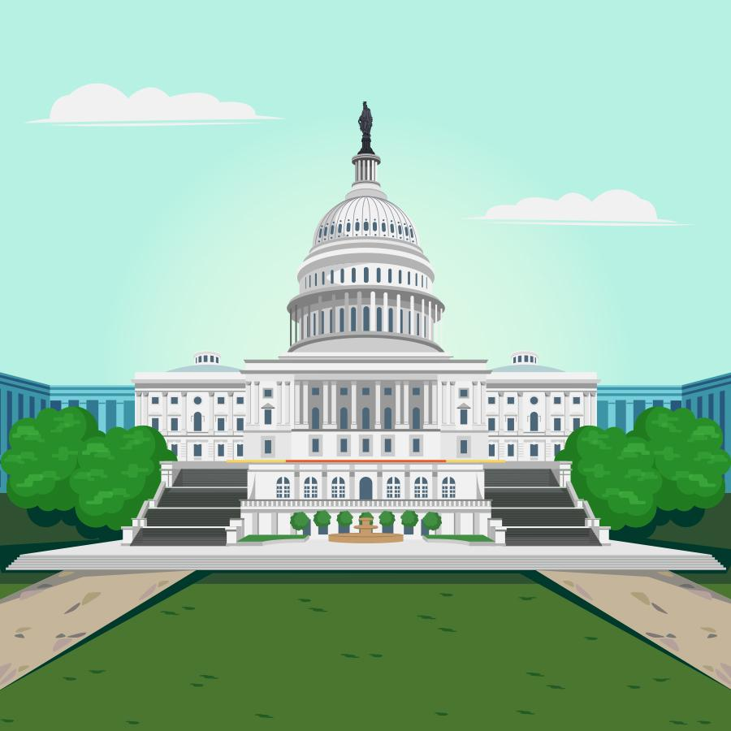
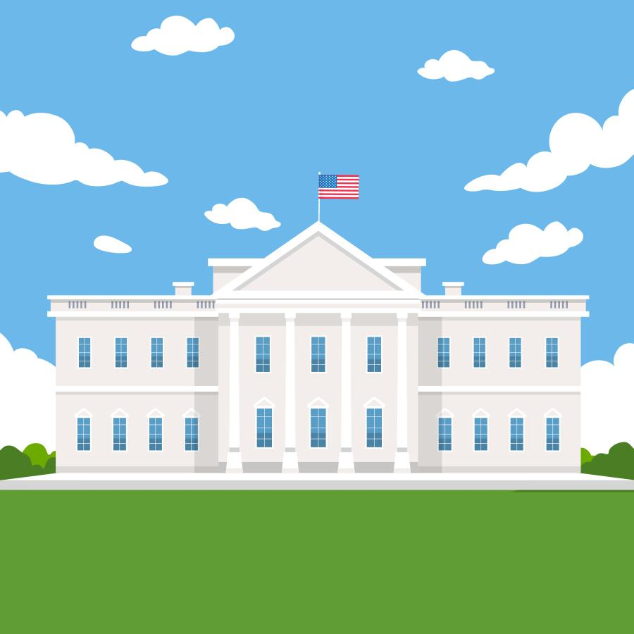
Legislative Branch | Branch of government that makes the laws
Executive Branch | Branch of government that enforces the laws

Slide 15
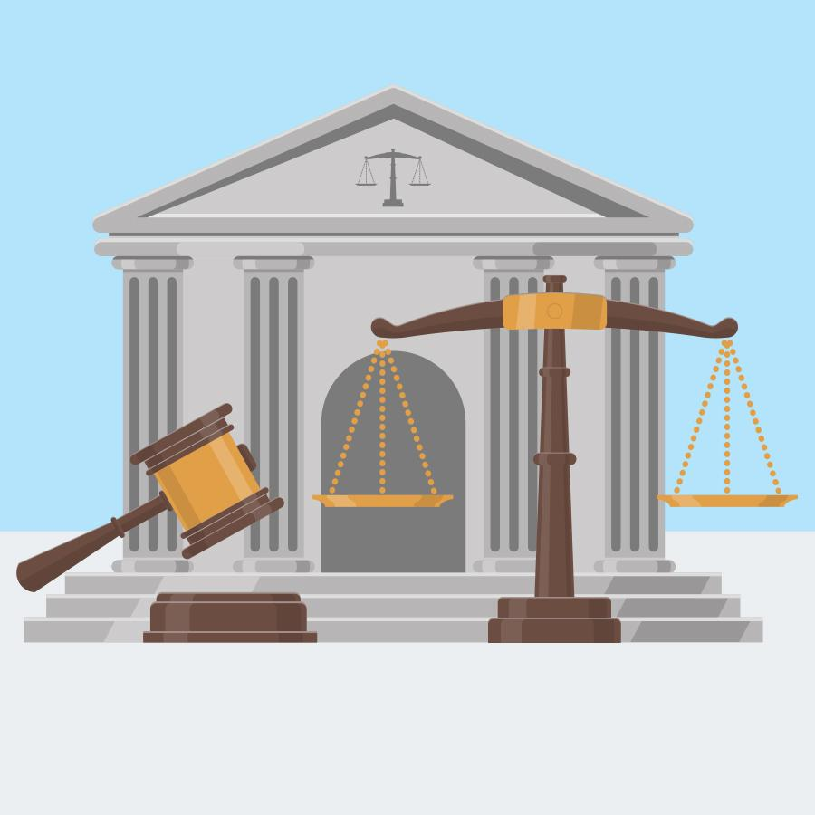
Judicial Branch | Branch of government that interprets the laws

Slide 17
Additional Ways to Play
Start with just the images and correctly match the terms and/or descriptions
Start with just the descriptions and correctly match the terms and/or images
Start with just the terms and correctly match the descriptions and/or images
Read a description aloud and have your child hold up the correct image and/or term
Have your child find two matches they think are similar or “go together” and explain why
Sort terms into categories such as “legislative, executive, judicial”
Sort the matches into “U.S. Topics” versus “Florida Topics” and discuss if any terms overlap
Ask “Which term/match do you think is the most interesting/important?” “Why?” “Least interesting/important?”

Slide 18
Sources
“Social team helping charity” by pch.vector is licensed under the Freepik License
“column, education, greek, history, learning, pillar, school, architecture icon” by manshagraphics is licensed under CC BY 3.0
“Mount Rushmore” from the National Department of the Interior is under the Public Domain
“J. M. Flagg, I Want You for U.S. Army poster” from the Library of Congress is under the Public Domain
“James Madison” from The White House is under the Public Domain
“Alexander Hamilton” from the Library of Congress is under the Public Domain
“Booker T. Washington” from the Library of Congress is under the Public Domain
“Susan B. Anthony” from the U.S. Department of the Interior is under the Public Domain
“U.S. Constitution” from The National Archives is under the Public Domain
“Florida’s Declaration of Rights” from Florida Memory is under the Public Domain
“Signing of the U.S. Constitution” by Howard Chandler Christy is under the Public Domain
“William Pope Duval” from Florida Memory is under the Public Domain
“William Dunn Moseley” from Florida Memory is under the Public Domain
“Josiah T. Walls” from Florida Memory is under the Public Domain
“Florida map geography state united” from Clker-Free-Vector-Images is licensed under the Pixabay license
“Washington Monument” from the National Park Service is under the Public Domain
“Florida State Seal” from Florida Memory is under the Public Domain
“Ron DeSantis 2020” from the U.S. Secretary of Defense is licensed under CC BY 2.0
“I Love USA (Stars and Stripes)” from ClipArt Best has no known copyright restrictions
“Joe Biden” on whitehouse.gov is licensed under CC BY 3.0 US
“We the People” by Navyatha123 is licensed under CC BY-SA 4.0

