Slide 1
Guidance on Government: Federal Edition
5th grade

Slide 2
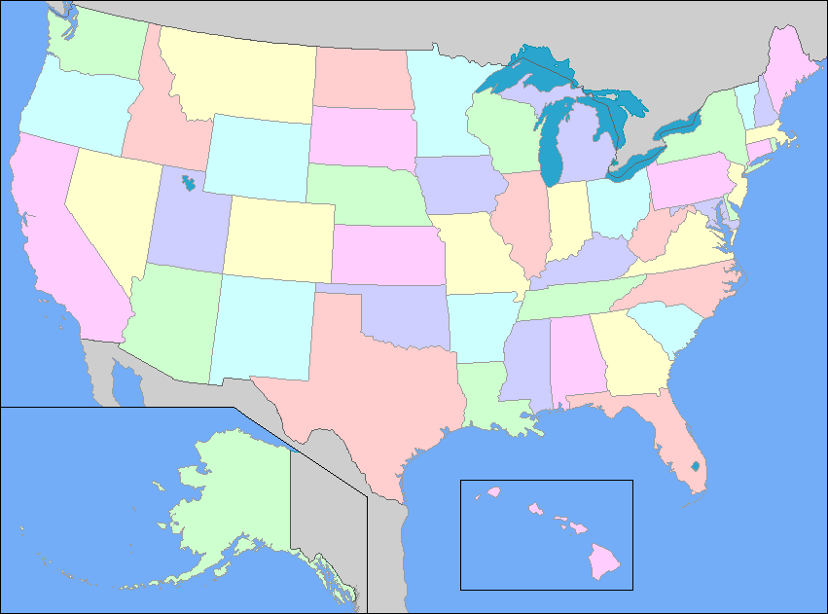
Notes:
United States map taken from http://www.yourchildlearns.com/us_map.htm, accessed on July 21, 2016.

Slide 3
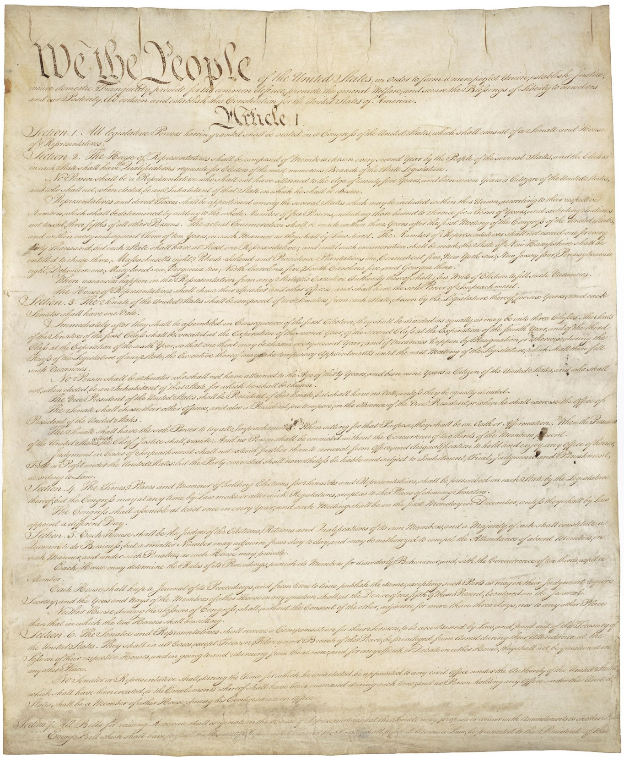
Notes:
Constitution of the United States, 9/17/1787; General Records of the United States Government, Record Group 11; National Archives at Washington, DC. National Archives Identifier: 1667751.
[https://catalog.archives.gov/id/1667751]
[https://www.docsteach.org/documents/document/constitution]

Slide 4
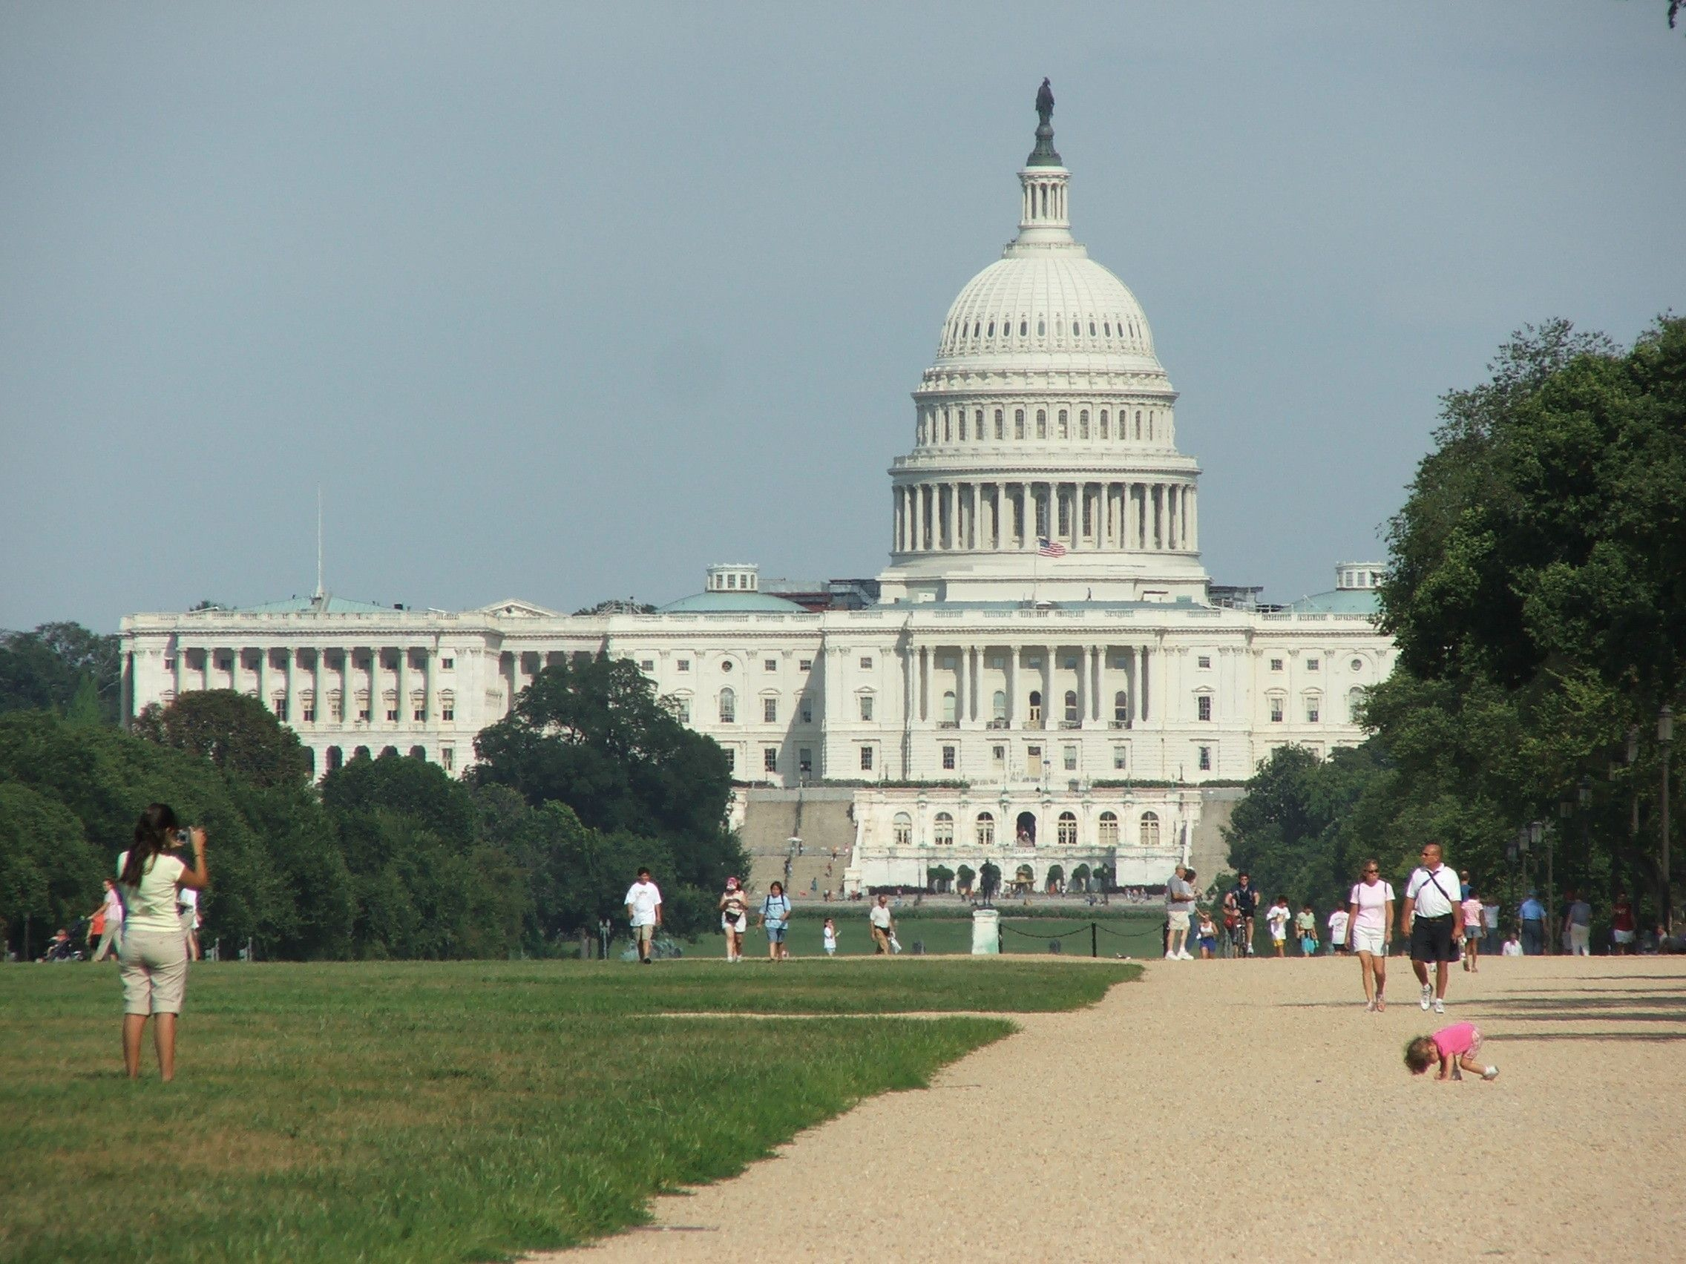
Notes:
Photograph of the View of U.S. Capitol, ca. 2013; Digital Photographs Related to America’s Byways, ca. 1995-ca. 2013; Records of the Federal Highway Administration, Record Group 406; National Archives at College Park. National Archives Identifier: 7718585.
[https://catalog.archives.gov/id/7718585]
[https://www.docsteach.org/documents/document/view-of-us-capitol]

Slide 5
Legislative Branch
Article I, Section 1
All legislative Powers herein granted shall be vested in a Congress of the United States, which shall consist of a Senate and House of Representatives.

Slide 6
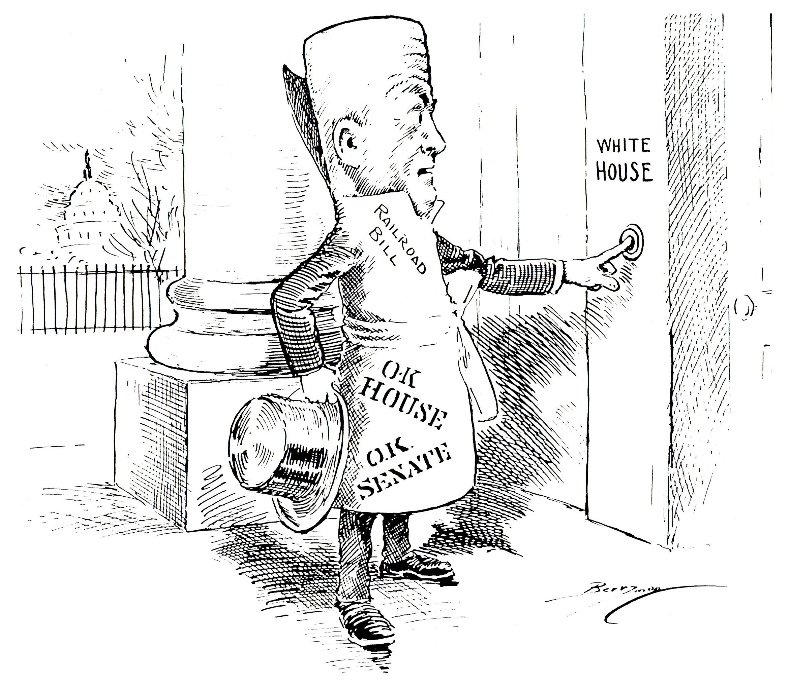
Notes:
Anyone Home? cartoon by Clifford Berryman, February 24, 1920; Berryman Political Cartoon Collection, 1896-1949; Records of the U.S. Senate, Record Group 46; Center for Legislative Archives, Washington, DC. National Archives Identifier: 6011590.
[https://catalog.archives.gov/id/6011590]
[https://www.docsteach.org/documents/document/untitled-%5Brailroad-bill%5D-cartoon-by-clifford-berryman]

Slide 7
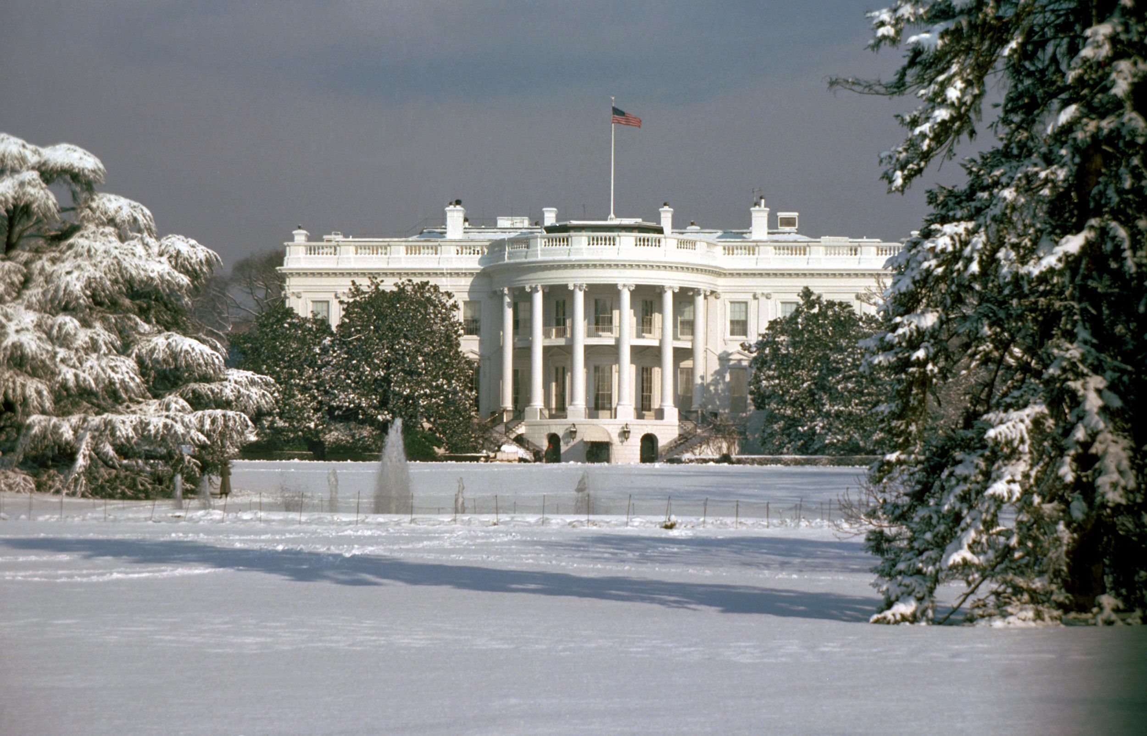
Notes:
Photograph of The White House, 1/15/1977; Combined Military Service Digital Photographic Files, 1982-2007; Records of the Office of the Secretary of Defense, Record Group 330; National Archives at College Park. National Archives Identifier: 6384319.
[https://catalog.archives.gov/id/6384319]
[https://www.docsteach.org/documents/document/2-the-white-house]

Slide 8
Executive Branch
Article II, Section 1
The executive Power shall be vested in a President of the United States of America. He shall hold his Office during the Term of four Years, and, together with the Vice President, chosen for the same Term…

Slide 9
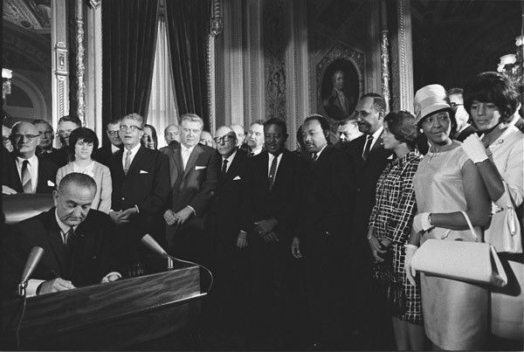
Notes:
Photograph of President Lyndon Johnson Signing the Voting Rights Act as Martin Luther King, Jr. with Other Civil Rights Leaders in the Capitol Rotunda, Washington, DC, 8/6/1965; White House Photo Office Collection, 11/22/1963-1/20/1969; Lyndon Baines Johnson Library. National Archives Identifier: 2803443.
[https://catalog.archives.gov/id/2803443]
[https://www.docsteach.org/documents/document/photograph-of-president-lyndon-johnson-signs-the-voting-rights-act-as-martin-luther-king-jr-with-other-civil-rights-leaders-in-the-capitol-rotunda-washington-dc]

Slide 10
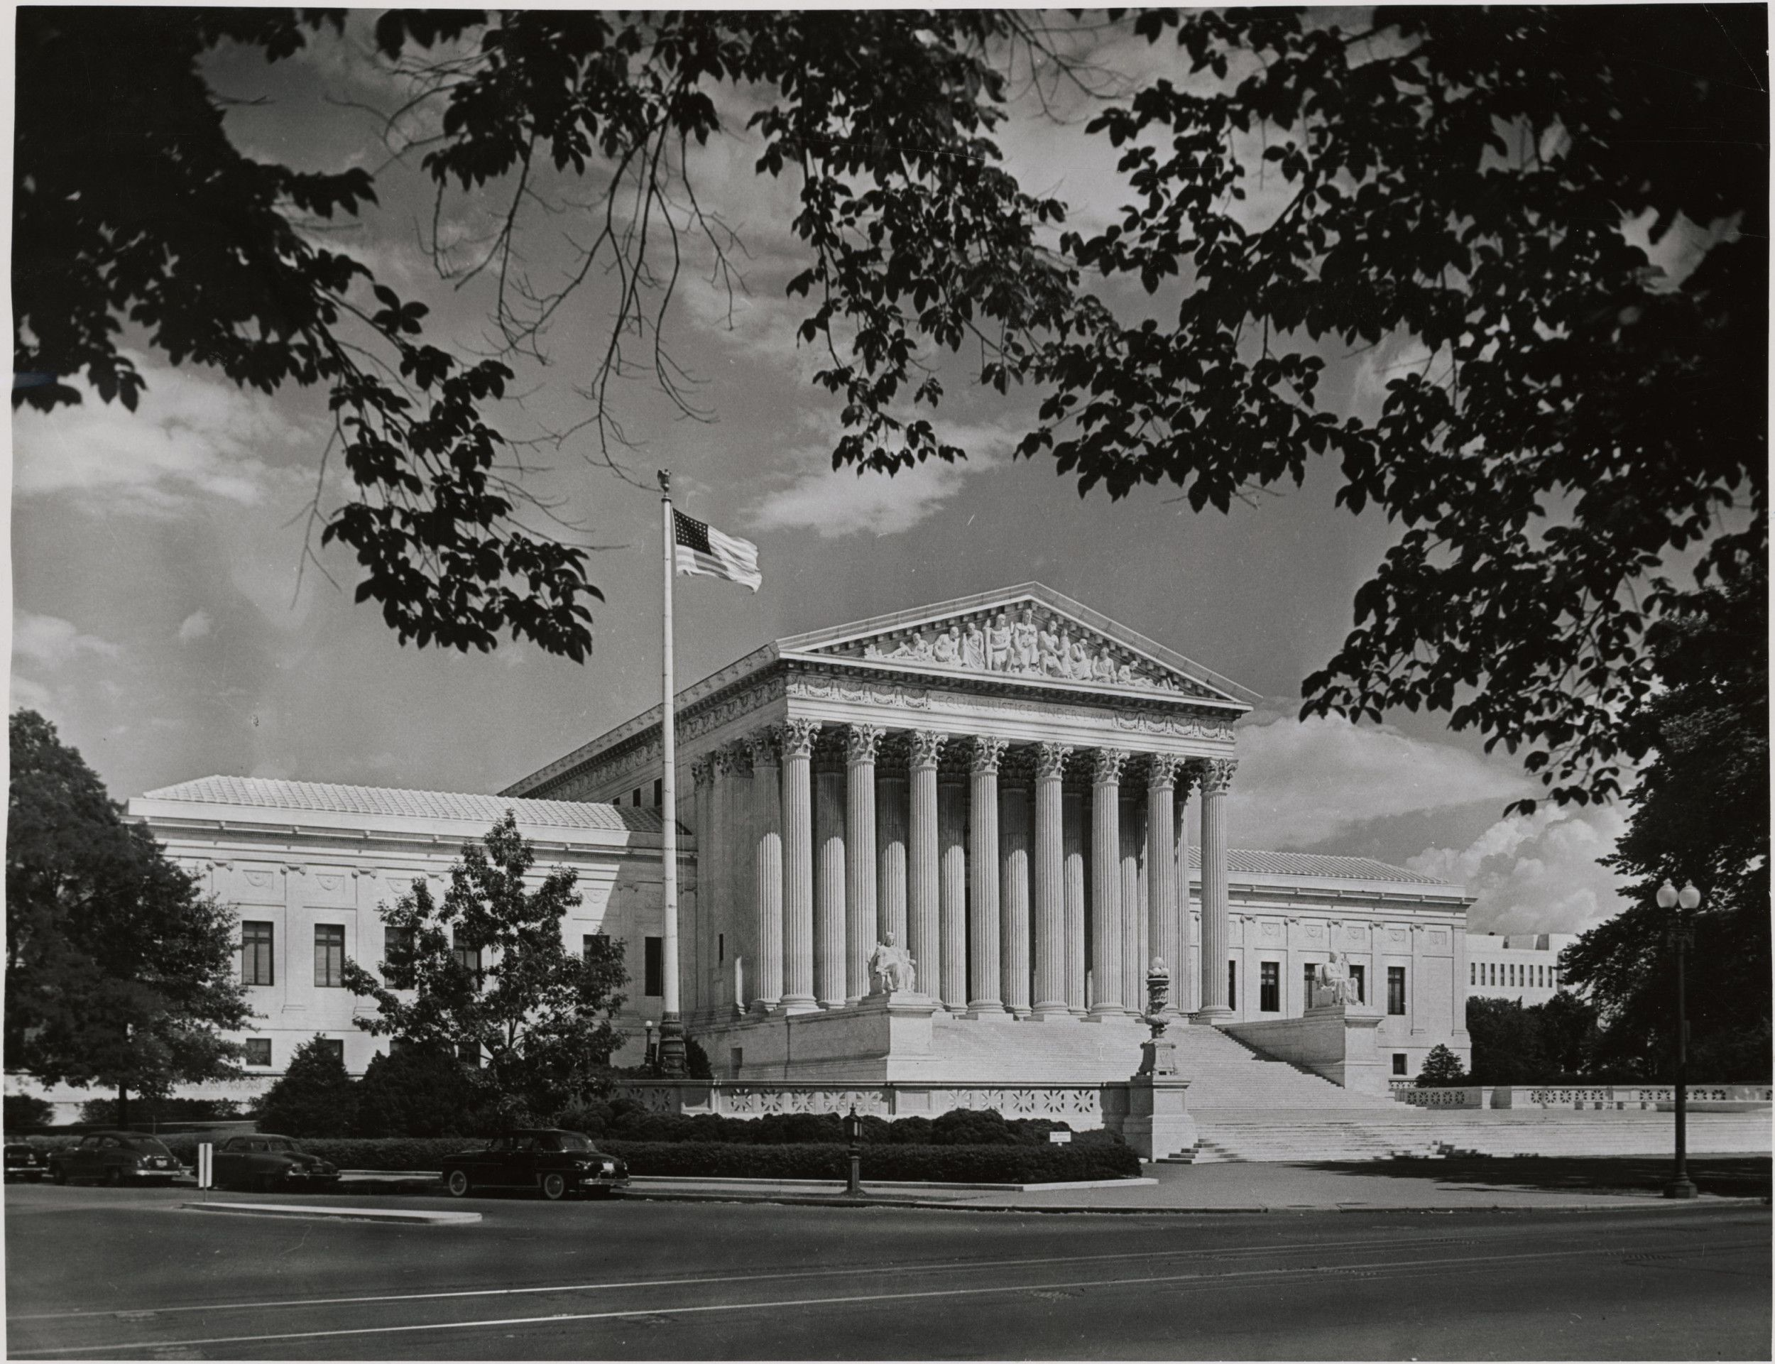
Notes:
Photograph of Supreme Court Building n.d.; Records of the National Archives and Records Administration, Record Group 64; National Archives at College Park. National Archives Identifier: 594954.
[https://catalog.archives.gov/id/594954]
[https://www.docsteach.org/documents/document/photograph-of-supreme-court-building]

Slide 11
Judicial Branch
Article III, Section 1
The judicial Power of the United States, shall be vested in one supreme Court, and in such inferior Courts as the Congress may from time to time ordain and establish. The Judges, both of the supreme and inferior Courts, shall hold their Offices during good Behaviour, and shall, at stated Times, receive for their Services, a Compensation, which shall not be diminished during their Continuance in Office.

Slide 12
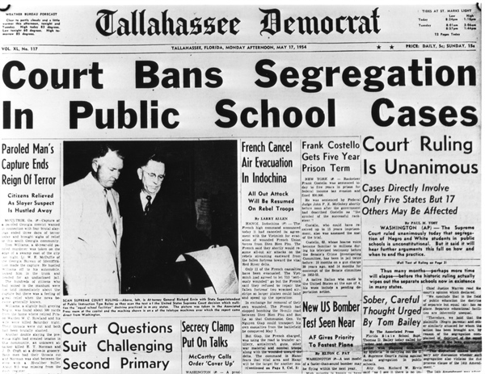
Notes:
Tallahassee Democrat headline for segregation ban - Tallahassee, Florida. 1954. Black & white photoprint. State Archives of Florida, Florida Memory. Accessed 21 Jul. 2016.<https://www.floridamemory.com/items/show/34838>.

