Slide 1
Thinking Through Timelines: Creating the Constitution
3rd Grade

Slide 2
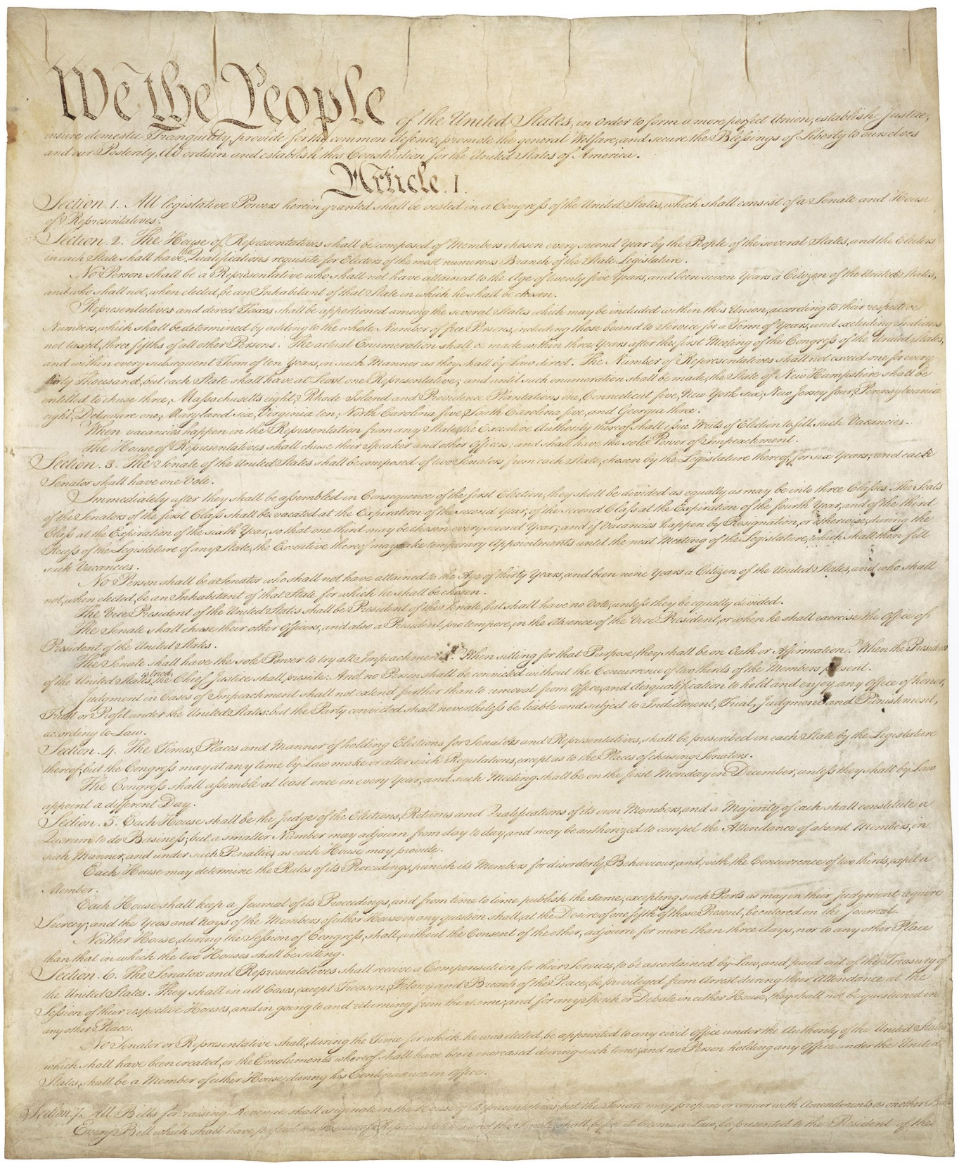
September 17, 1787
Notes:
Constitution of the United States, 9/17/1787; General Records of the United States Government, Record Group 11; National Archives at Washington, DC. National Archives Identifier: 1667751.
[https://catalog.archives.gov/id/1667751]
[https://www.docsteach.org/documents/document/constitution]

Slide 3
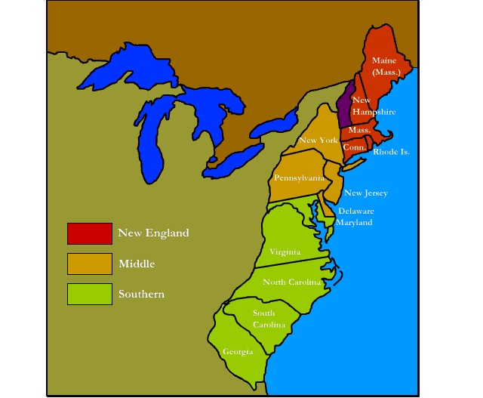
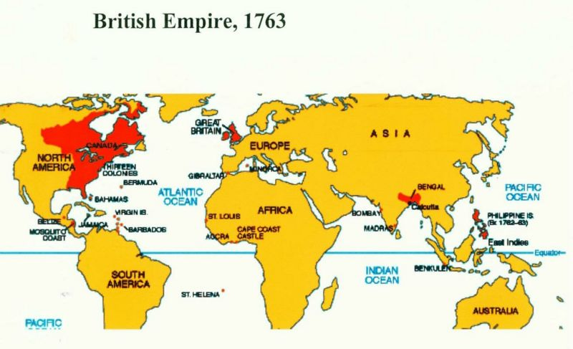
The 13 Colonies in 1776 http://mrnussbaum.com/images/13map13a.gif
The British Empire in 1763 http://www.conservapedia.com/File:B-Emp-1763.jpg
Notes:
Map of the Original 13 Colonies in 1776 taken from http://mrnussbaum.com/images/13map13a.gif, accessed on July 22, 2016.
Map of the British Empire in 1763 taken from http://www.conservapedia.com/File:B-Emp-1763.jpg , accessed on July 22, 2016.

Slide 4
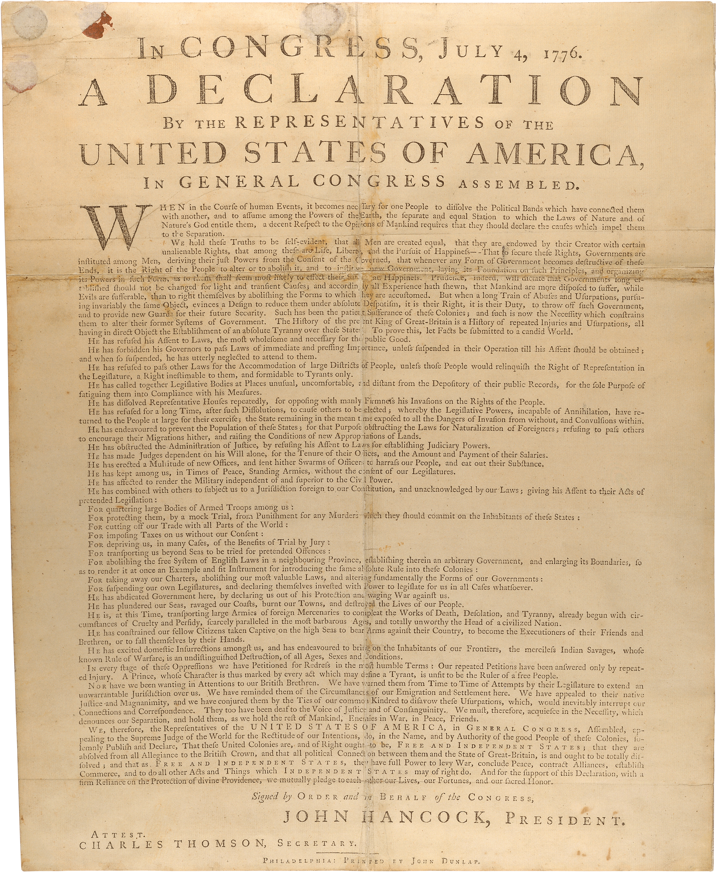
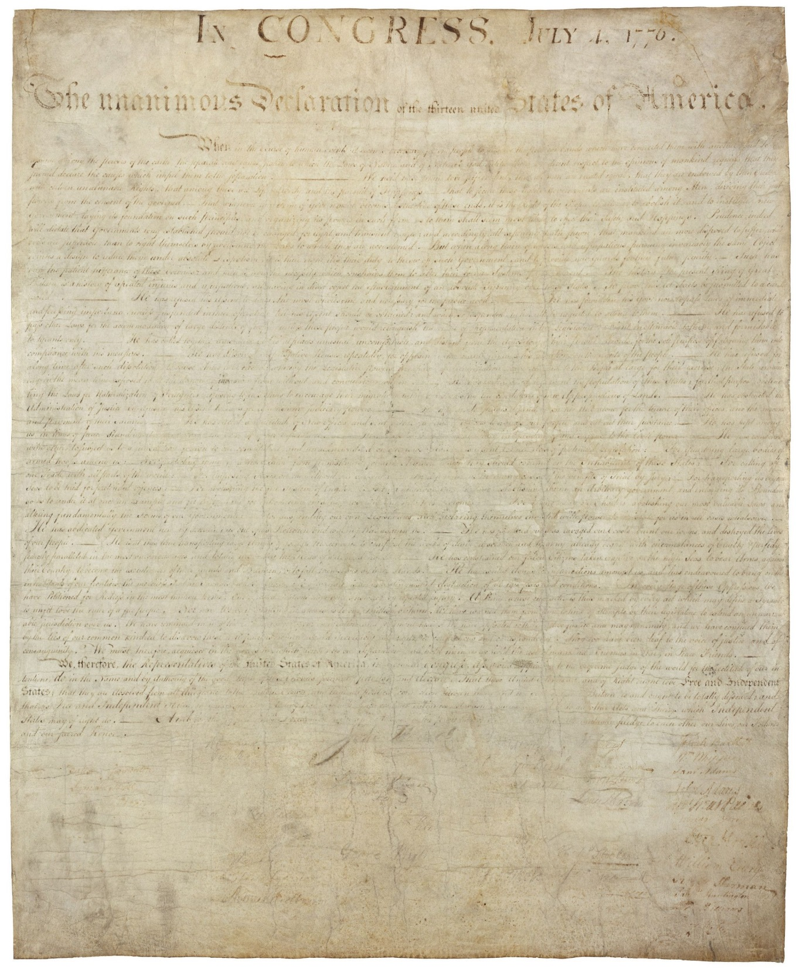
July 4,
1776
Notes:
Dunlap Broadside [Declaration of Independence], July 4, 1776; Rough Journals, 9/5/1774 - 3/2/1789; Records of the Continental and Confederation Congresses and the Constitutional Convention, 1765 - 1821, Record Group 360; National Archives Building, Washington DC. National Archives Identifier: 301682.
[https://catalog.archives.gov/id/301682]
[https://www.docsteach.org/documents/document/dunlap-broadside]

Slide 5
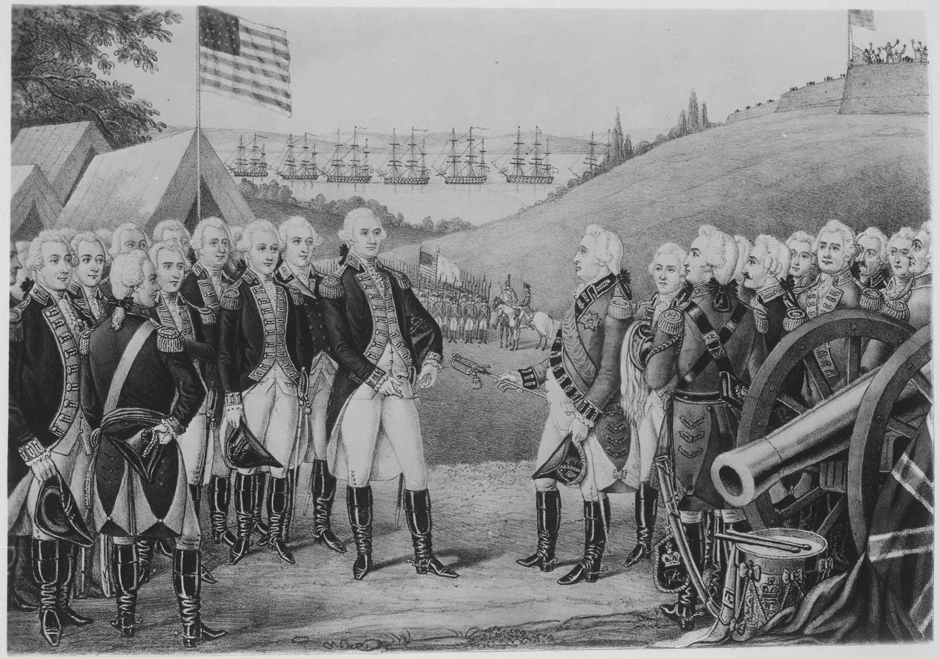
October 19,
1781
Notes:
Surrender of Cornwallis at Yorktown, Virginia, October 19, 1781, by which over 7,000 British and Hessians became prisoners. Copy of lithograph by James Baillie, circa 1845; George Washington Bicentennial Commission, 1931 - 1932; Records of Commissions of the Legislative Branch, Record Group 148. National Archives at College Park. National Archives Identifier: 532883.
[https://catalog.archives.gov/id/532883]
[https://www.docsteach.org/documents/document/surrender-of-cornwallis-at-yorktown-virginia-october-19-1781-lithograph-by-james-baillie]

Slide 6
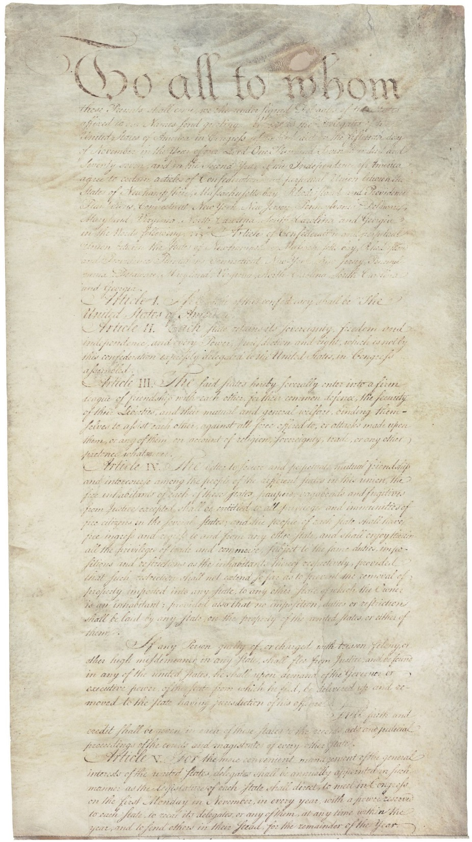
March 1,
1781
Notes:
Articles of Confederation, 3/1/1781; Records of the Continental and Confederation Congresses and the Constitutional Convention, Record Group 360. National Archives at Washington, DC. National Archives Identifier: 301687.
[https://catalog.archives.gov/id/301687]
[https://www.docsteach.org/documents/document/articles-of-confederation]

Slide 7
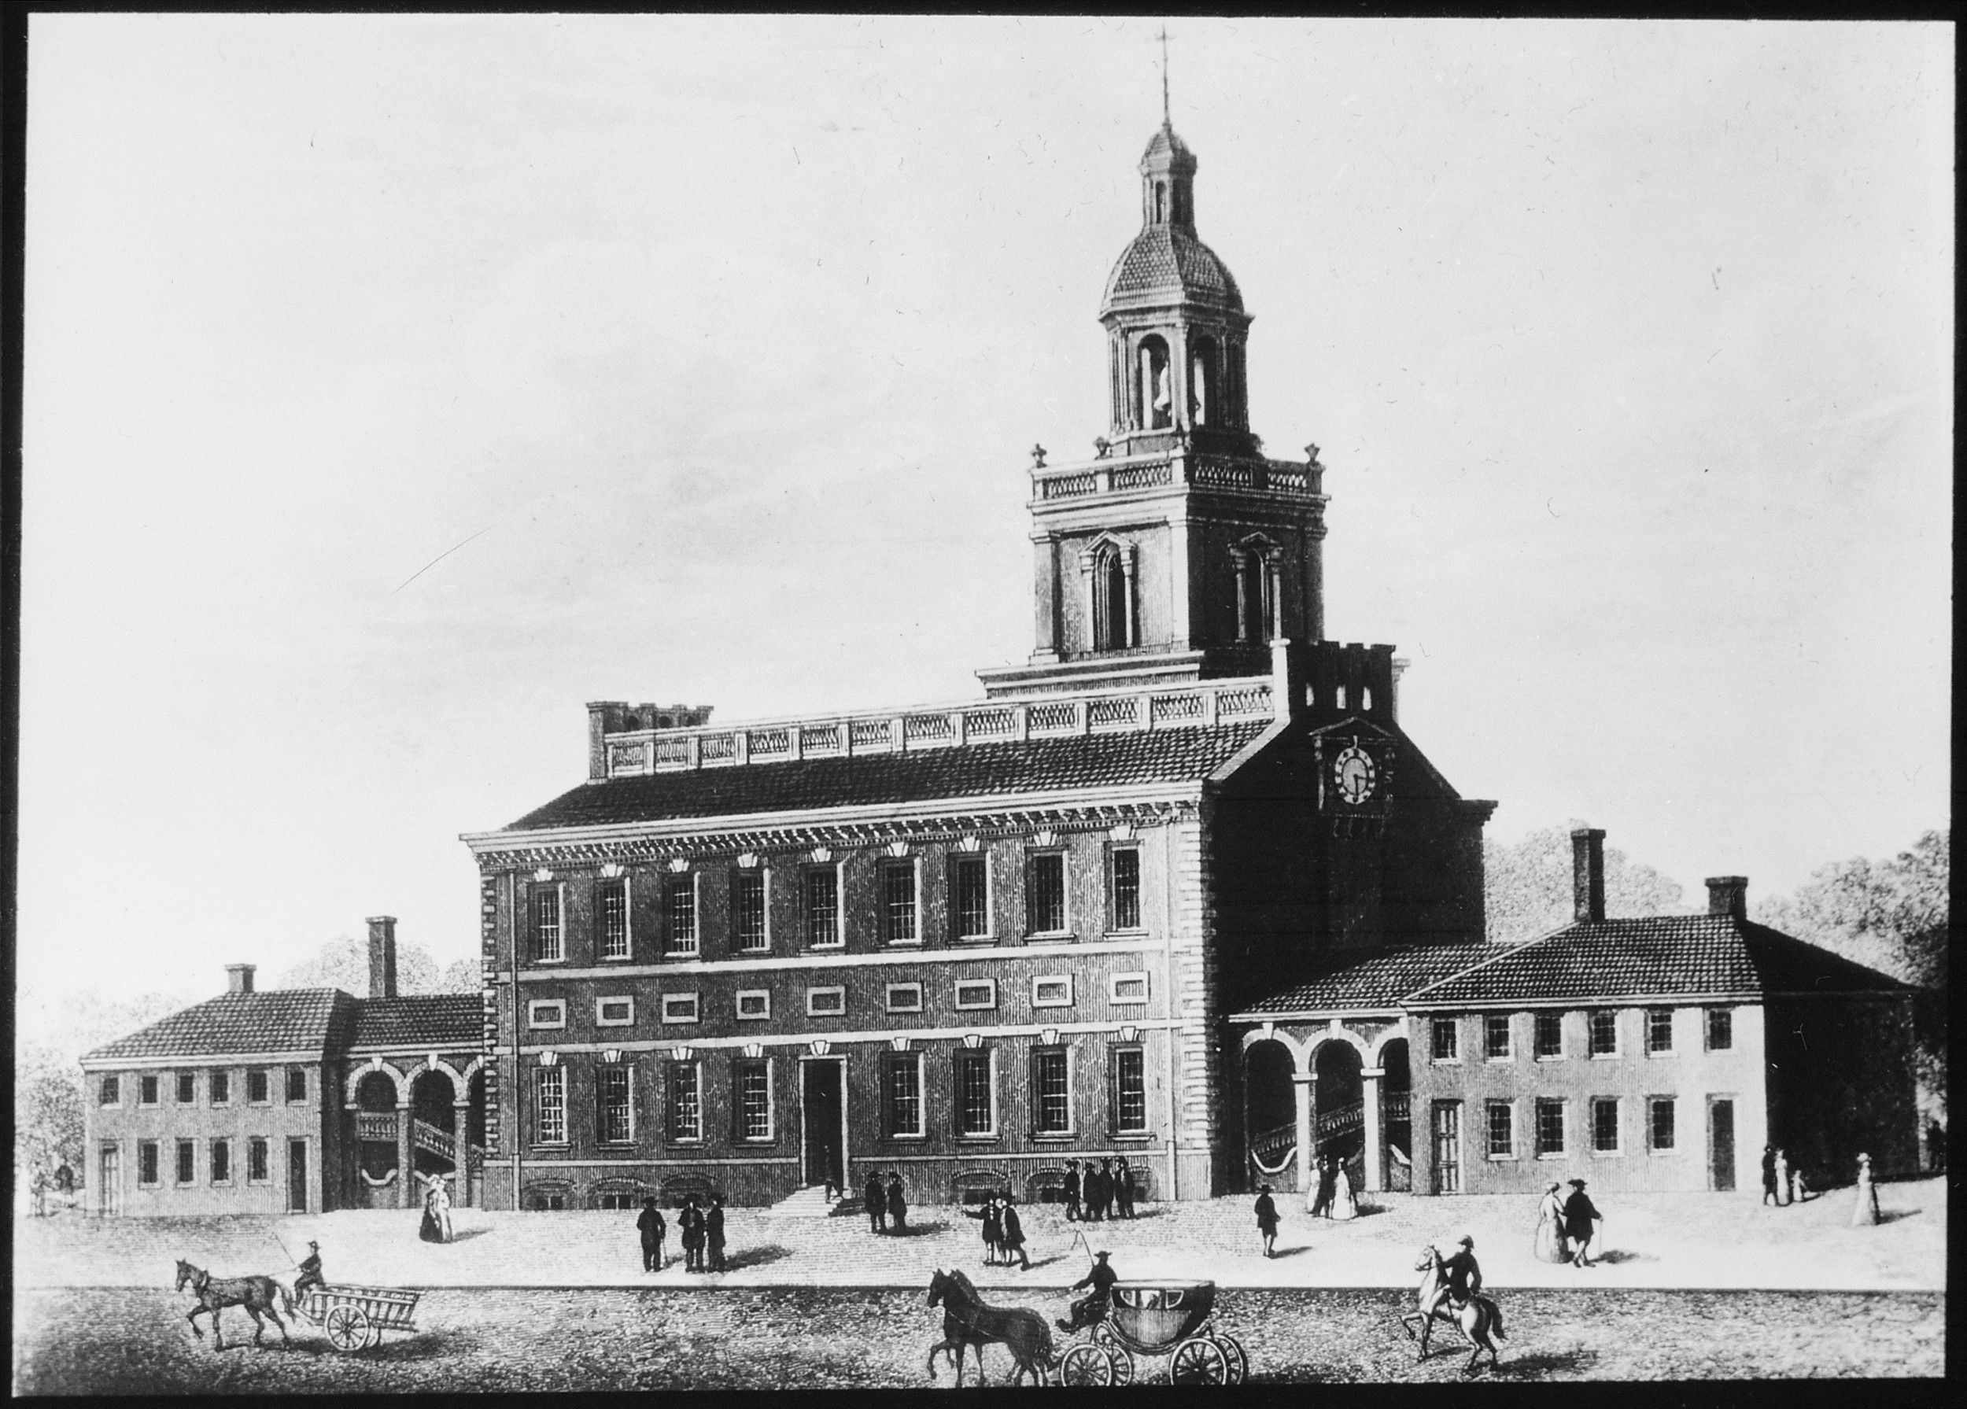
1776
Notes:
Exterior view of Independence Hall, ca. 1776; General Photographic File of the Commission of Fine Arts, ca. 1910 - 1950; Records of the Commission of Fine Arts, Record Group 66. National Archives at College Park. National Archives Identifier: 518208.
[https://catalog.archives.gov/id/518208]
[https://www.docsteach.org/documents/document/exterior-view-of-independence-hall]

Slide 8
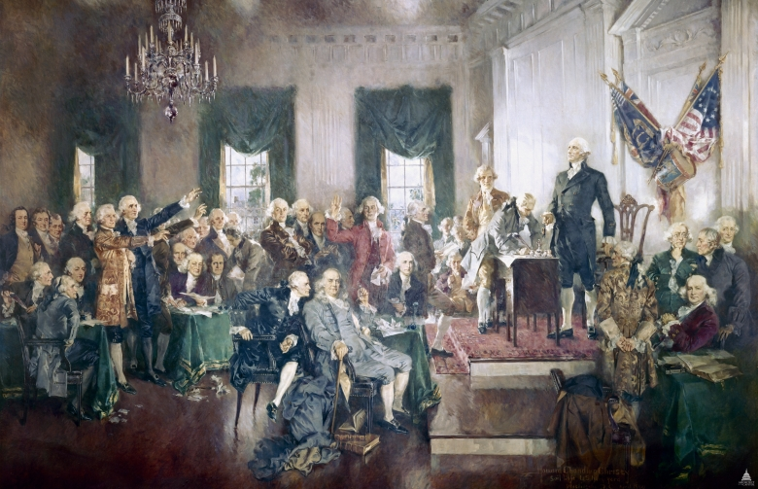
September 17, 1787
Notes:
Signing of the Constitution by Howard Chandler Christy, 1940. Oil on Canvas. House wing, east stairway U.S. Capitol Building, Washington, DC. Accessed 31 July 2016. [http://www.aoc.gov/art/other-paintings-and-murals/signing-constitution]

Slide 9
September 17, 1787
Notes:
Constitution of the United States, 9/17/1787; General Records of the United States Government, Record Group 11; National Archives at Washington, DC. National Archives Identifier: 1667751.
[https://catalog.archives.gov/id/1667751]
[https://www.docsteach.org/documents/document/constitution]

