Slide 1
BIG IDEAS THROUGH POLITICAL CARTOONS
U.S. History

Slide 2
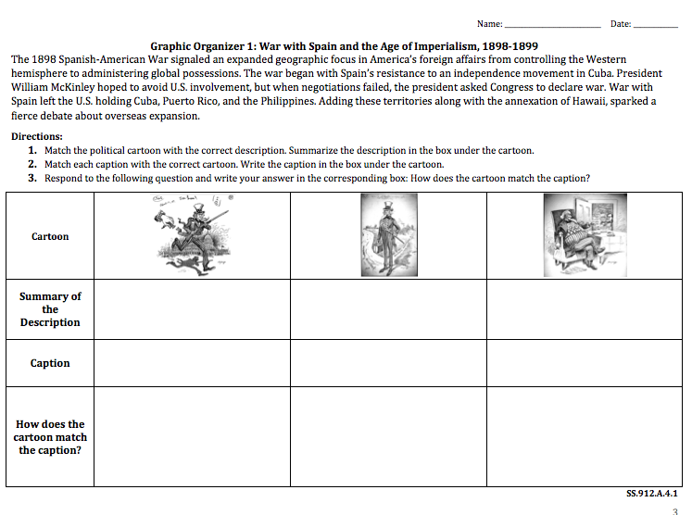
BIG IDEAS THROUGH POLITICAL CARTOONS GRAPHIC ORGANIZERS

Slide 3
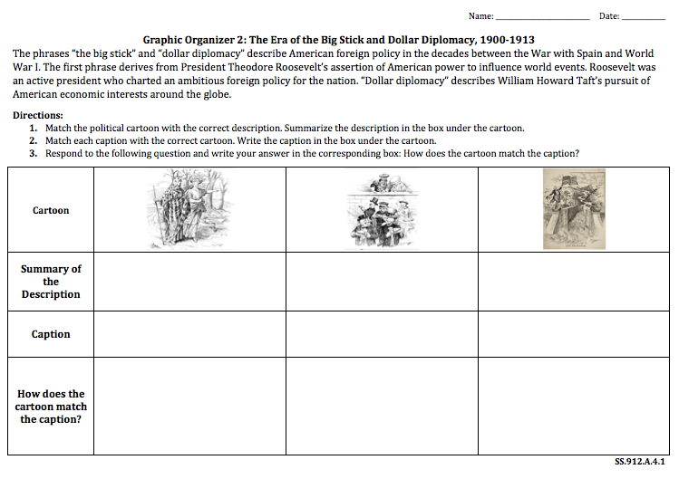
WHAT ARE WE GOING TO DO?
Read and Text Code

Slide 4
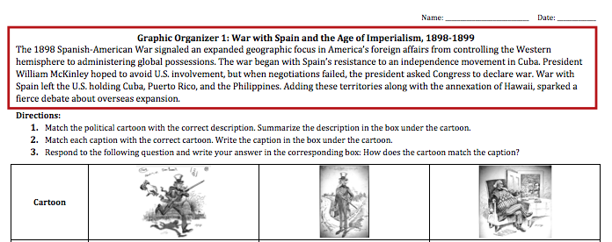
Read the Paragraph on the Graphic Organizer
Circle the History Vocabulary Terms
Notes:
START HERE

Slide 5
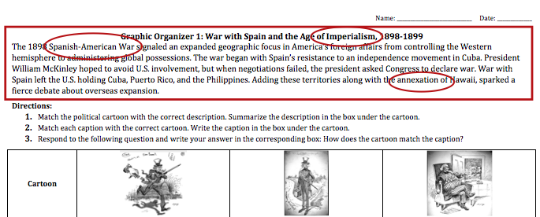
Read the Paragraph on the Graphic Organizer
Circle the History Vocabulary Terms

Slide 6
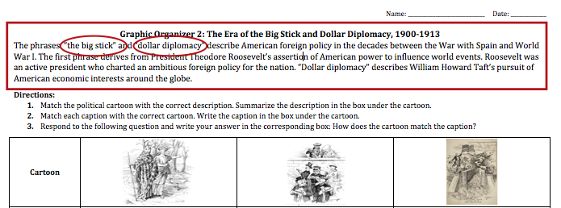
Read the Paragraph on the Graphic Organizer
Circle the History Vocabulary Terms

Slide 7
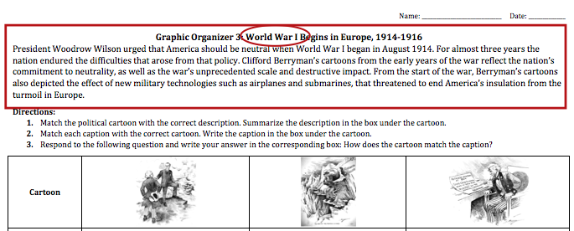
Read the Paragraph on the Graphic Organizer
Circle the History Vocabulary Terms

Slide 8
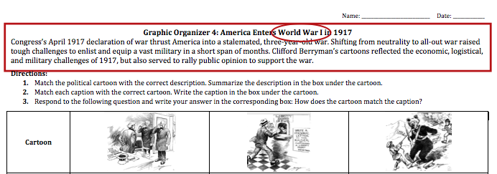
Read the Paragraph on the Graphic Organizer
Circle the History Vocabulary Terms

Slide 9
Read the Paragraph on the Graphic Organizer
Circle the History Vocabulary Terms

Slide 10
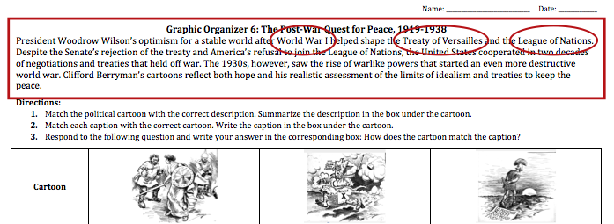
Read the Paragraph on the Graphic Organizer
Circle the History Vocabulary Terms

Slide 11
Read the Paragraph on the Graphic Organizer
Circle the History Vocabulary Terms

Slide 12
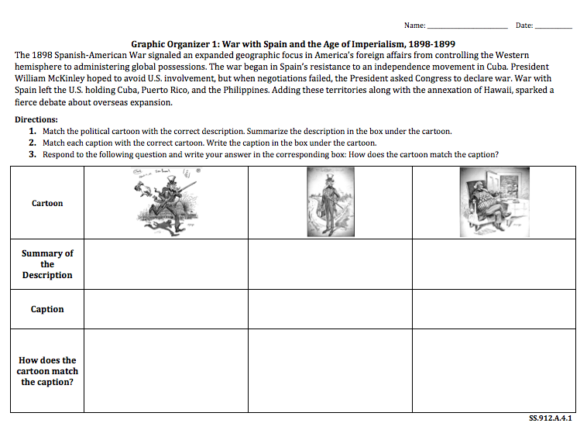
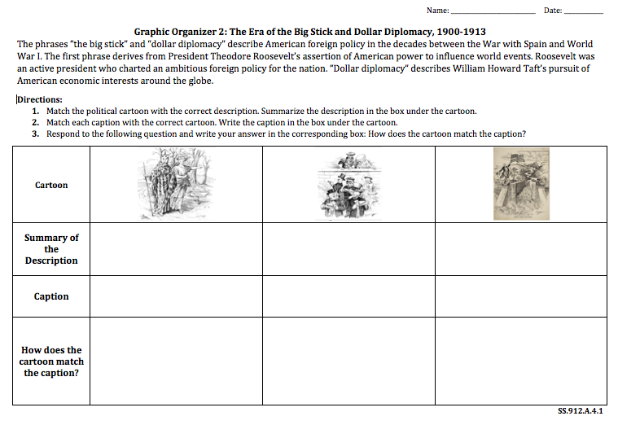
WHAT ARE WE GOING TO DO?
Carousel Stations

Slide 13
Re-Read the Paragraph on the Graphic Organizer
This paragraph provides general information

Slide 14
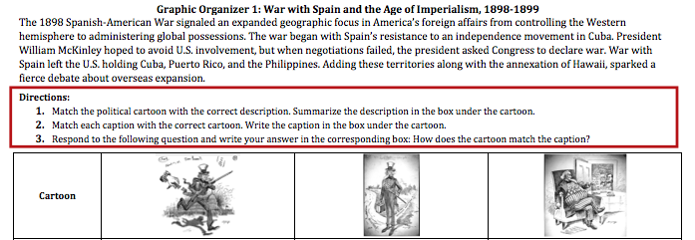
Follow the Directions on the Graphic Organizer
Complete Steps 1-3

Slide 15
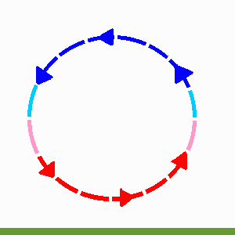
ROTATE TO THE NEXT STATION

