Slide 1
Education for the Future
2018 Meadow Woods Middle School
Afterschool Zone Program
Civic Action Project
Notes:
Greeting presented - Jayleen Rodriquez

Slide 2
Introduction
8th grade
  Hezekiah Beureuse
  Doudney Cadet
  Marcus Dubois
  David Flores
  Ven-Allen Lubin
  Amari Denis-McCormick
  Jayleen Rodriquez
7th grade
  Jackson Solide
  Marquis Washington
6th grade
  Adrian Obis
  Ismaria Castro
Notes:
Group introduction- Doudney Cadet

Slide 3
The Issue
Can an Orange County Public School Student enroll in an online class to satisfy this requirement without having to go thru their guidance councilor?
Can Orange County Public School Students use Virtual School to satisfy the elective requirement to graduate middle school?
There is a wide spread discrepancy of the elective courses available/ offered between the different middle schools
Notes:
The Issue- A series of questions asked by David Flores with responses given by Hezekiah Beureuse
Question 1 read by David
Answer from Hezekiah- No in order for an OCPS Student to meet this requirement they must talk to there guidance counselor
Question 2 read by David
Answer from Hezekiah- Yes, but they can not do it in a traditional middle school setting
Statement 3 read by David
Hezekiah explains what the issue is and how it impacts not only himself but his fellow student as well

Slide 4
The Policy
Florida Statue 1003.4282 Requirements for high school graduation
The Policy
ONLINE COURSE REQUIREMENT.—At least one course within the 24 credits required under this section must be completed through online learning.
(a) An online course taken in grade 6, grade 7, or grade 8 fulfills the requirements of this subsection. The requirement is met through an online course offered by the Florida Virtual School, a virtual education provider approved by the State Board of Education, a high school, or an online dual enrollment course
Public school part-time students are enrolled in a traditional Orange County middle or high school full-time and may take supplemental courses online with OCVS. Part-time students take courses online for graduation acceleration, credit recovery, grade forgiveness, or to earn high school credit while in middle school. In order to be accepted as a part-time, public school student with OCVS, you must currently attend an Orange County public school.
Cited from OCPS
Notes:
The Policy read by Amari Denis-McCormick
The Statute read by Jayleen Rodriquez

Slide 5
Civic Actions
Research high school educational tracks including prerequisite requirements so that Meadow Woods Middle School students can start taking identified courses for those respective programs of career interests.
Provide digital/technology hybrid classes where students can start and complete online high school courses while they are in middle school. These online high school courses can be offered in a traditional classroom setting.
Notes:
Civic actions taken to explore the issue and determine the right actions to take read by Hezekiah Beureuse

Slide 6
Making the Right Connections/The change we are looking for:
To use this requirement to provide ourselves with the opportunity to choose online electives that may better serve our academic goals.
Main objective: To have access to course offerings that are not offered at Meadow Woods such as:
  Exploring Information Technology Careers and Career Planning
  Computer application in business 1
  Fundamentals of Finance
Notes:
Applying the issue and what are the desired outcomes read by Hezekiah Beureuse

Slide 7

Pubic Service Announcement
Notes:
PSA video introduced by Ven-Allen Lubin

Slide 8
Impact
The 8th Survey Results
The 6/7th Grade Survey Results
Based on 100 surveys we administered to 8th grade
  92% of students would prefer to use an online course to satisfy their elective requirements
  Of the online courses available over 73% of the students surveyed chose electives that they believed would help further them to a professional career
Based on 200 survey we administered to 6th/7th grade
  75% of the students surveyed were not happy about their elective choices at Meadow Woods Middle School
  95% of the students if they had a choice would take an elective that was not offered at Meadow Woods
Notes:
Survey result and their impact explained Jackson Solide

Slide 9
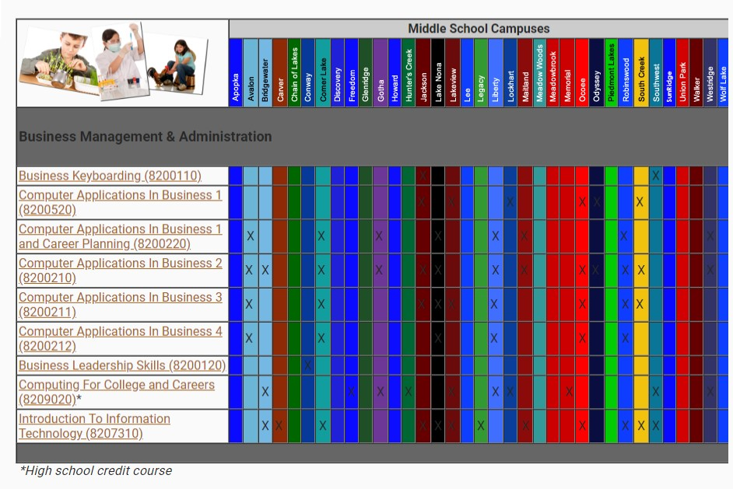
Course offered by OCPS Middle Schools for Business Management & Administration
Notes:
A graph of the Business Management & Administration courses not offered at Meadow Woods Middle School read by Hezekiah Beureuse

Slide 10
Course offered by OCPS Middle Schools for Business Management & Administration
There are 22 out of 35 schools that offer Business Management & Administration courses
Which means 13 other schools are losing opportunities in these courses
Notes:
An analysis of the Business Management & Administration courses not offered at Meadow Woods Middle School read by Hezekiah Beureuse

Slide 11
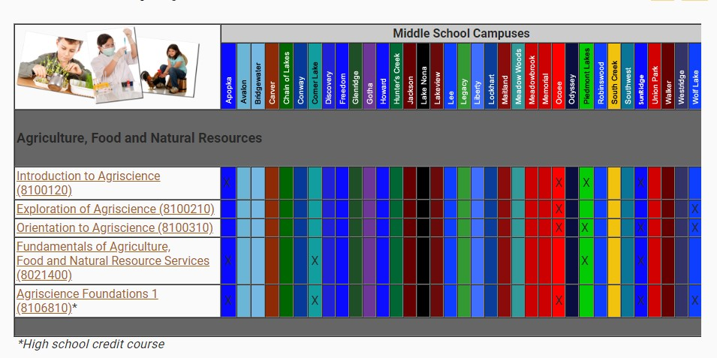
Course offered by OCPS Middle Schools for Agriculture, Food and Natural Resources
Notes:
A graph of the Agriculture, Food and Natural Resources courses not offered at Meadow Woods Middle School ready by Hezekiah Beureuse

Slide 12
Course offered by OCPS Middle Schools for Agriculture, Food and Natural Resources
There are 6 out of 35 schools that offer Agriculture, Food and Natural Resources courses
Which means 29 other schools are losing opportunities in these courses
Notes:
An analysis of the Agriculture, Food and Natural Resources courses not offered at Meadow Woods Middle School ready by Hezekiah Beureuse

Slide 13
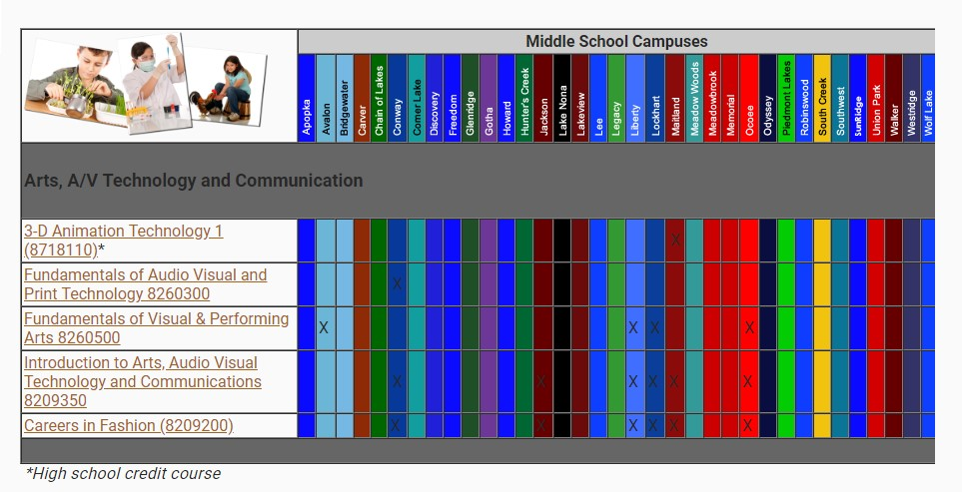
Course offered by OCPS Middle Schools for Arts, A/V Technology and Communication
Notes:
A graph of Arts, A/V Technology and Communication courses not offered at Meadow Woods Middle School ready by Hezekiah Beureuse

Slide 14
Course offered by OCPS Middle Schools for Arts, A/V Technology and Communication
There are 6 out of 35 schools that offer Arts, A/V Technology and Communication courses
Which means 29 other schools are losing opportunities in these courses
Notes:
An analysis of Arts, A/V Technology and Communication courses not offered at Meadow Woods Middle School ready by Hezekiah Beureuse

Slide 15
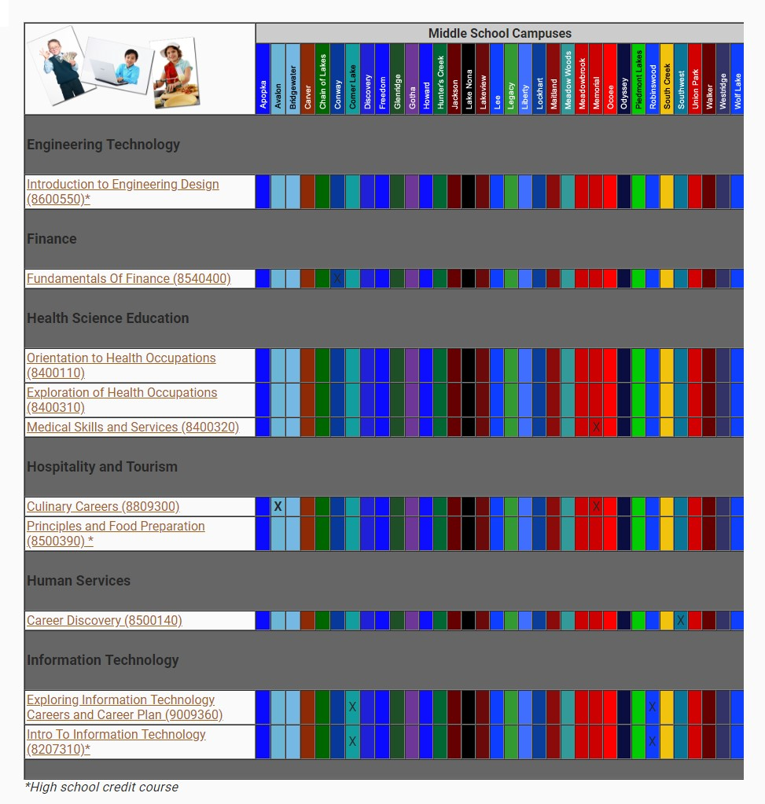
Course offered by OCPS Middle Schools for Finance
Notes:
A graph of the Finance courses not offered at Meadow Woods Middle School ready by Hezekiah Beureuse

Slide 16
Course offered by OCPS Middle Schools for Finance
There are 6 out of 35 schools that offer Finance courses
Which means 29 other schools are losing opportunities in these courses
Notes:
A analysis of the Finance courses not offered at Meadow Woods Middle School ready by Hezekiah Beureuse

Slide 17
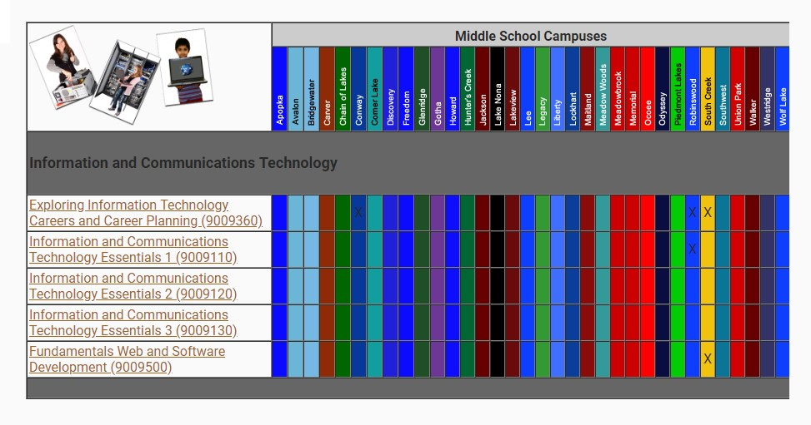
Course offered by OCPS Middle Schools for Information and Communications Technology
Notes:
A graph of the Information and Communications Technology courses not offered at Meadow Woods Middle School ready by Hezekiah Beureuse

Slide 18
Course offered by OCPS Middle Schools for Information and Communications Technology
There are 3 out of 35 schools that offer Information and Communications Technology courses
Which means 32 other schools are losing opportunities in these courses
Notes:
A analysis of the Information and Communications Technology courses not offered at Meadow Woods Middle School ready by Hezekiah Beureuse

Slide 19
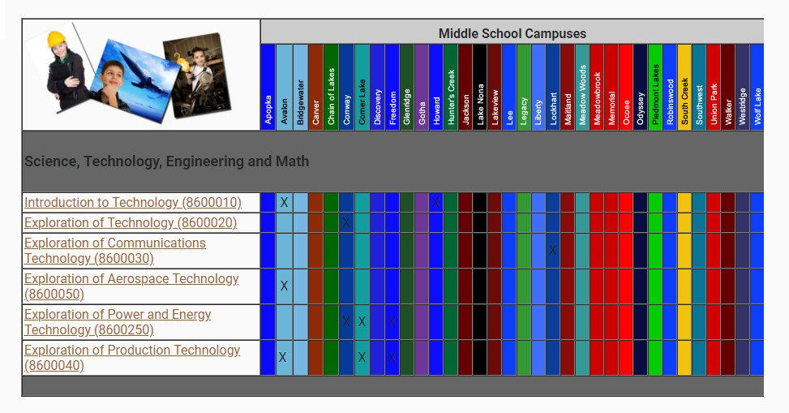
Course offered by OCPS Middle Schools for Science Technology Engineering Math
S.T.E.M
Notes:
A graph of the Science Technology Engineering Math S.T.E.M courses not offered at Meadow Woods Middle School ready by Hezekiah Beureuse

Slide 20
Course offered by OCPS Middle Schools for Science Technology Engineering Math
S.T.E.M
There are 6 out of 35 schools that offer Science Technology Engineering Math- S.T.E.M courses
Which means 29 other schools are losing opportunities in these courses
Notes:
A analysis of the Science Technology Engineering Math S.T.E.M courses not offered at Meadow Woods Middle School ready by Hezekiah Beureuse

Slide 21
The Supporters
Surveyed the 6th 7th and 8th grade students of MWMS
Formally Interviewed the 8th Guidance Counselor
Conducted a Q&A with the Chair of the Elective Department
Notes:
The people that support the change in the issue we are looking to accomplish ready by Hezekiah Beureuse

Slide 22

Notes:
A quote from Geoffery Canada ready by Hezekiah Beureuse

Slide 23
Questions and Answers
Education for the Future
Boys & Girls Clubs of Central Florida
After School Zone Program
Meadow Woods Middle School
Notes:
Closing statements and remarks by Marcus Dubois

Slide 24
Citations
Part-Time Options - OCPS Orange County Virtual School. https://ocvs.ocps.net/academics_curriculum/Programs/o_c_v_s_program_info_grades_612/part_time_options/&p=DevEx,5040.1.

